Slide 1
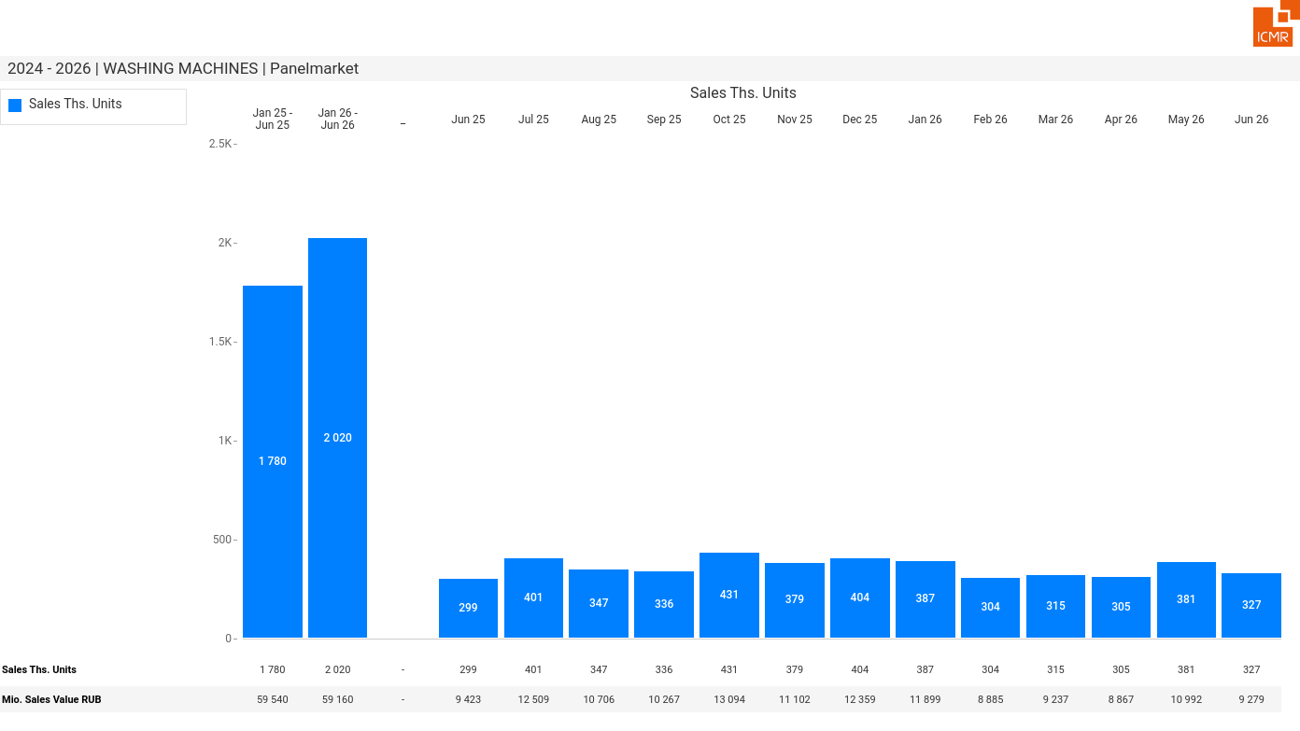
07/2026 PRJ 26fc7bc0 - TMPL 146345ef - FRM 43b6d360 - ID 1

Slide 2
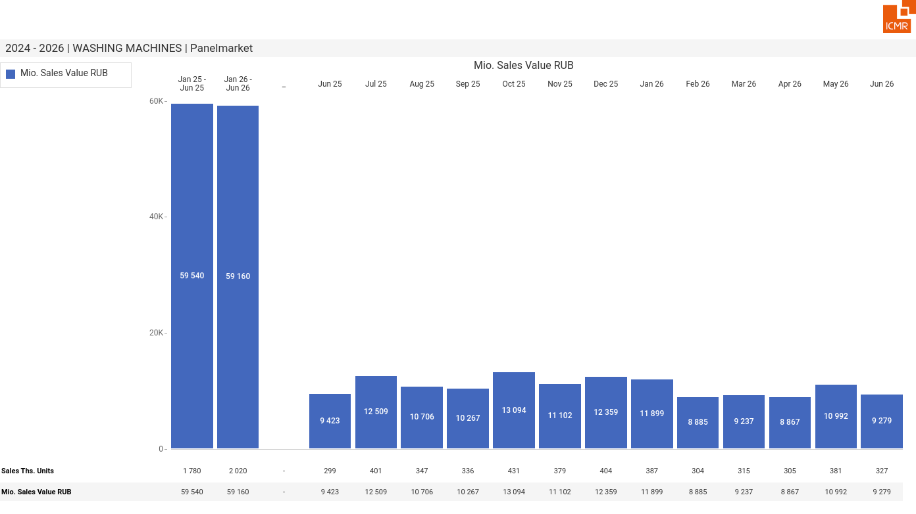
07/2026 PRJ 26fc7bc0 - TMPL 146345ef - FRM 0f6847d5 - ID 2

Slide 3
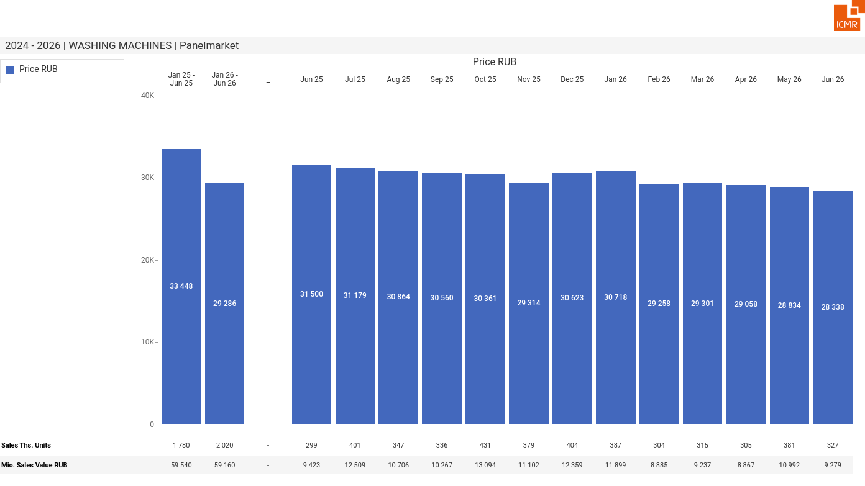
07/2026 PRJ 26fc7bc0 - TMPL 146345ef - FRM af71f05b - ID 3

Slide 4
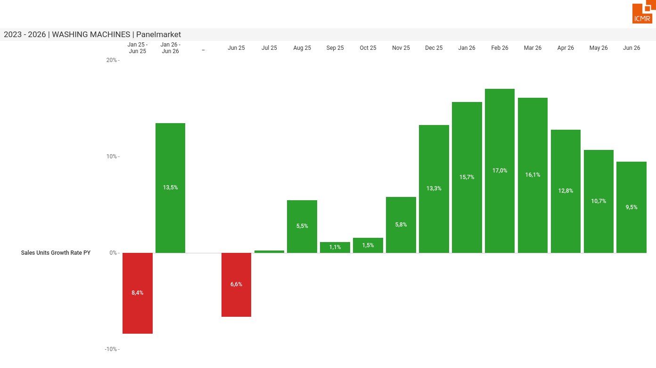
07/2026 PRJ 26fc7bc0 - TMPL 146345ef - FRM 5c6262b6 - ID 4

Slide 5
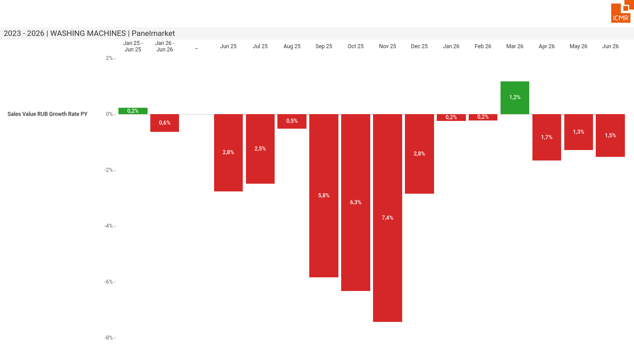
07/2026 PRJ 26fc7bc0 - TMPL 146345ef - FRM 8667105f - ID 5

Slide 6
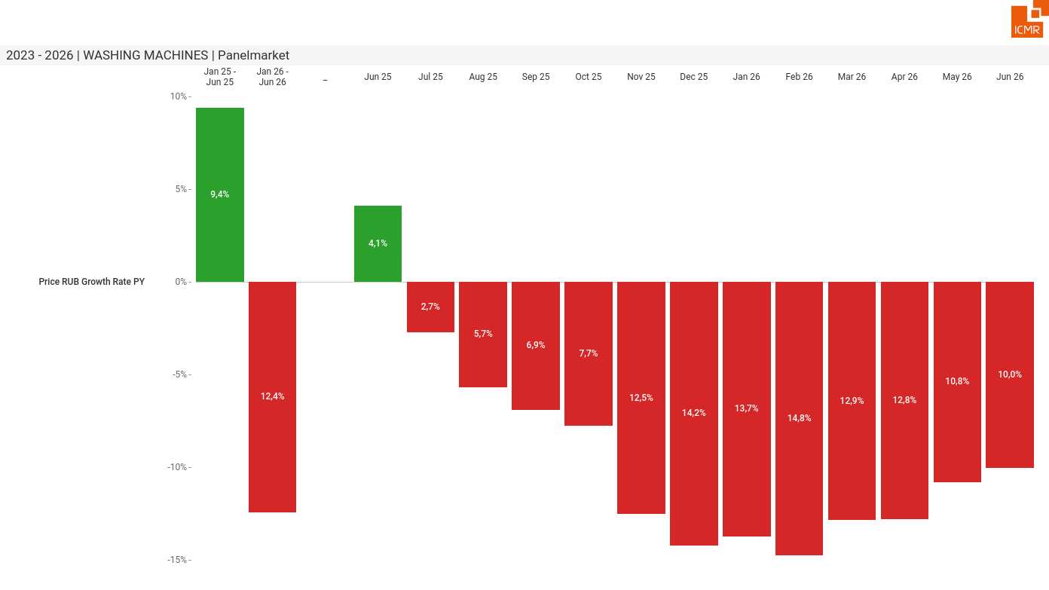
07/2026 PRJ 26fc7bc0 - TMPL 146345ef - FRM 711163db - ID 6

Slide 7
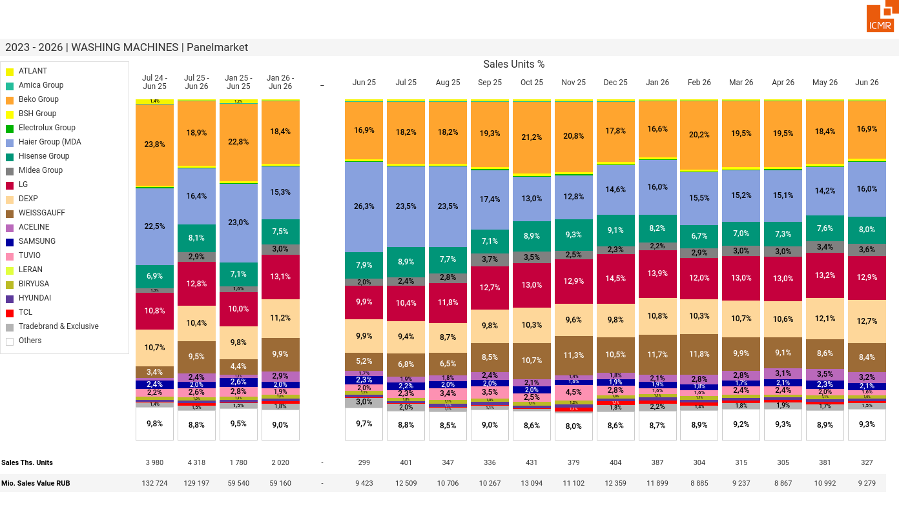
07/2026 PRJ 26fc7bc0 - TMPL 146345ef - FRM a1c3a0dc - ID 7

Slide 8
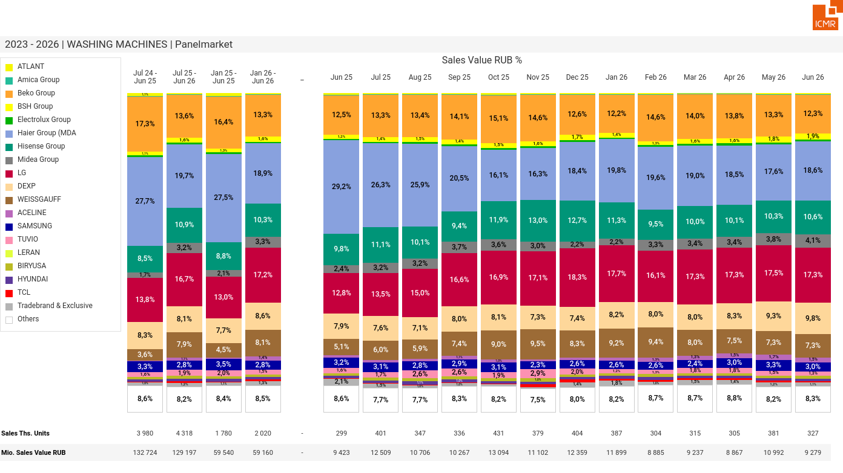
07/2026 PRJ 26fc7bc0 - TMPL 146345ef - FRM 83f82d81 - ID 8

Slide 9
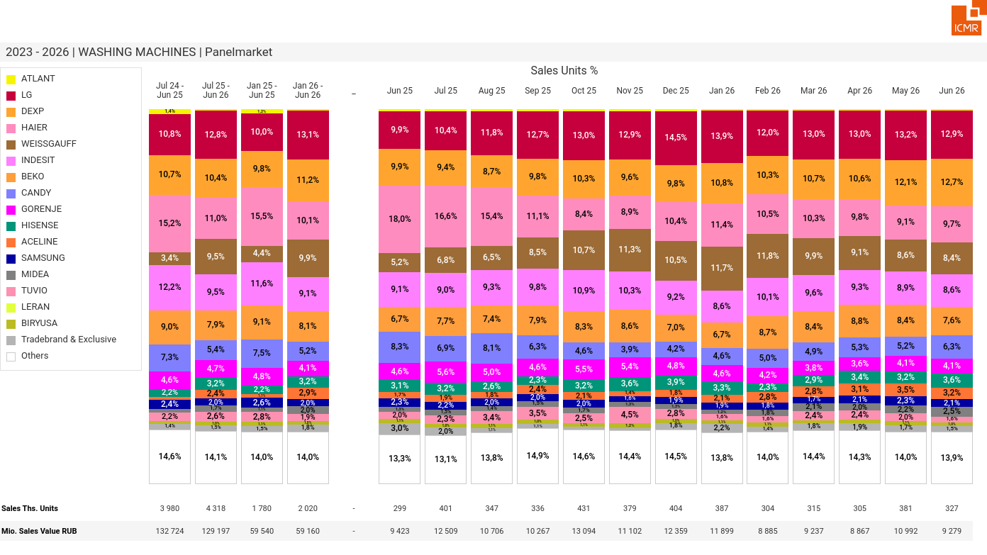
07/2026 PRJ 26fc7bc0 - TMPL 146345ef - FRM bd77683f - ID 9

Slide 10
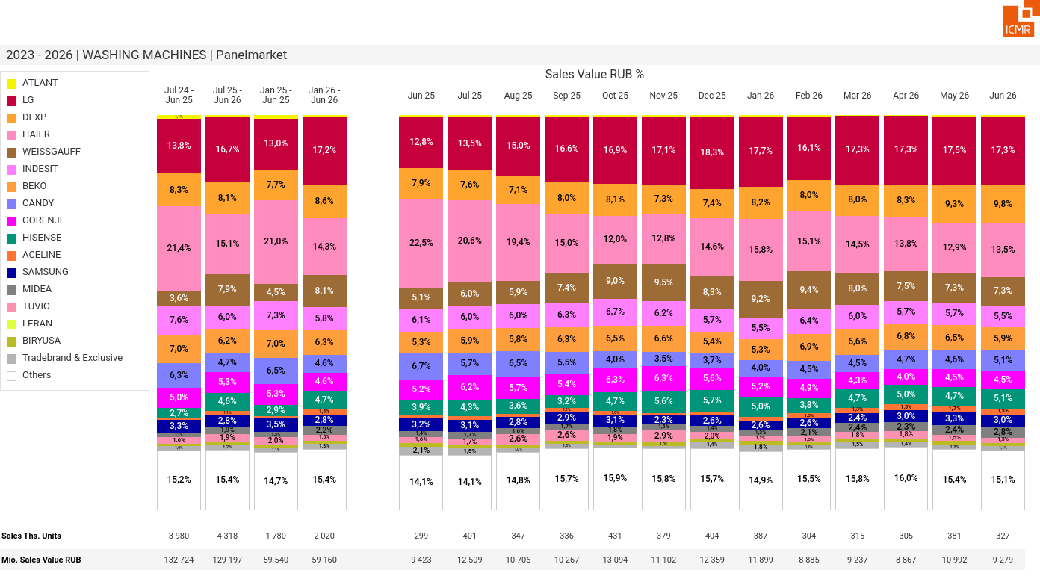
07/2026 PRJ 26fc7bc0 - TMPL 146345ef - FRM c382ec7c - ID 10

Slide 11
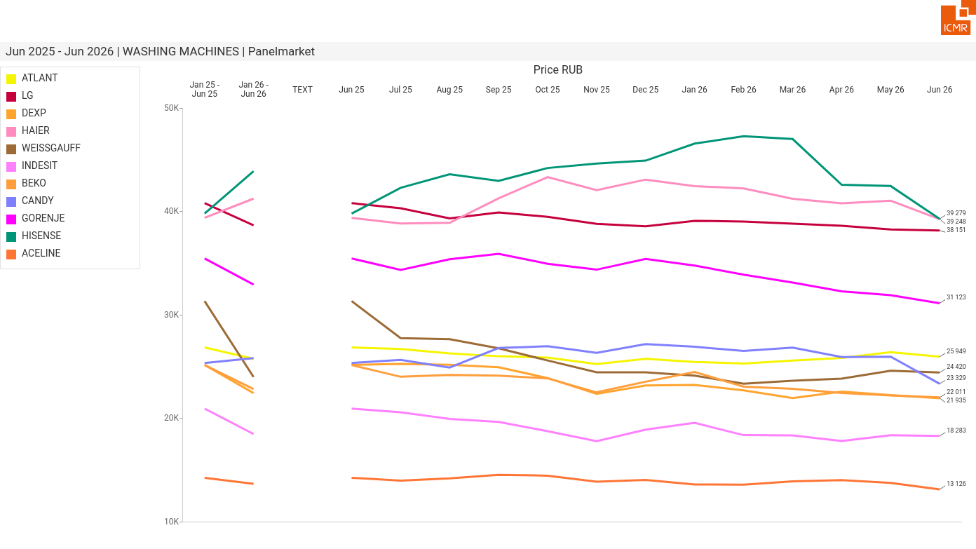
07/2026 PRJ 26fc7bc0 - TMPL 146345ef - FRM 1688321f - ID 11

Slide 12
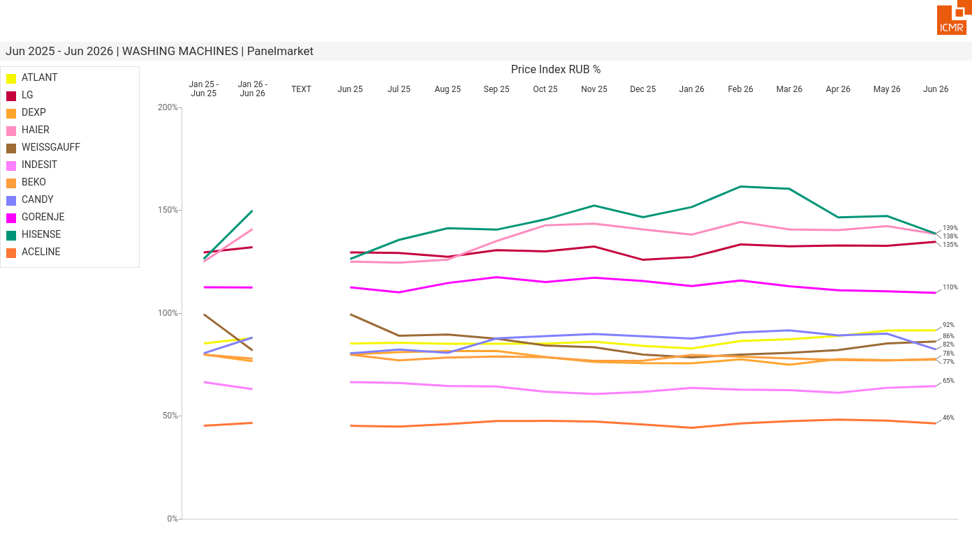
07/2026 PRJ 26fc7bc0 - TMPL 146345ef - FRM 56609a04 - ID 12

Slide 13
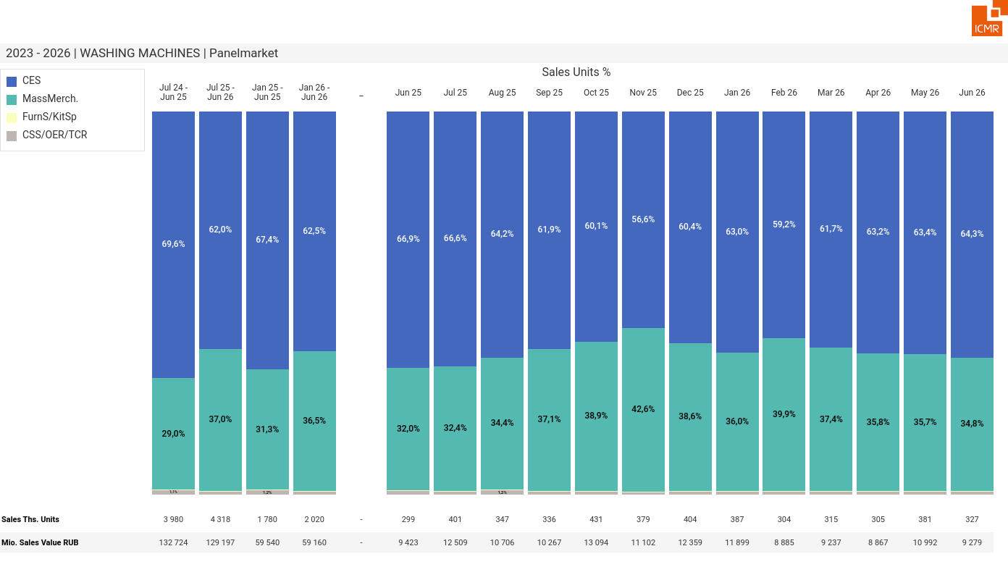
07/2026 PRJ 26fc7bc0 - TMPL 146345ef - FRM 45033477 - ID 13

Slide 14
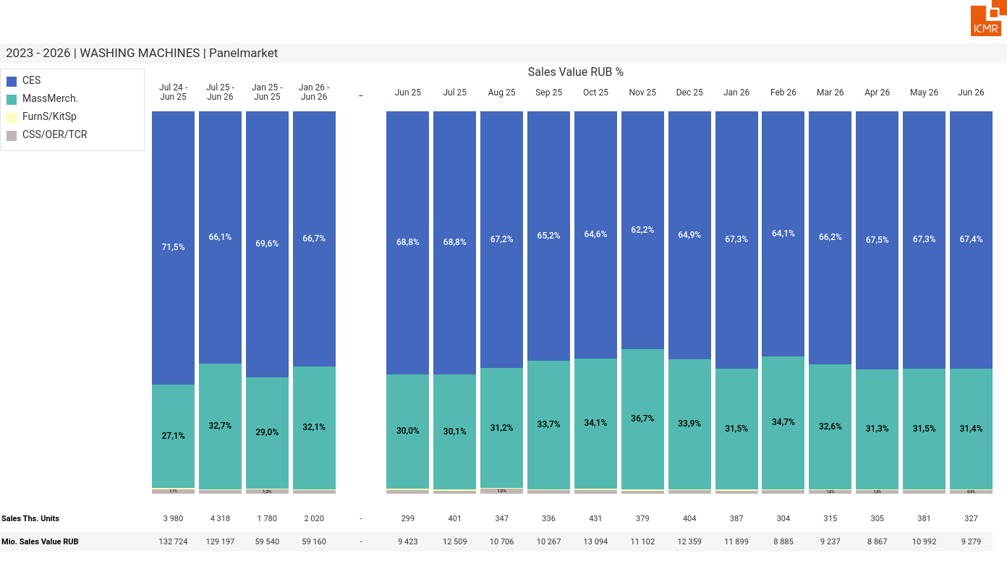
07/2026 PRJ 26fc7bc0 - TMPL 146345ef - FRM 413bfc5b - ID 14

Slide 15
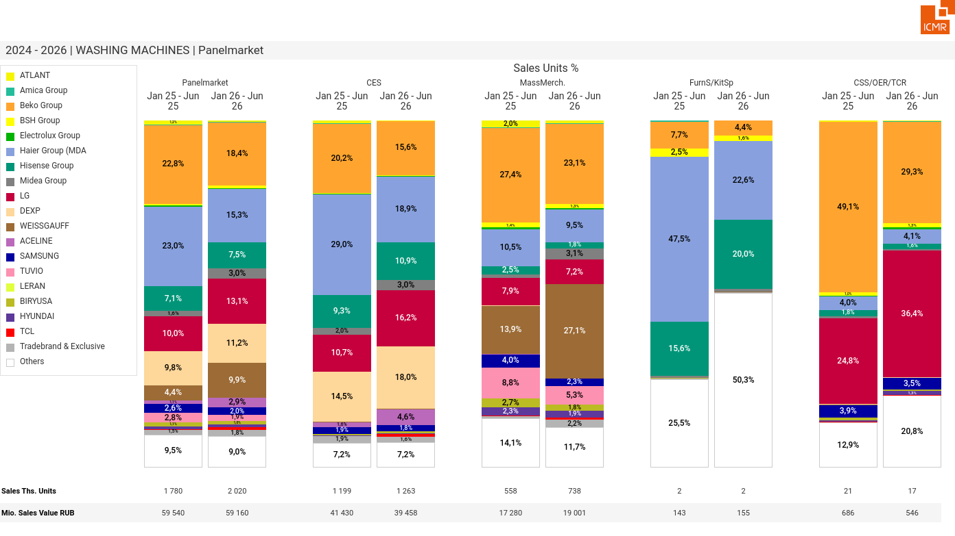
07/2026 PRJ 26fc7bc0 - TMPL 146345ef - FRM 0cd127ac - ID 15

Slide 16
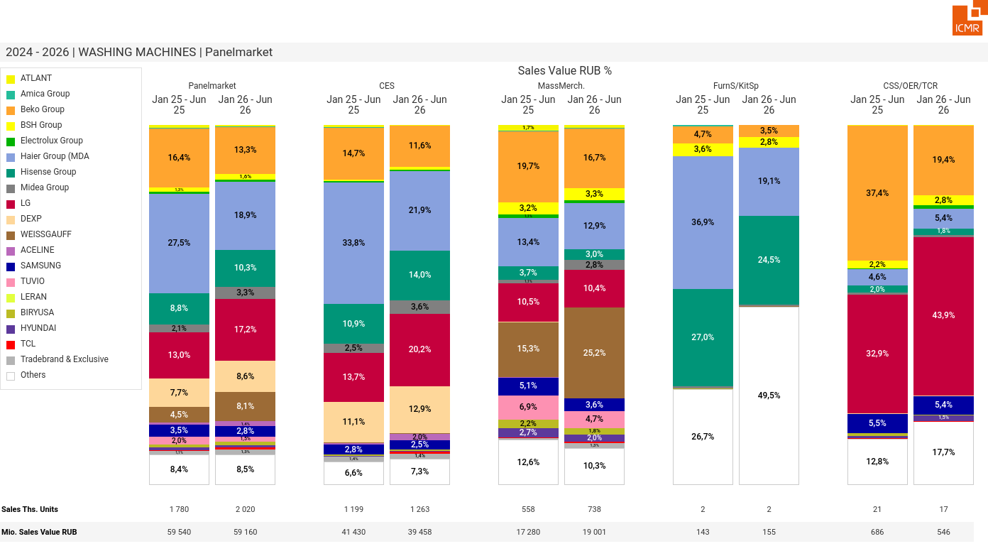
07/2026 PRJ 26fc7bc0 - TMPL 146345ef - FRM 65f7aede - ID 16

Slide 17
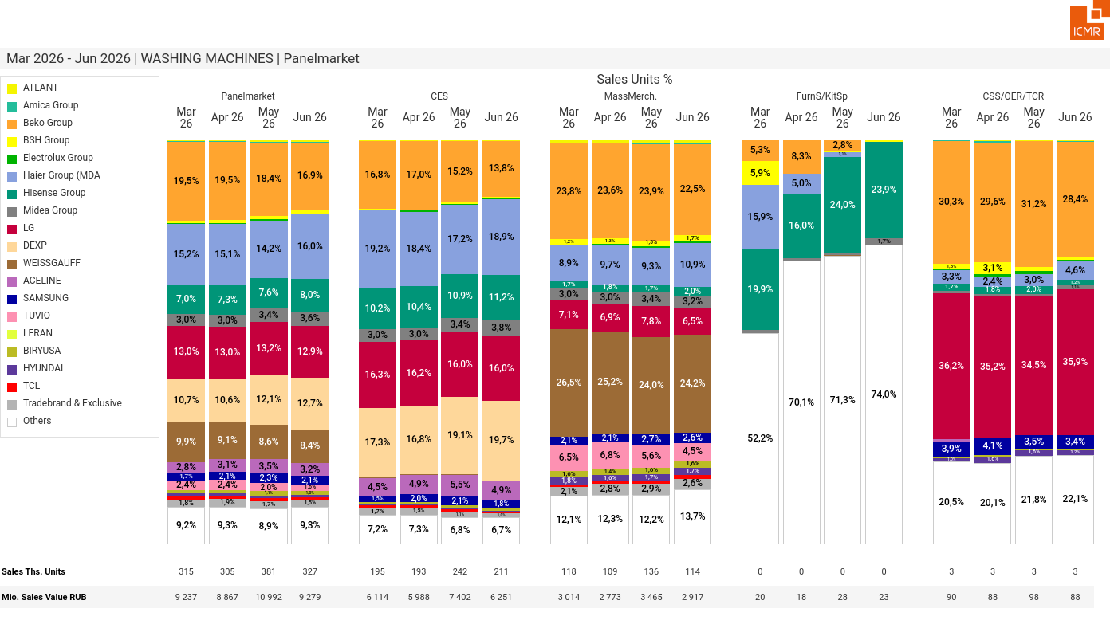
07/2026 PRJ 26fc7bc0 - TMPL 146345ef - FRM d58e466c - ID 17

Slide 18
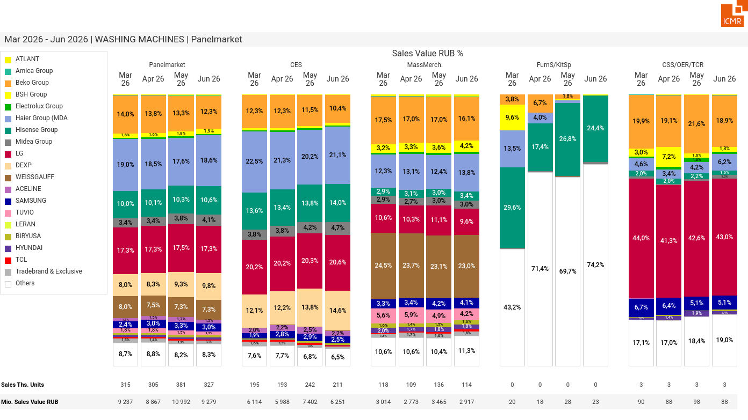
07/2026 PRJ 26fc7bc0 - TMPL 146345ef - FRM 8576b417 - ID 18

Slide 19
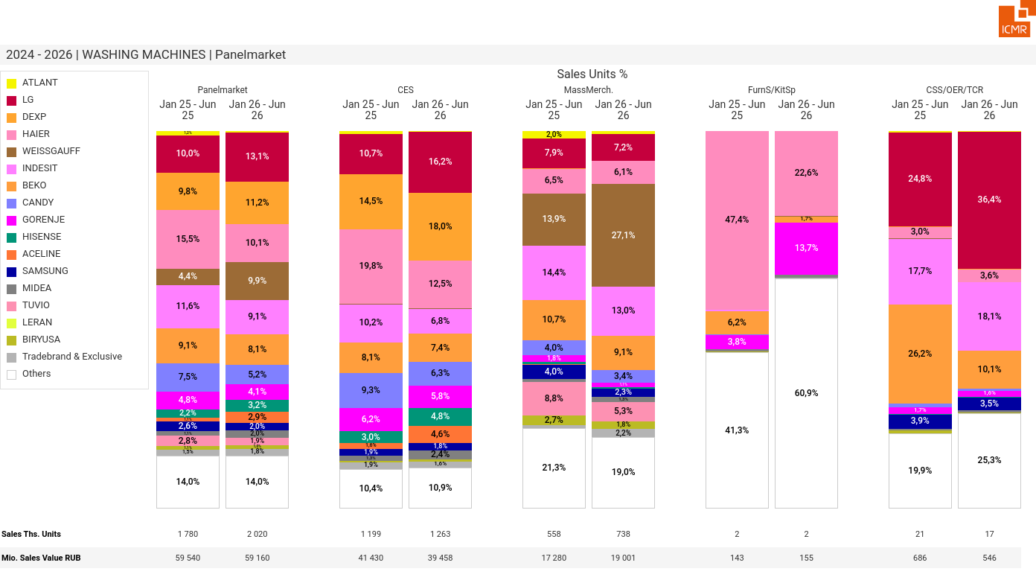
07/2026 PRJ 26fc7bc0 - TMPL 146345ef - FRM 6603d185 - ID 19

Slide 20
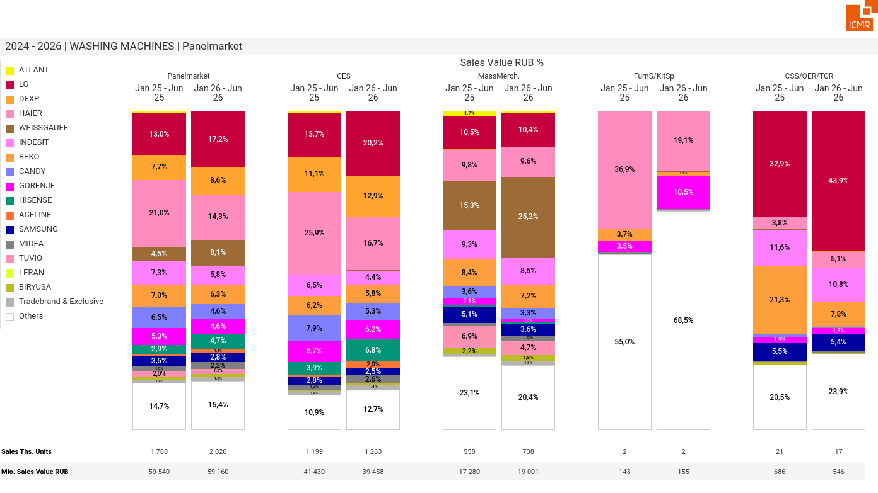
07/2026 PRJ 26fc7bc0 - TMPL 146345ef - FRM a2483301 - ID 20

Slide 21
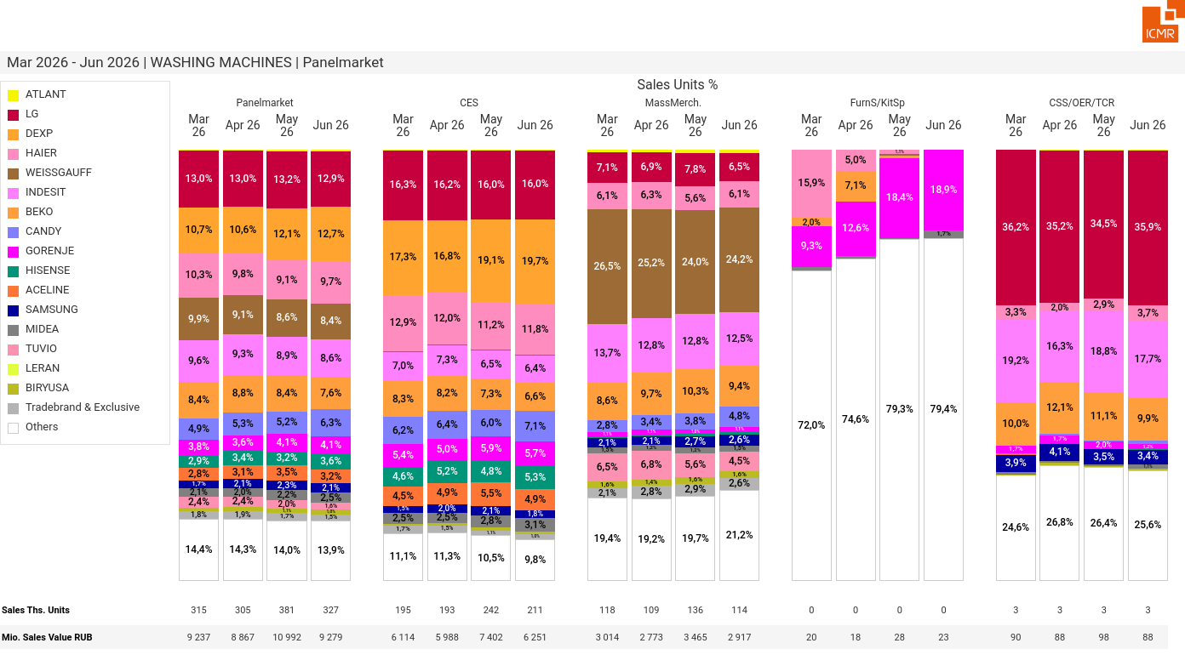
07/2026 PRJ 26fc7bc0 - TMPL 146345ef - FRM 8edf7d70 - ID 21

Slide 22
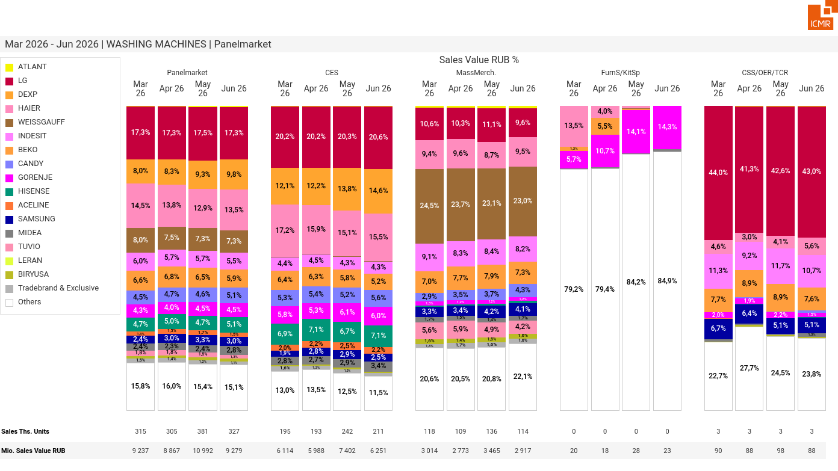
07/2026 PRJ 26fc7bc0 - TMPL 146345ef - FRM 5ebd2cd1 - ID 22

Slide 23
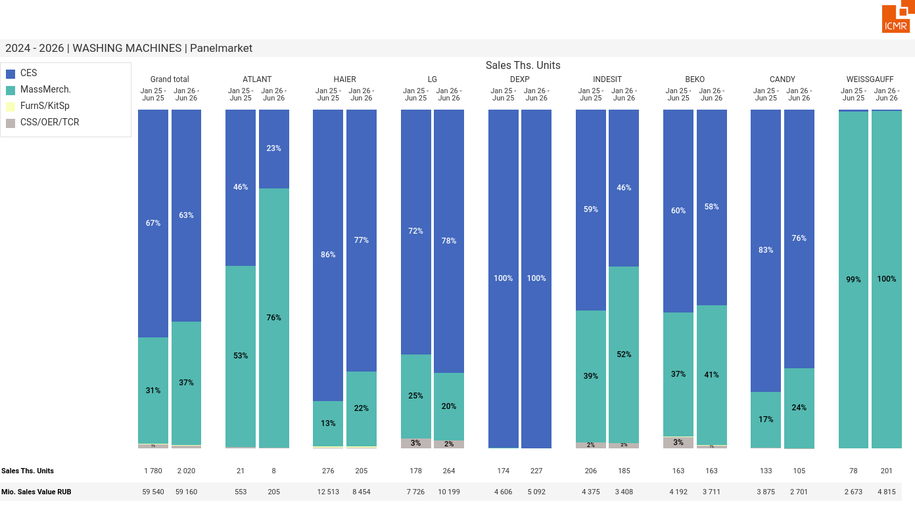
07/2026 PRJ 26fc7bc0 - TMPL 146345ef - FRM 6af7cb08 - ID 23

Slide 24
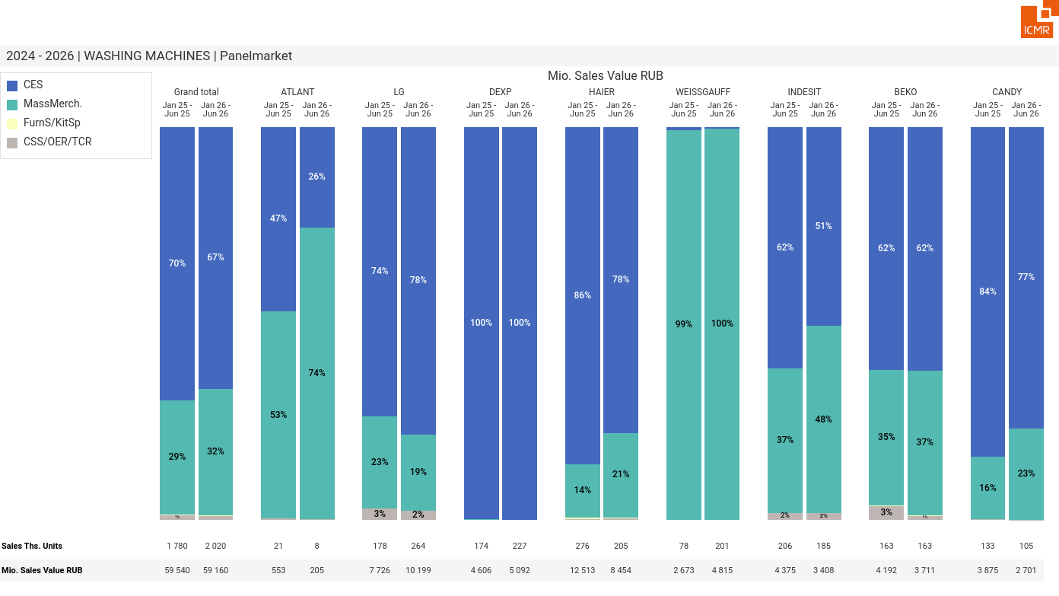
07/2026 PRJ 26fc7bc0 - TMPL 146345ef - FRM 31122ad9 - ID 24

Slide 25
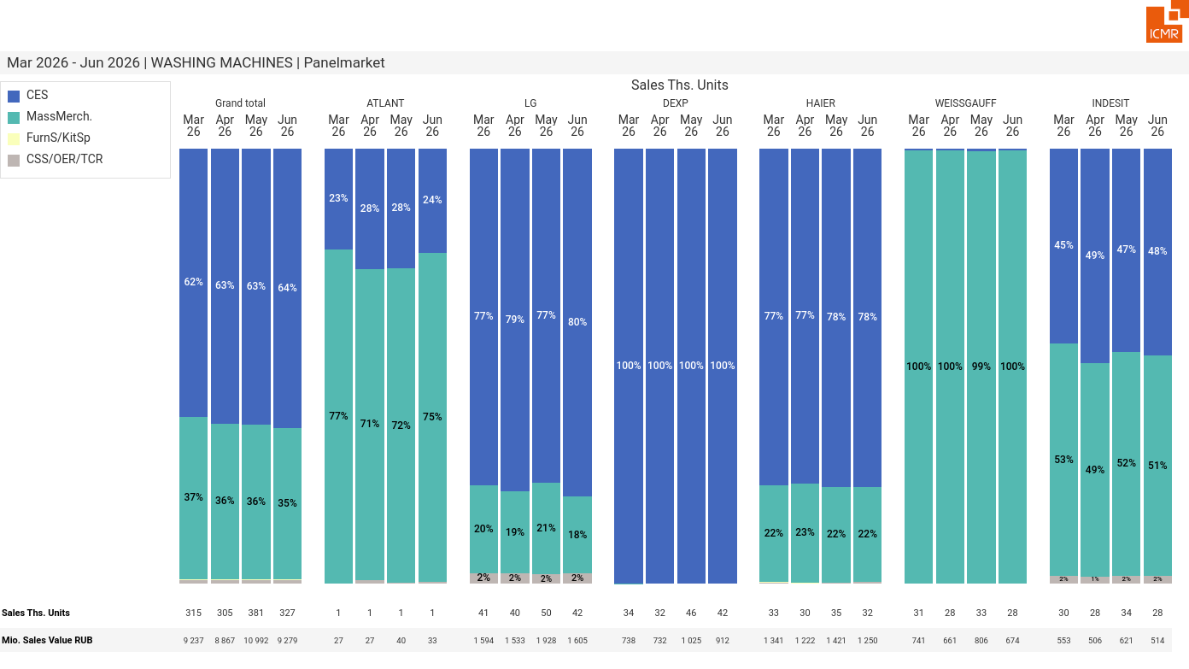
07/2026 PRJ 26fc7bc0 - TMPL 146345ef - FRM e20fbbf7 - ID 25

Slide 26
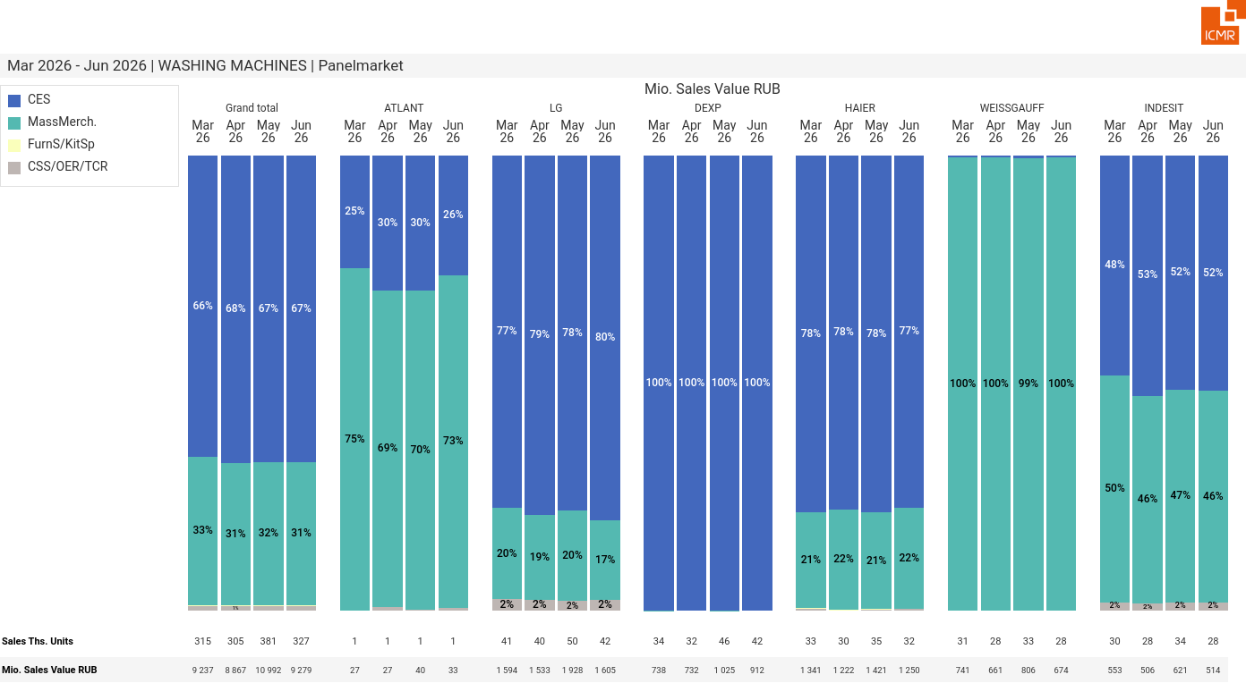
07/2026 PRJ 26fc7bc0 - TMPL 146345ef - FRM 4704af53 - ID 26

Slide 27
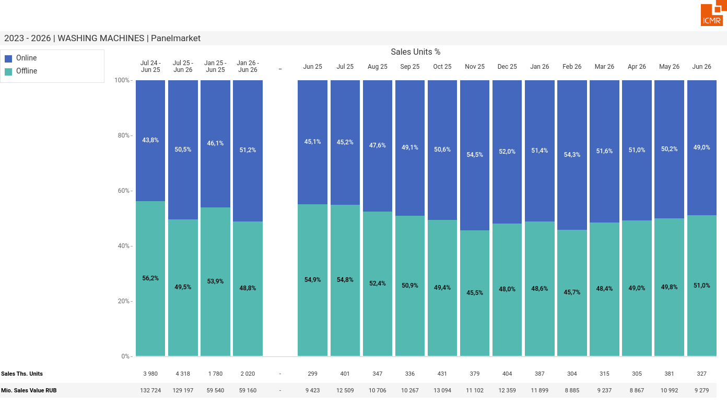
07/2026 PRJ 26fc7bc0 - TMPL 146345ef - FRM a02be7b5 - ID 27

Slide 28
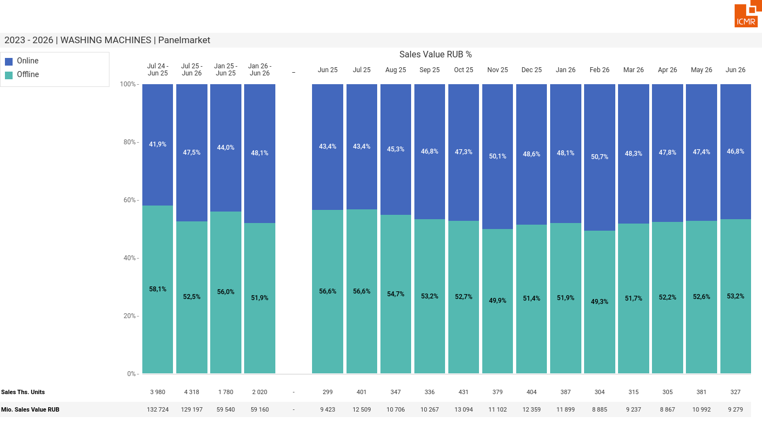
07/2026 PRJ 26fc7bc0 - TMPL 146345ef - FRM 31410fde - ID 28

Slide 29
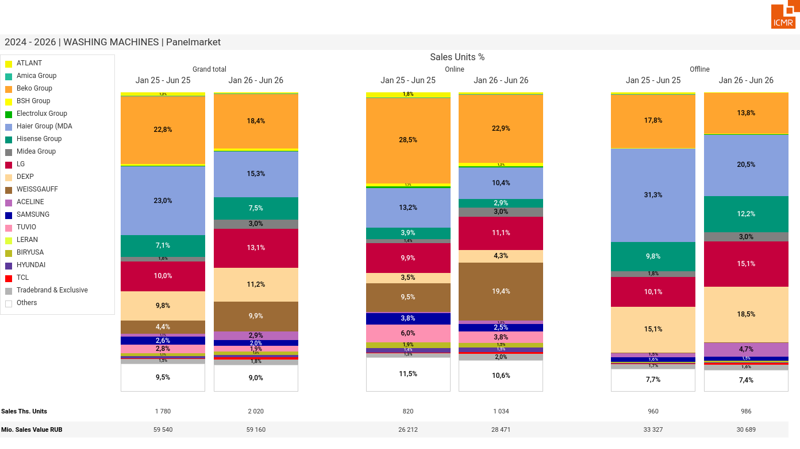
07/2026 PRJ 26fc7bc0 - TMPL 146345ef - FRM 3cc684de - ID 29

Slide 30
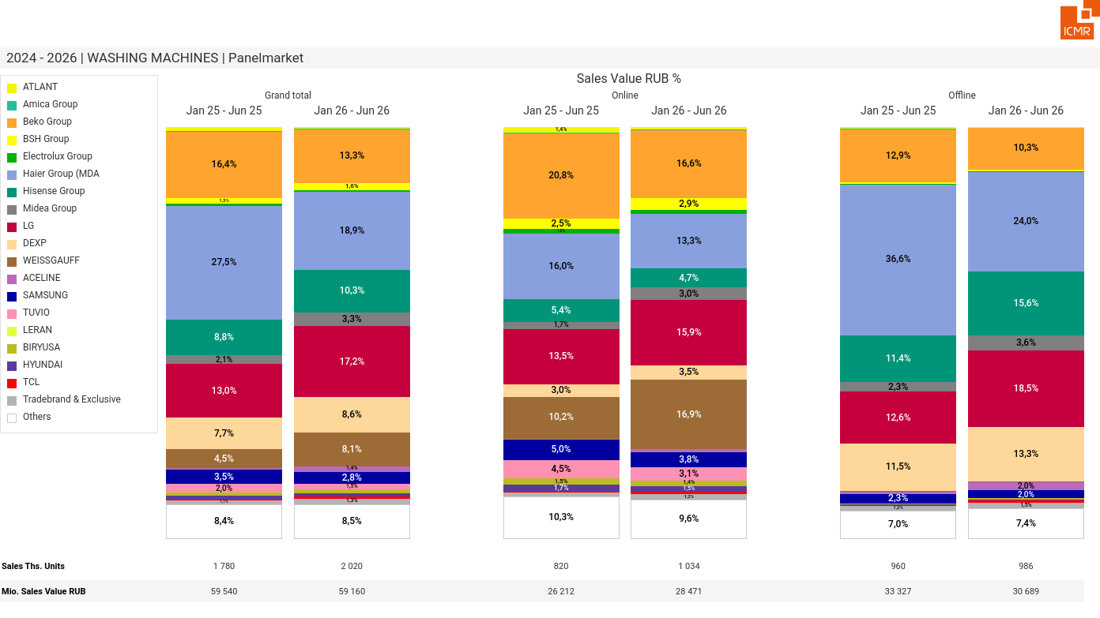
07/2026 PRJ 26fc7bc0 - TMPL 146345ef - FRM 29194c9b - ID 30

Slide 31
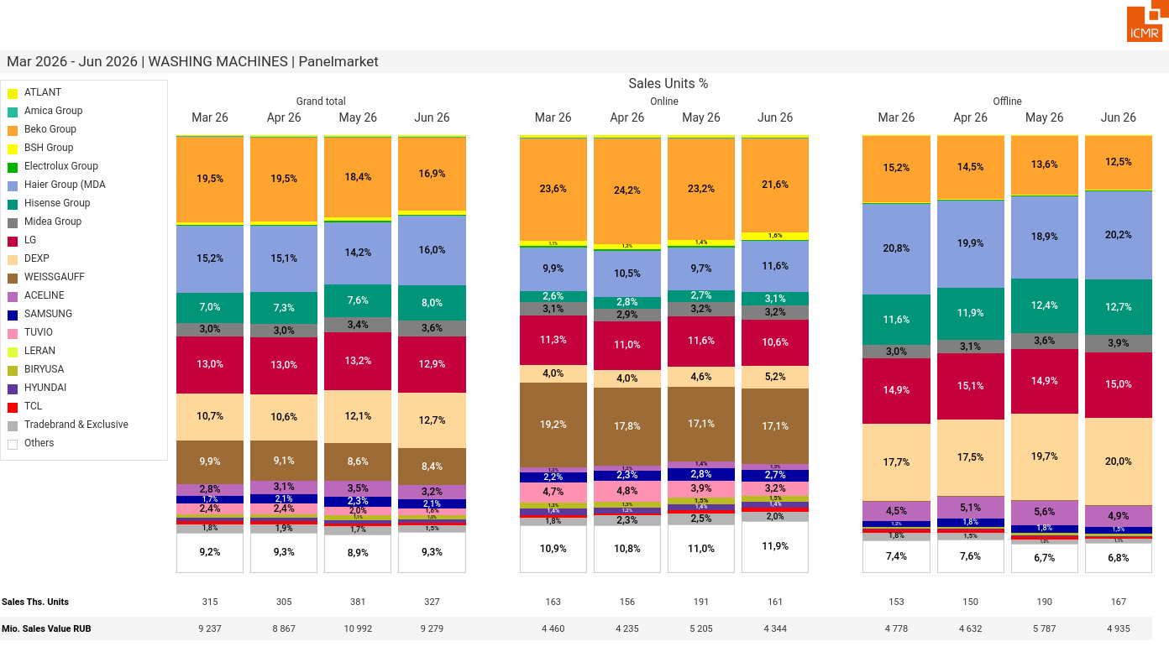
07/2026 PRJ 26fc7bc0 - TMPL 146345ef - FRM 85ba5c8f - ID 31

Slide 32
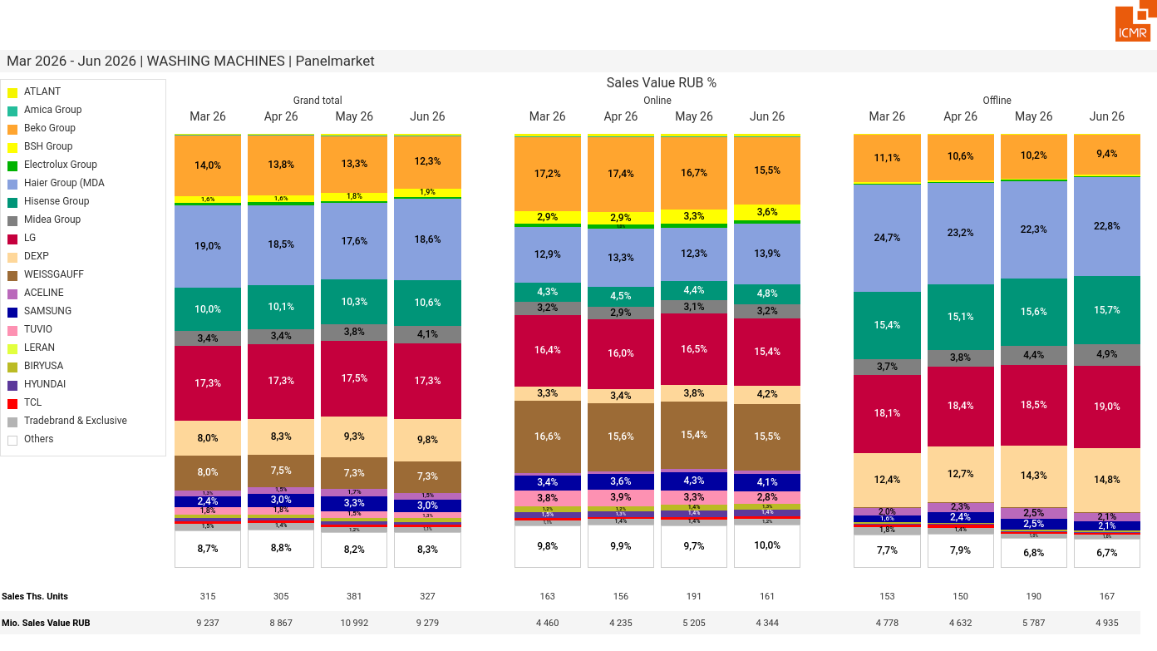
07/2026 PRJ 26fc7bc0 - TMPL 146345ef - FRM 0e16bfdb - ID 32

Slide 33
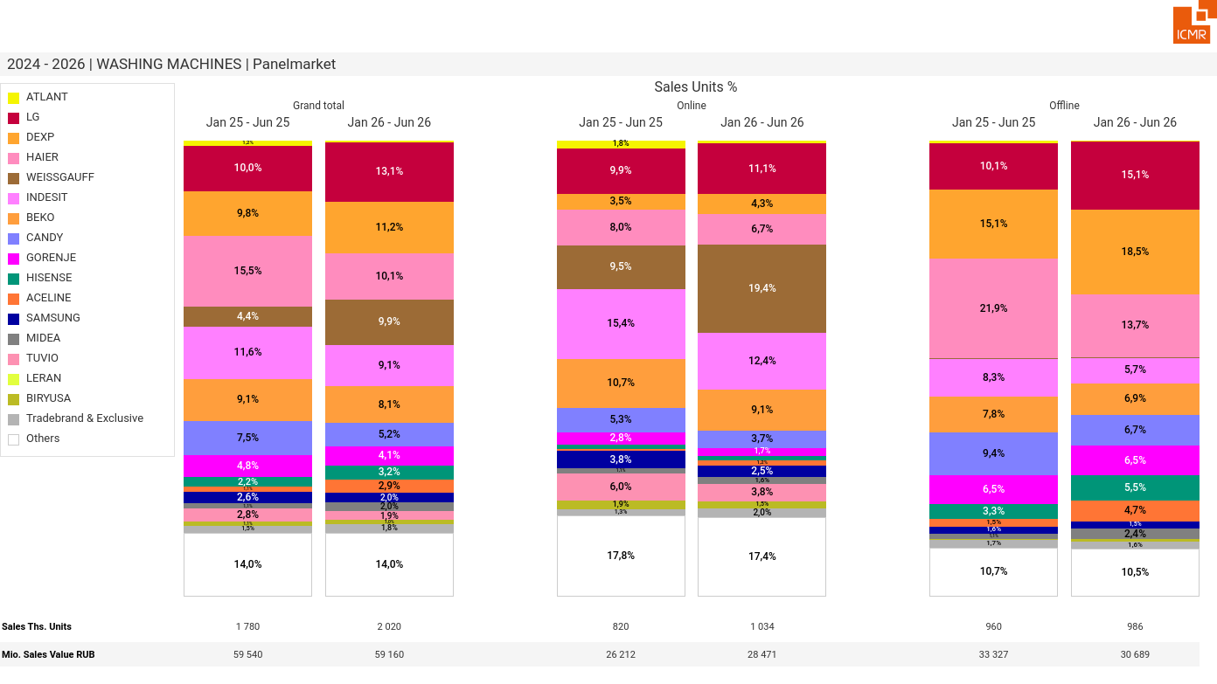
07/2026 PRJ 26fc7bc0 - TMPL 146345ef - FRM b14c46c5 - ID 33

Slide 34
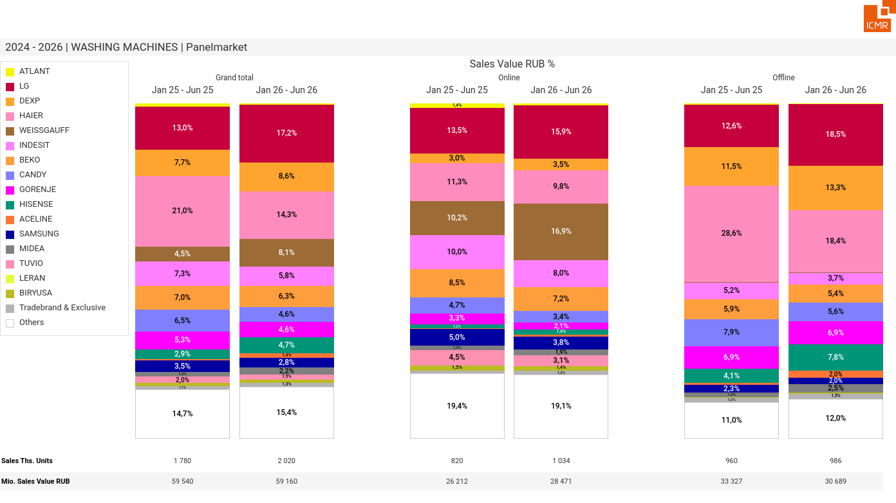
07/2026 PRJ 26fc7bc0 - TMPL 146345ef - FRM 91a2451d - ID 34

Slide 35
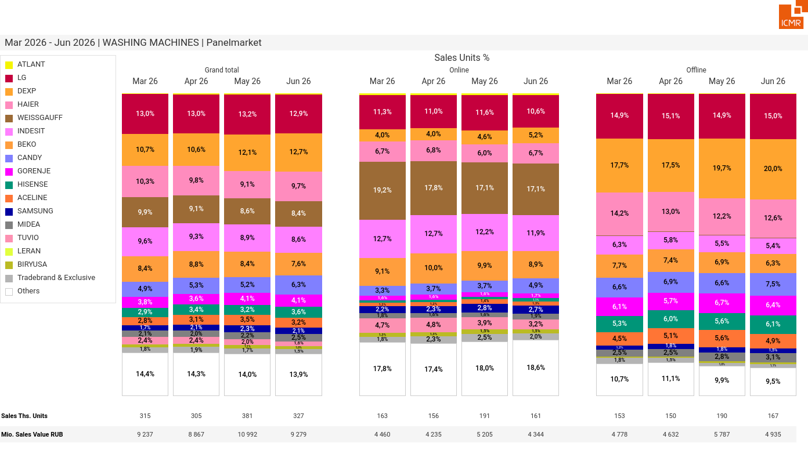
07/2026 PRJ 26fc7bc0 - TMPL 146345ef - FRM b5a89693 - ID 35

Slide 36
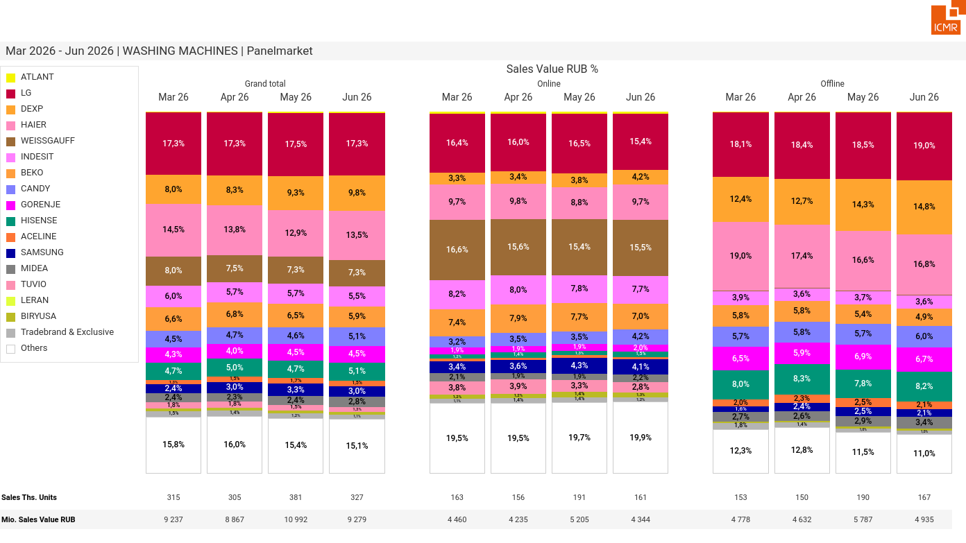
07/2026 PRJ 26fc7bc0 - TMPL 146345ef - FRM 47c83a98 - ID 36

Slide 37
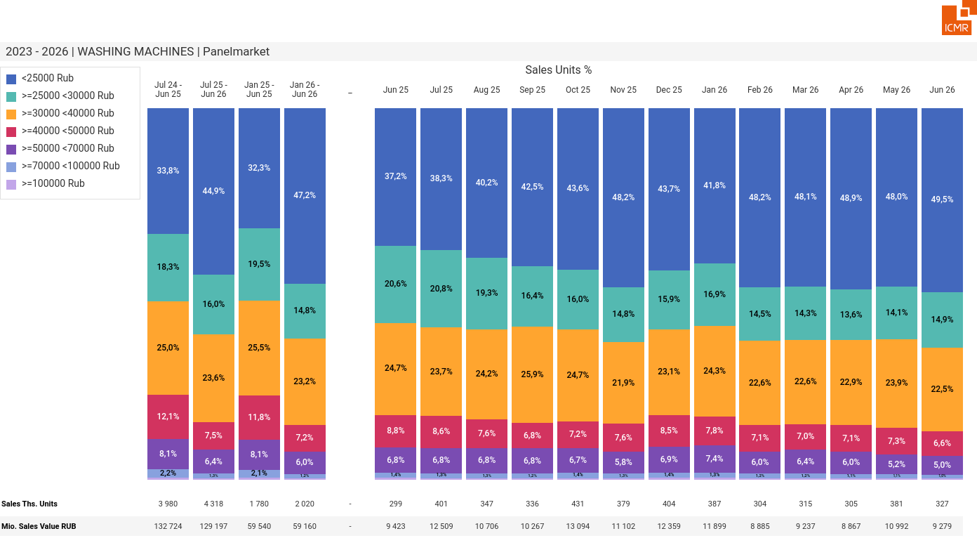
07/2026 PRJ 26fc7bc0 - TMPL 146345ef - FRM 2819947a - ID 37

Slide 38
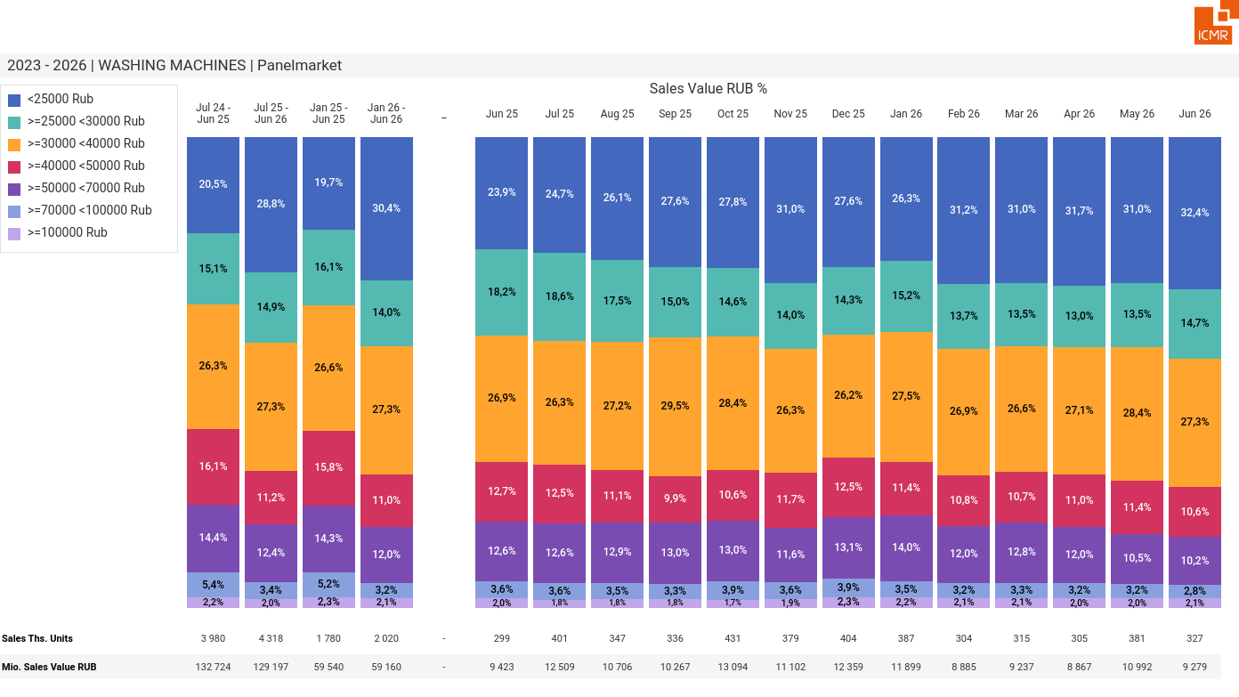
07/2026 PRJ 26fc7bc0 - TMPL 146345ef - FRM febfb3ae - ID 38

Slide 39
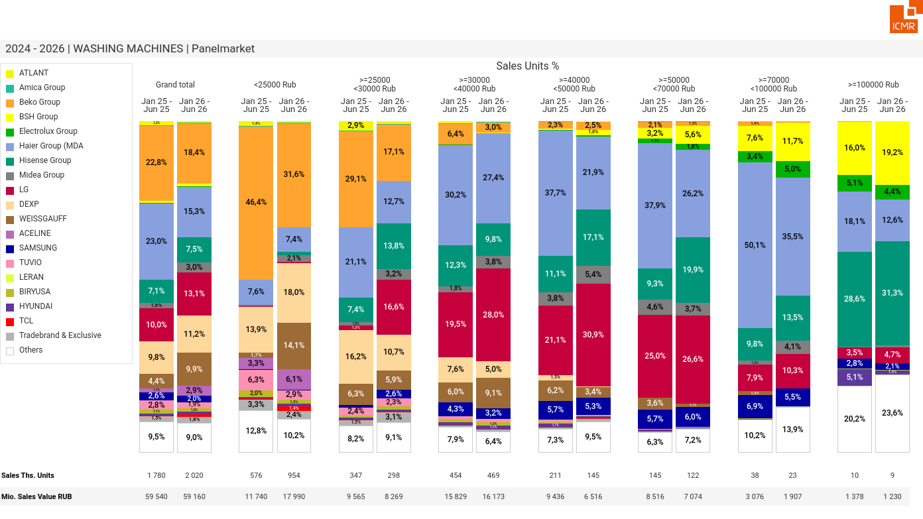
07/2026 PRJ 26fc7bc0 - TMPL 146345ef - FRM 6186a51b - ID 39

Slide 40
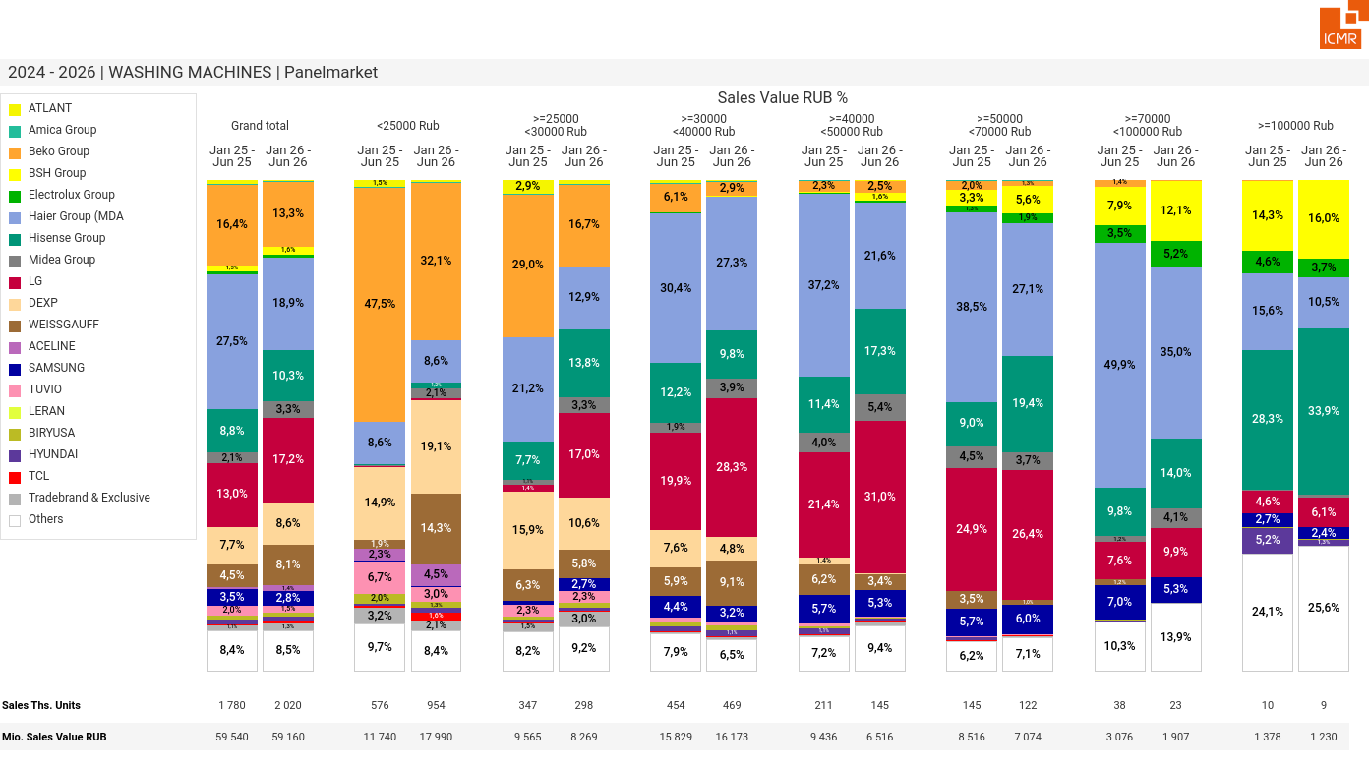
07/2026 PRJ 26fc7bc0 - TMPL 146345ef - FRM 8201c8cf - ID 40

Slide 41
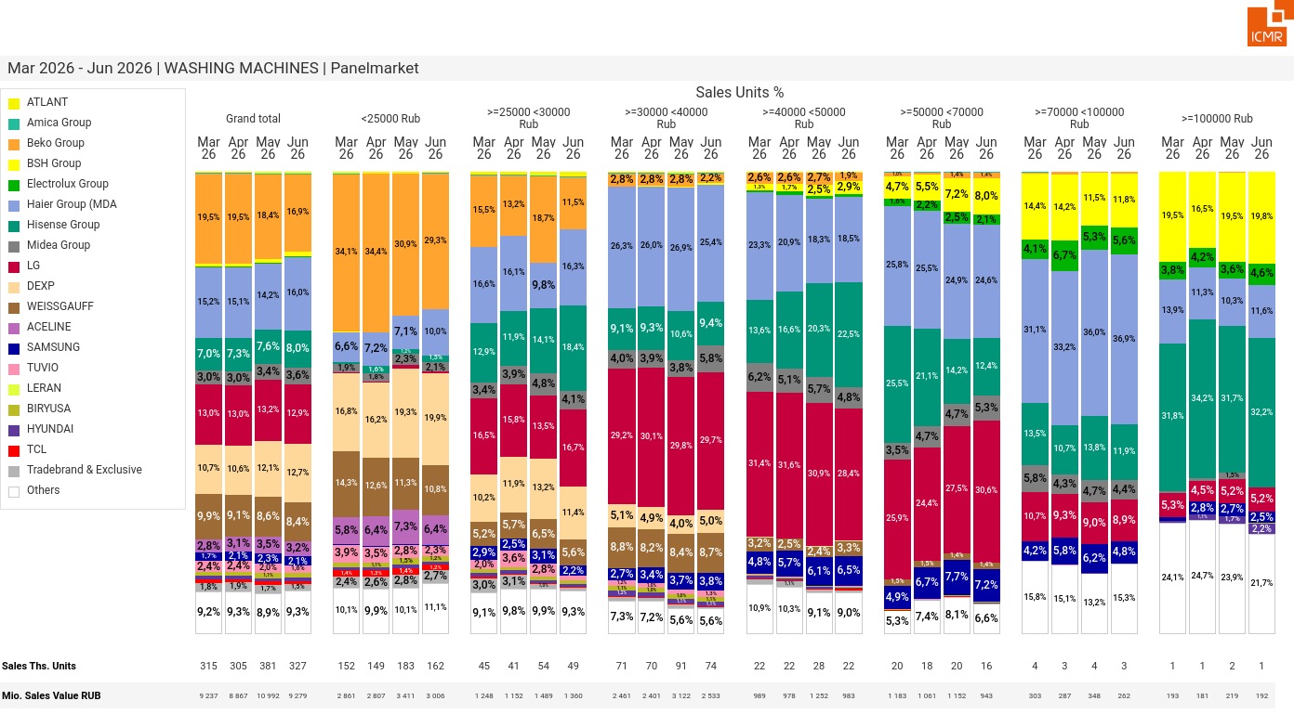
07/2026 PRJ 26fc7bc0 - TMPL 146345ef - FRM f916eb36 - ID 41

Slide 42
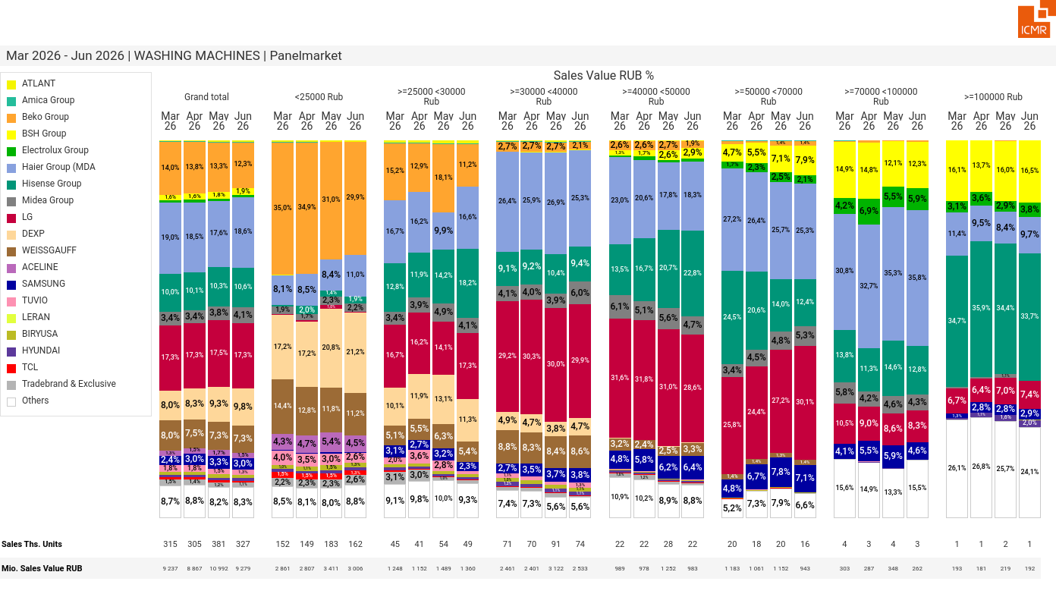
07/2026 PRJ 26fc7bc0 - TMPL 146345ef - FRM d186ef17 - ID 42

Slide 43
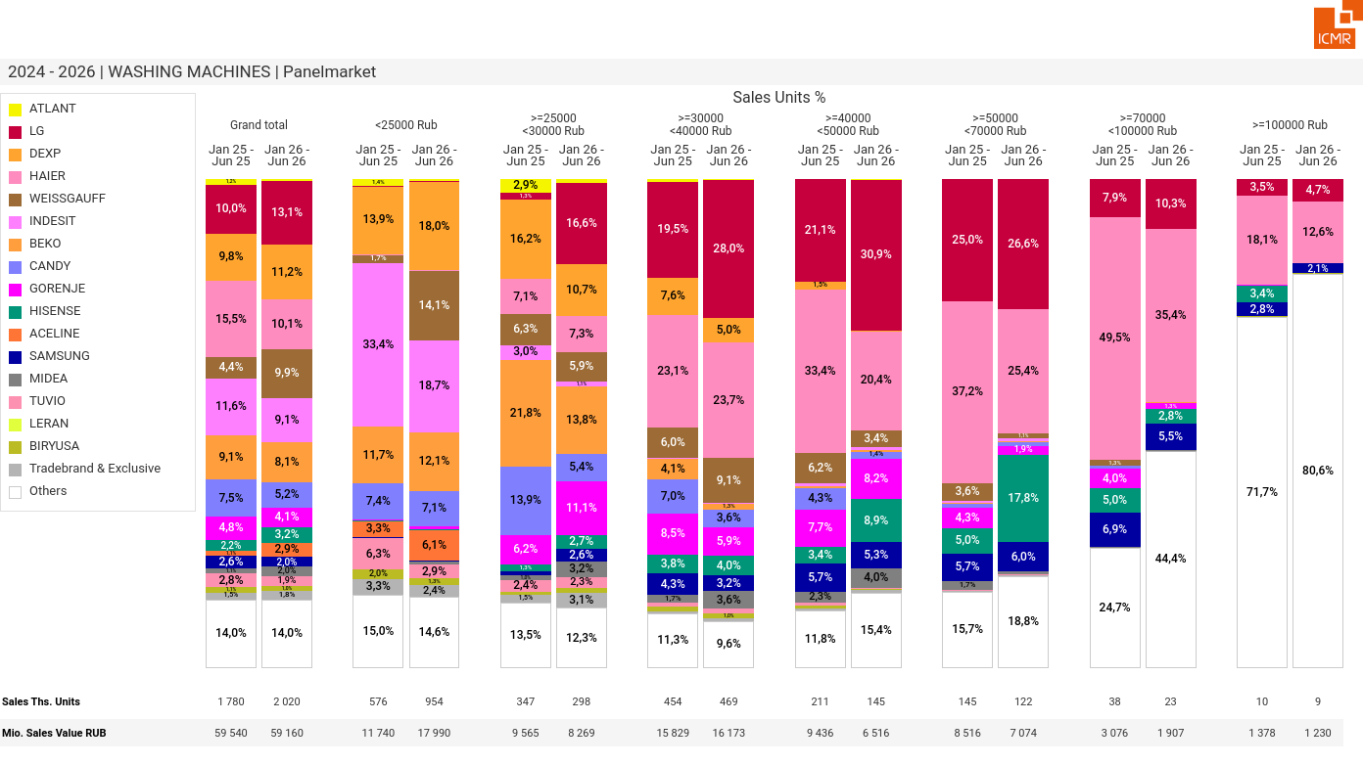
07/2026 PRJ 26fc7bc0 - TMPL 146345ef - FRM f4c2f4bd - ID 43

Slide 44
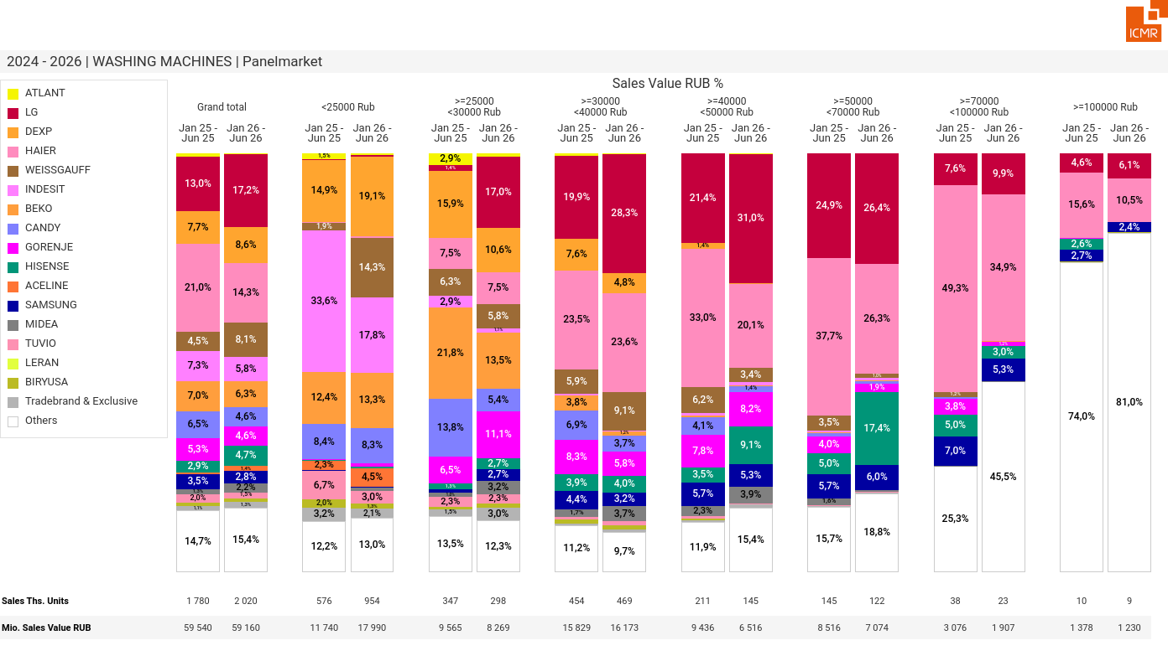
07/2026 PRJ 26fc7bc0 - TMPL 146345ef - FRM aeb6bcc1 - ID 44

Slide 45
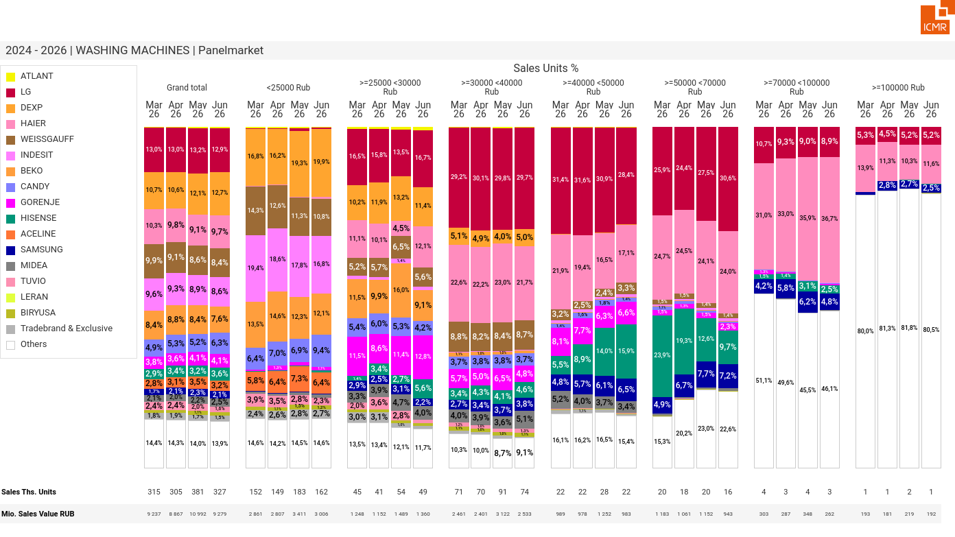
07/2026 PRJ 26fc7bc0 - TMPL 146345ef - FRM d4ed3a4b - ID 45

Slide 46
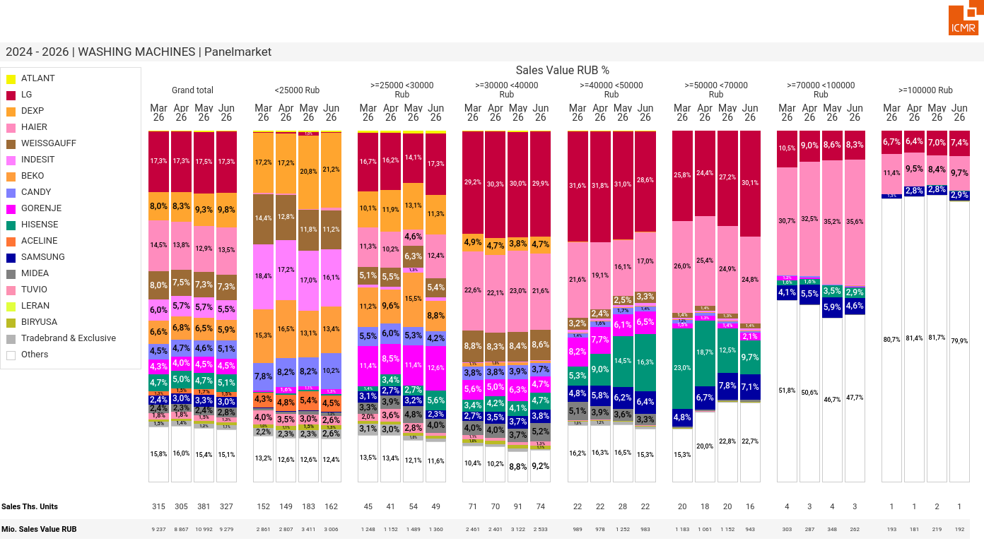
07/2026 PRJ 26fc7bc0 - TMPL 146345ef - FRM 93f48365 - ID 46

Slide 47
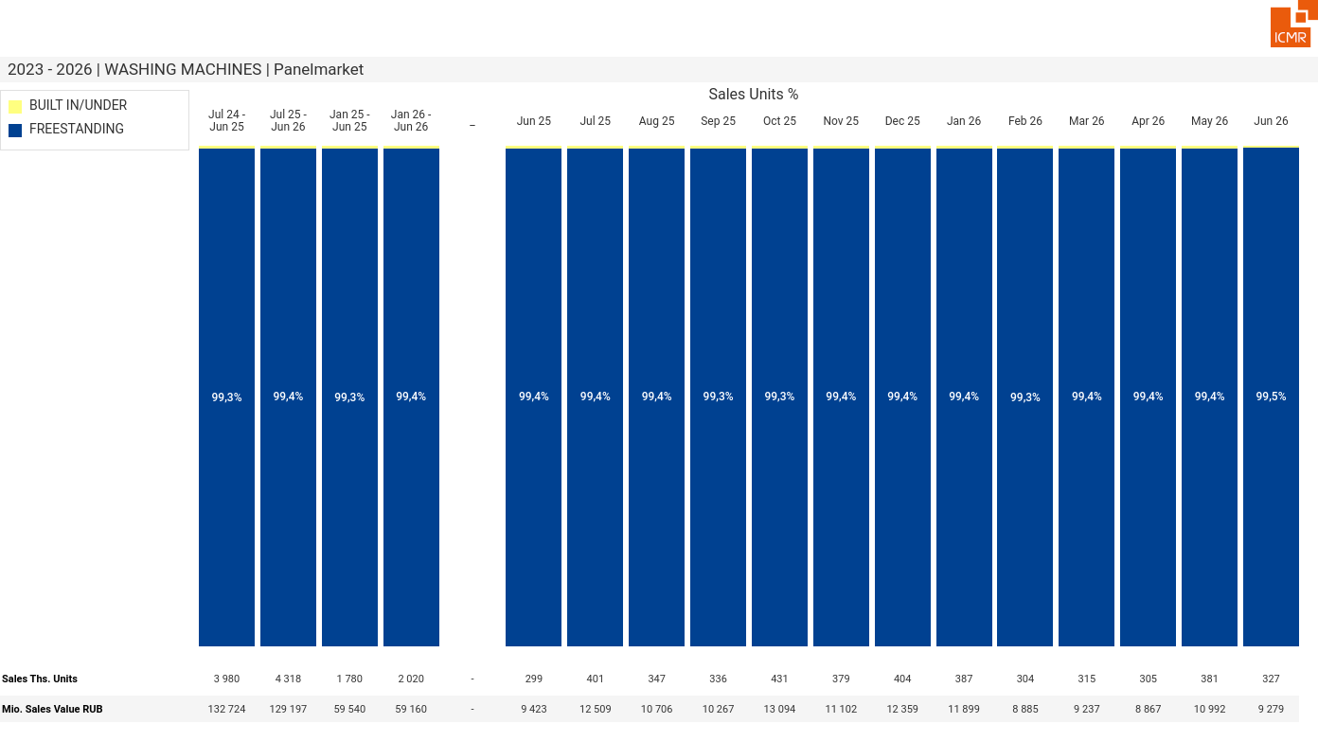
07/2026 PRJ 26fc7bc0 - TMPL 146345ef - FRM afcee99b - ID 47

Slide 48

07/2026 PRJ 26fc7bc0 - TMPL 146345ef - FRM 51e56e39 - ID 48

Slide 49
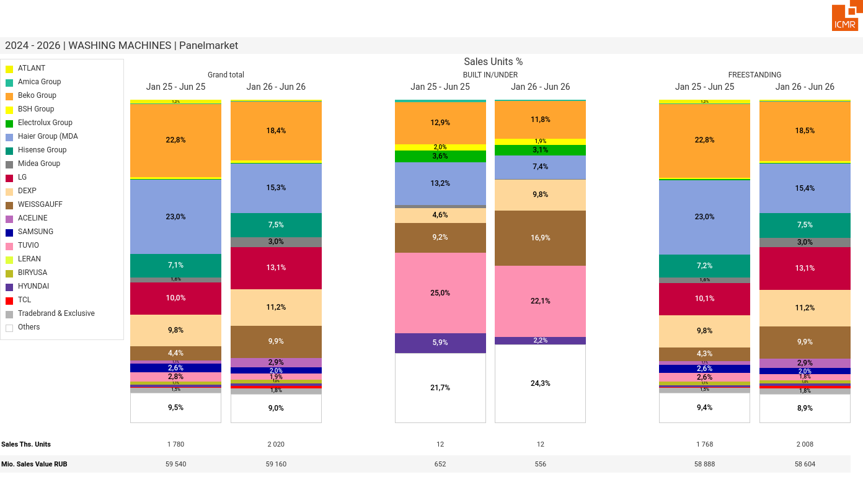
07/2026 PRJ 26fc7bc0 - TMPL 146345ef - FRM 5a19ef3e - ID 49

Slide 50
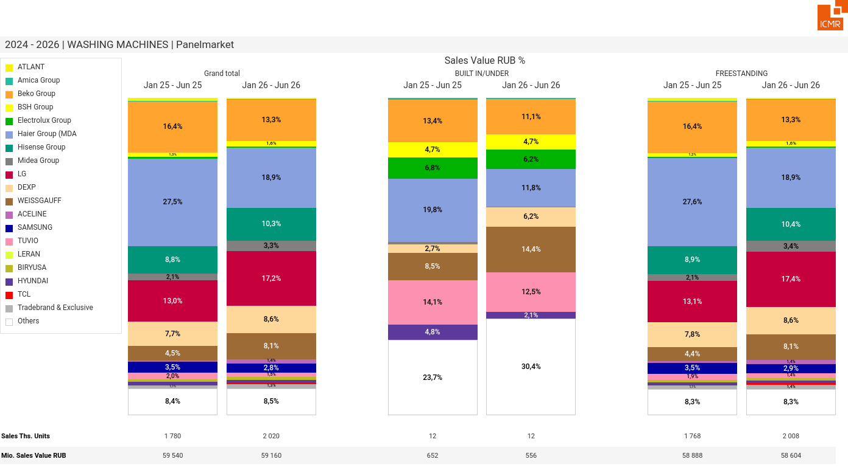
07/2026 PRJ 26fc7bc0 - TMPL 146345ef - FRM 7c03d6ab - ID 50

Slide 51
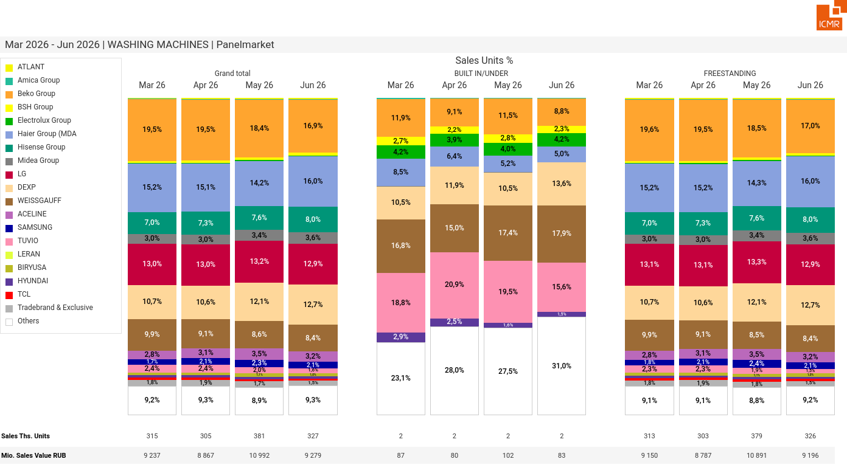
07/2026 PRJ 26fc7bc0 - TMPL 146345ef - FRM b6ad87b1 - ID 51

Slide 52

07/2026 PRJ 26fc7bc0 - TMPL 146345ef - FRM 0686a2d2 - ID 52

Slide 53

07/2026 PRJ 26fc7bc0 - TMPL 146345ef - FRM 5b2a4e3b - ID 53

Slide 54

07/2026 PRJ 26fc7bc0 - TMPL 146345ef - FRM 4569e3a7 - ID 54

Slide 55

07/2026 PRJ 26fc7bc0 - TMPL 146345ef - FRM bede5c15 - ID 55

Slide 56

07/2026 PRJ 26fc7bc0 - TMPL 146345ef - FRM 087a9161 - ID 56

Slide 57

07/2026 PRJ 26fc7bc0 - TMPL 146345ef - FRM ffe8584d - ID 57

Slide 58

07/2026 PRJ 26fc7bc0 - TMPL 146345ef - FRM 66770f2c - ID 58

Slide 59

07/2026 PRJ 26fc7bc0 - TMPL 146345ef - FRM 9ef500c1 - ID 59

Slide 60

07/2026 PRJ 26fc7bc0 - TMPL 146345ef - FRM 783097a7 - ID 60

Slide 61

07/2026 PRJ 26fc7bc0 - TMPL 146345ef - FRM 42dc3c69 - ID 61

Slide 62

07/2026 PRJ 26fc7bc0 - TMPL 146345ef - FRM 76b9ff8b - ID 62

Slide 63

07/2026 PRJ 26fc7bc0 - TMPL 146345ef - FRM 4fc091e6 - ID 63

Slide 64

07/2026 PRJ 26fc7bc0 - TMPL 146345ef - FRM bb85e071 - ID 64

Slide 65

07/2026 PRJ 26fc7bc0 - TMPL 146345ef - FRM a510b07a - ID 65

Slide 66

07/2026 PRJ 26fc7bc0 - TMPL 146345ef - FRM 5592abcf - ID 66

Slide 67

07/2026 PRJ 26fc7bc0 - TMPL 146345ef - FRM 17967a14 - ID 67

Slide 68

07/2026 PRJ 26fc7bc0 - TMPL 146345ef - FRM 9447d649 - ID 68

Slide 69

07/2026 PRJ 26fc7bc0 - TMPL 146345ef - FRM 2d579001 - ID 69

Slide 70

07/2026 PRJ 26fc7bc0 - TMPL 146345ef - FRM 775e0e60 - ID 70

Slide 71

07/2026 PRJ 26fc7bc0 - TMPL 146345ef - FRM f9fe248a - ID 71

Slide 72

07/2026 PRJ 26fc7bc0 - TMPL 146345ef - FRM 51f351cf - ID 72

Slide 73

07/2026 PRJ 26fc7bc0 - TMPL 146345ef - FRM a8472be8 - ID 73

Slide 74

07/2026 PRJ 26fc7bc0 - TMPL 146345ef - FRM 9c5b050c - ID 74

Slide 75

07/2026 PRJ 26fc7bc0 - TMPL 146345ef - FRM c83e62b7 - ID 75

Slide 76

07/2026 PRJ 26fc7bc0 - TMPL 146345ef - FRM 58c3df1e - ID 76

Slide 77

07/2026 PRJ 26fc7bc0 - TMPL 146345ef - FRM b29b2106 - ID 77

Slide 78

07/2026 PRJ 26fc7bc0 - TMPL 146345ef - FRM 237ff8bc - ID 78

Slide 79

07/2026 PRJ 26fc7bc0 - TMPL 146345ef - FRM a4a42c8b - ID 79

Slide 80

07/2026 PRJ 26fc7bc0 - TMPL 146345ef - FRM ba257b6d - ID 80

Slide 81

07/2026 PRJ 26fc7bc0 - TMPL 146345ef - FRM c2a427c1 - ID 81

Slide 82

07/2026 PRJ 26fc7bc0 - TMPL 146345ef - FRM 49da8176 - ID 82

Slide 83

07/2026 PRJ 26fc7bc0 - TMPL 146345ef - FRM aaf9be16 - ID 83

Slide 84

07/2026 PRJ 26fc7bc0 - TMPL 146345ef - FRM 1a7eda08 - ID 84

Slide 85

07/2026 PRJ 26fc7bc0 - TMPL 146345ef - FRM 88b8f969 - ID 85

Slide 86

07/2026 PRJ 26fc7bc0 - TMPL 146345ef - FRM aa09078f - ID 86

Slide 87

07/2026 PRJ 26fc7bc0 - TMPL 146345ef - FRM fcb11a74 - ID 87

Slide 88

07/2026 PRJ 26fc7bc0 - TMPL 146345ef - FRM 91ffd2f8 - ID 88

Slide 89

07/2026 PRJ 26fc7bc0 - TMPL 146345ef - FRM 94652c6d - ID 89

Slide 90

07/2026 PRJ 26fc7bc0 - TMPL 146345ef - FRM 234e83c1 - ID 90

Slide 91

07/2026 PRJ 26fc7bc0 - TMPL 146345ef - FRM 103446c7 - ID 91

Slide 92
07/2026 PRJ 26fc7bc0 - TMPL 146345ef - FRM 2dfee36f - ID 92

Slide 93

07/2026 PRJ 26fc7bc0 - TMPL 146345ef - FRM 27583698 - ID 93

Slide 94

07/2026 PRJ 26fc7bc0 - TMPL 146345ef - FRM 09492c49 - ID 94

Slide 95

07/2026 PRJ 26fc7bc0 - TMPL 146345ef - FRM 99afeff0 - ID 95

Slide 96

07/2026 PRJ 26fc7bc0 - TMPL 146345ef - FRM 1e8a2421 - ID 96

Slide 97

07/2026 PRJ 26fc7bc0 - TMPL 146345ef - FRM 11ac90b6 - ID 97

Slide 98

07/2026 PRJ 26fc7bc0 - TMPL 146345ef - FRM 2588c978 - ID 98

Slide 99

07/2026 PRJ 26fc7bc0 - TMPL 146345ef - FRM fd54e1a1 - ID 99

Slide 100

07/2026 PRJ 26fc7bc0 - TMPL 146345ef - FRM 77809c96 - ID 100

Slide 101

07/2026 PRJ 26fc7bc0 - TMPL 146345ef - FRM b7fe0153 - ID 101

Slide 102

07/2026 PRJ 26fc7bc0 - TMPL 146345ef - FRM 48f5225d - ID 102

Slide 103

07/2026 PRJ 26fc7bc0 - TMPL 146345ef - FRM 674a8101 - ID 103

Slide 104

07/2026 PRJ 26fc7bc0 - TMPL 146345ef - FRM 0fc24906 - ID 104

Slide 105

07/2026 PRJ 26fc7bc0 - TMPL 146345ef - FRM f3e2f0b6 - ID 105

Slide 106

07/2026 PRJ 26fc7bc0 - TMPL 146345ef - FRM b93d55e3 - ID 106

Slide 107

07/2026 PRJ 26fc7bc0 - TMPL 146345ef - FRM 8a5ceb21 - ID 107

Slide 108

07/2026 PRJ 26fc7bc0 - TMPL 146345ef - FRM 2d6d4875 - ID 108

Slide 109

07/2026 PRJ 26fc7bc0 - TMPL 146345ef - FRM 0d8e65ce - ID 109

Slide 110

07/2026 PRJ 26fc7bc0 - TMPL 146345ef - FRM 0bf97313 - ID 110

Slide 111

07/2026 PRJ 26fc7bc0 - TMPL 146345ef - FRM 0d4ccfda - ID 111

Slide 112

07/2026 PRJ 26fc7bc0 - TMPL 146345ef - FRM e89fa26e - ID 112

Slide 113

07/2026 PRJ 26fc7bc0 - TMPL 146345ef - FRM 8b76df3b - ID 113

Slide 114

07/2026 PRJ 26fc7bc0 - TMPL 146345ef - FRM 991d10cb - ID 114

Slide 115

07/2026 PRJ 26fc7bc0 - TMPL 146345ef - FRM 09d2668f - ID 115

Slide 116

07/2026 PRJ 26fc7bc0 - TMPL 146345ef - FRM 3d6a200c - ID 116

Slide 117

07/2026 PRJ 26fc7bc0 - TMPL 146345ef - FRM 5e70996f - ID 117

Slide 118

07/2026 PRJ 26fc7bc0 - TMPL 146345ef - FRM 18e8012f - ID 118

Slide 119

07/2026 PRJ 26fc7bc0 - TMPL 146345ef - FRM 2aa093f6 - ID 119

Slide 120

07/2026 PRJ 26fc7bc0 - TMPL 146345ef - FRM a387305c - ID 120

Slide 121

07/2026 PRJ 26fc7bc0 - TMPL 146345ef - FRM bb001f99 - ID 121

Slide 122

07/2026 PRJ 26fc7bc0 - TMPL 146345ef - FRM a6983f90 - ID 122

Slide 123

07/2026 PRJ 26fc7bc0 - TMPL 146345ef - FRM 2b8b3de4 - ID 123

Slide 124

07/2026 PRJ 26fc7bc0 - TMPL 146345ef - FRM 96aaf85d - ID 124

Slide 125

07/2026 PRJ 26fc7bc0 - TMPL 146345ef - FRM c11e8c6f - ID 125

Slide 126

07/2026 PRJ 26fc7bc0 - TMPL 146345ef - FRM d728fa2b - ID 126

Slide 127

07/2026 PRJ 26fc7bc0 - TMPL 146345ef - FRM 7e3e7855 - ID 127

Slide 128

07/2026 PRJ 26fc7bc0 - TMPL 146345ef - FRM 8eb07e16 - ID 128

Slide 129

07/2026 PRJ 26fc7bc0 - TMPL 146345ef - FRM 120c6ff4 - ID 129

Slide 130

07/2026 PRJ 26fc7bc0 - TMPL 146345ef - FRM 8a3ac99f - ID 130

Slide 131

07/2026 PRJ 26fc7bc0 - TMPL 146345ef - FRM 66fb523f - ID 131

Slide 132

07/2026 PRJ 26fc7bc0 - TMPL 146345ef - FRM 08babcde - ID 132

Slide 133

07/2026 PRJ 26fc7bc0 - TMPL 146345ef - FRM 3c39ee29 - ID 133

Slide 134

07/2026 PRJ 26fc7bc0 - TMPL 146345ef - FRM 954b4bab - ID 134

Slide 135

07/2026 PRJ 26fc7bc0 - TMPL 146345ef - FRM ac3809ab - ID 135

Slide 136

07/2026 PRJ 26fc7bc0 - TMPL 146345ef - FRM 18cc0558 - ID 136

Slide 137

07/2026 PRJ 26fc7bc0 - TMPL 146345ef - FRM 5a5251ca - ID 137

Slide 138

07/2026 PRJ 26fc7bc0 - TMPL 146345ef - FRM dc246aaa - ID 138

Slide 139

07/2026 PRJ 26fc7bc0 - TMPL 146345ef - FRM 4a96a9bd - ID 139

Slide 140

07/2026 PRJ 26fc7bc0 - TMPL 146345ef - FRM 8d525818 - ID 140

Slide 141

07/2026 PRJ 26fc7bc0 - TMPL 146345ef - FRM 8043e5e9 - ID 141

Slide 142

07/2026 PRJ 26fc7bc0 - TMPL 146345ef - FRM e41bf1de - ID 142

Slide 143

07/2026 PRJ 26fc7bc0 - TMPL 146345ef - FRM 591ef37f - ID 143

Slide 144

07/2026 PRJ 26fc7bc0 - TMPL 146345ef - FRM 034260fc - ID 144

Slide 145

07/2026 PRJ 26fc7bc0 - TMPL 146345ef - FRM 3b631917 - ID 145

Slide 146

07/2026 PRJ 26fc7bc0 - TMPL 146345ef - FRM 550e9850 - ID 146

Slide 147

07/2026 PRJ 26fc7bc0 - TMPL 146345ef - FRM 210eb87d - ID 147

Slide 148

07/2026 PRJ 26fc7bc0 - TMPL 146345ef - FRM d6c55466 - ID 148

Slide 149

07/2026 PRJ 26fc7bc0 - TMPL 146345ef - FRM 3a134396 - ID 149

Slide 150

07/2026 PRJ 26fc7bc0 - TMPL 146345ef - FRM 9cbeb83d - ID 150

Slide 151

07/2026 PRJ 26fc7bc0 - TMPL 146345ef - FRM 5dc811f9 - ID 151

Slide 152

07/2026 PRJ 26fc7bc0 - TMPL 146345ef - FRM 06b9eea8 - ID 152

Slide 153

07/2026 PRJ 26fc7bc0 - TMPL 146345ef - FRM 568b805d - ID 153

Slide 154

07/2026 PRJ 26fc7bc0 - TMPL 146345ef - FRM 831111b9 - ID 154

Slide 155

07/2026 PRJ 26fc7bc0 - TMPL 146345ef - FRM f99f309f - ID 155

Slide 156

07/2026 PRJ 26fc7bc0 - TMPL 146345ef - FRM c9926b4c - ID 156

Slide 157

07/2026 PRJ 26fc7bc0 - TMPL 146345ef - FRM eb88706d - ID 157

Slide 158

07/2026 PRJ 26fc7bc0 - TMPL 146345ef - FRM b82204a4 - ID 158

Slide 159

07/2026 PRJ 26fc7bc0 - TMPL 146345ef - FRM 8125442e - ID 159

Slide 160

07/2026 PRJ 26fc7bc0 - TMPL 146345ef - FRM f4233d77 - ID 160

Slide 161

07/2026 PRJ 26fc7bc0 - TMPL 146345ef - FRM 1188f5a8 - ID 161

Slide 162

07/2026 PRJ 26fc7bc0 - TMPL 146345ef - FRM 8076d92e - ID 162

Slide 163

07/2026 PRJ 26fc7bc0 - TMPL 146345ef - FRM 6e1d85af - ID 163

Slide 164

07/2026 PRJ 26fc7bc0 - TMPL 146345ef - FRM 0a6652df - ID 164

Slide 165

07/2026 PRJ 26fc7bc0 - TMPL 146345ef - FRM 7301b901 - ID 165

Slide 166

07/2026 PRJ 26fc7bc0 - TMPL 146345ef - FRM f2c8b3f9 - ID 166

Slide 167

07/2026 PRJ 26fc7bc0 - TMPL 146345ef - FRM 76f1b090 - ID 167

Slide 168

07/2026 PRJ 26fc7bc0 - TMPL 146345ef - FRM 66fe9733 - ID 168

Slide 169

07/2026 PRJ 26fc7bc0 - TMPL 146345ef - FRM fe9c54ad - ID 169

Slide 170

07/2026 PRJ 26fc7bc0 - TMPL 146345ef - FRM 0ee9f535 - ID 170

Slide 171

07/2026 PRJ 26fc7bc0 - TMPL 146345ef - FRM ca5045fb - ID 171

Slide 172

07/2026 PRJ 26fc7bc0 - TMPL 146345ef - FRM 9d476bee - ID 172

Slide 173

07/2026 PRJ 26fc7bc0 - TMPL 146345ef - FRM 475bfb8d - ID 173

Slide 174

07/2026 PRJ 26fc7bc0 - TMPL 146345ef - FRM 6063e86d - ID 174

Slide 175

07/2026 PRJ 26fc7bc0 - TMPL 146345ef - FRM 38d0fe8c - ID 175

Slide 176

07/2026 PRJ 26fc7bc0 - TMPL 146345ef - FRM ad7162b2 - ID 176

Slide 177

07/2026 PRJ 26fc7bc0 - TMPL 146345ef - FRM 3605ed6d - ID 177

Slide 178

07/2026 PRJ 26fc7bc0 - TMPL 146345ef - FRM 13f3c316 - ID 178

Slide 179

07/2026 PRJ 26fc7bc0 - TMPL 146345ef - FRM 38560dc0 - ID 179

Slide 180

07/2026 PRJ 26fc7bc0 - TMPL 146345ef - FRM 05b4ccb4 - ID 180

Slide 181

07/2026 PRJ 26fc7bc0 - TMPL 146345ef - FRM 0ebe34f8 - ID 181

Slide 182

07/2026 PRJ 26fc7bc0 - TMPL 146345ef - FRM 33d98b67 - ID 182

Slide 183

07/2026 PRJ 26fc7bc0 - TMPL 146345ef - FRM 3623ad04 - ID 183

Slide 184

07/2026 PRJ 26fc7bc0 - TMPL 146345ef - FRM 542019a1 - ID 184

Slide 185

07/2026 PRJ 26fc7bc0 - TMPL 146345ef - FRM 9f16a9ed - ID 185

Slide 186

07/2026 PRJ 26fc7bc0 - TMPL 146345ef - FRM 733efbe5 - ID 186

Slide 187

07/2026 PRJ 26fc7bc0 - TMPL 146345ef - FRM 89691bc0 - ID 187

Slide 188

07/2026 PRJ 26fc7bc0 - TMPL 146345ef - FRM 713e8b7a - ID 188

Slide 189

07/2026 PRJ 26fc7bc0 - TMPL 146345ef - FRM 69bb9359 - ID 189

Slide 190

07/2026 PRJ 26fc7bc0 - TMPL 146345ef - FRM 613b4f26 - ID 190

Slide 191

07/2026 PRJ 26fc7bc0 - TMPL 146345ef - FRM 789f2065 - ID 191

Slide 192

07/2026 PRJ 26fc7bc0 - TMPL 146345ef - FRM c4ee7407 - ID 192

Slide 193

07/2026 PRJ 26fc7bc0 - TMPL 146345ef - FRM e73705f0 - ID 193

Slide 194

07/2026 PRJ 26fc7bc0 - TMPL 146345ef - FRM 808b0aed - ID 194

Slide 195

07/2026 PRJ 26fc7bc0 - TMPL 146345ef - FRM 957f8da7 - ID 195

Slide 196

07/2026 PRJ 26fc7bc0 - TMPL 146345ef - FRM 7834d792 - ID 196

Slide 197

07/2026 PRJ 26fc7bc0 - TMPL 146345ef - FRM ea4d63ce - ID 197

Slide 198

07/2026 PRJ 26fc7bc0 - TMPL 146345ef - FRM d230b55c - ID 198

Slide 199

07/2026 PRJ 26fc7bc0 - TMPL 146345ef - FRM 9077925b - ID 199

Slide 200

07/2026 PRJ 26fc7bc0 - TMPL 146345ef - FRM abb8bb0e - ID 200

Slide 201

07/2026 PRJ 26fc7bc0 - TMPL 146345ef - FRM b903d603 - ID 201

Slide 202

07/2026 PRJ 26fc7bc0 - TMPL 146345ef - FRM d893fd86 - ID 202

Slide 203

07/2026 PRJ 26fc7bc0 - TMPL 146345ef - FRM 00fed9c1 - ID 203

Slide 204

07/2026 PRJ 26fc7bc0 - TMPL 146345ef - FRM e0f91aea - ID 204

Slide 205

07/2026 PRJ 26fc7bc0 - TMPL 146345ef - FRM 74b2ac85 - ID 205

Slide 206

07/2026 PRJ 26fc7bc0 - TMPL 146345ef - FRM 2efeb26c - ID 206

Slide 207
07/2026 PRJ 26fc7bc0 - TMPL 146345ef - FRM 41a94058 - ID 207

Slide 208
07/2026 PRJ 26fc7bc0 - TMPL 146345ef - FRM e25cd582 - ID 208

Slide 209
07/2026 PRJ 26fc7bc0 - TMPL 146345ef - FRM 8ea4f6b1 - ID 209

Slide 210
07/2026 PRJ 26fc7bc0 - TMPL 146345ef - FRM 50478295 - ID 210

Slide 211
07/2026 PRJ 26fc7bc0 - TMPL 146345ef - FRM 78e14ecd - ID 211

Slide 212
07/2026 PRJ 26fc7bc0 - TMPL 146345ef - FRM 804ecbe2 - ID 212

Slide 213
07/2026 PRJ 26fc7bc0 - TMPL 146345ef - FRM 88be8f40 - ID 213

Slide 214
07/2026 PRJ 26fc7bc0 - TMPL 146345ef - FRM 6ac2959c - ID 214

Slide 215
07/2026 PRJ 26fc7bc0 - TMPL 146345ef - FRM f915285f - ID 215

Slide 216
07/2026 PRJ 26fc7bc0 - TMPL 146345ef - FRM 55b7cebf - ID 216

Slide 217
07/2026 PRJ 26fc7bc0 - TMPL 146345ef - FRM fa6b1557 - ID 217

Slide 218
07/2026 PRJ 26fc7bc0 - TMPL 146345ef - FRM a67526aa - ID 218

Slide 219
07/2026 PRJ 26fc7bc0 - TMPL 146345ef - FRM 3c402f45 - ID 219

Slide 220
07/2026 PRJ 26fc7bc0 - TMPL 146345ef - FRM 0cc7f4f9 - ID 220

Slide 221
07/2026 PRJ 26fc7bc0 - TMPL 146345ef - FRM 6a60dc53 - ID 221

Slide 222
07/2026 PRJ 26fc7bc0 - TMPL 146345ef - FRM 65a61469 - ID 222

Slide 223
07/2026 PRJ 26fc7bc0 - TMPL 146345ef - FRM de7e1f68 - ID 223

Slide 224
07/2026 PRJ 26fc7bc0 - TMPL 146345ef - FRM 85f72d8b - ID 224

Slide 225
07/2026 PRJ 26fc7bc0 - TMPL 146345ef - FRM 4171185e - ID 225

Slide 226
07/2026 PRJ 26fc7bc0 - TMPL 146345ef - FRM c542dddd - ID 226

Slide 227
07/2026 PRJ 26fc7bc0 - TMPL 146345ef - FRM 69d9618f - ID 227

Slide 228
07/2026 PRJ 26fc7bc0 - TMPL 146345ef - FRM c6d2f09b - ID 228

Slide 229
07/2026 PRJ 26fc7bc0 - TMPL 146345ef - FRM a8a0697d - ID 229

Slide 230
07/2026 PRJ 26fc7bc0 - TMPL 146345ef - FRM 953c4649 - ID 230

Slide 231
07/2026 PRJ 26fc7bc0 - TMPL 146345ef - FRM 4d356c2f - ID 231

Slide 232
07/2026 PRJ 26fc7bc0 - TMPL 146345ef - FRM c2b1d817 - ID 232

Slide 233
07/2026 PRJ 26fc7bc0 - TMPL 146345ef - FRM 8da27d70 - ID 233

Slide 234
07/2026 PRJ 26fc7bc0 - TMPL 146345ef - FRM dba99b83 - ID 234

Slide 235
07/2026 PRJ 26fc7bc0 - TMPL 146345ef - FRM cfd83b53 - ID 235

Slide 236
07/2026 PRJ 26fc7bc0 - TMPL 146345ef - FRM fbe503b0 - ID 236

Slide 237
07/2026 PRJ 26fc7bc0 - TMPL 146345ef - FRM a9faf35e - ID 237

Slide 238
07/2026 PRJ 26fc7bc0 - TMPL 146345ef - FRM 5bdff360 - ID 238

Slide 239
07/2026 PRJ 26fc7bc0 - TMPL 146345ef - FRM 4eaac25c - ID 239

Slide 240
07/2026 PRJ 26fc7bc0 - TMPL 146345ef - FRM b8fa4934 - ID 240

Slide 241
07/2026 PRJ 26fc7bc0 - TMPL 146345ef - FRM 6dfa0a2e - ID 241

Slide 242
07/2026 PRJ 26fc7bc0 - TMPL 146345ef - FRM 219a9c01 - ID 242

Slide 243
07/2026 PRJ 26fc7bc0 - TMPL 146345ef - FRM 51f7875b - ID 243

Slide 244
07/2026 PRJ 26fc7bc0 - TMPL 146345ef - FRM 0228d441 - ID 244

Slide 245
07/2026 PRJ 26fc7bc0 - TMPL 146345ef - FRM b3f2f1e0 - ID 245

Slide 246
07/2026 PRJ 26fc7bc0 - TMPL 146345ef - FRM a80f5715 - ID 246

Slide 247
07/2026 PRJ 26fc7bc0 - TMPL 146345ef - FRM 8730f14a - ID 247

Slide 248
07/2026 PRJ 26fc7bc0 - TMPL 146345ef - FRM 1d5a4eb5 - ID 248

Slide 249
07/2026 PRJ 26fc7bc0 - TMPL 146345ef - FRM b5eebabd - ID 249

Slide 250
07/2026 PRJ 26fc7bc0 - TMPL 146345ef - FRM b3aa72d5 - ID 250

Slide 251
07/2026 PRJ 26fc7bc0 - TMPL 146345ef - FRM 6d319792 - ID 251

Slide 252
07/2026 PRJ 26fc7bc0 - TMPL 146345ef - FRM f45e6e8c - ID 252

Slide 253
07/2026 PRJ 26fc7bc0 - TMPL 146345ef - FRM 8721d473 - ID 253

Slide 254
07/2026 PRJ 26fc7bc0 - TMPL 146345ef - FRM 5307cd2c - ID 254

Slide 255
07/2026 PRJ 26fc7bc0 - TMPL 146345ef - FRM f6594872 - ID 255

Slide 256
07/2026 PRJ 26fc7bc0 - TMPL 146345ef - FRM ff6d2672 - ID 256

Slide 257
07/2026 PRJ 26fc7bc0 - TMPL 146345ef - FRM e499cbac - ID 257

Slide 258
07/2026 PRJ 26fc7bc0 - TMPL 146345ef - FRM 4d0ccfa3 - ID 258

Slide 259
07/2026 PRJ 26fc7bc0 - TMPL 146345ef - FRM d7d661e8 - ID 259

Slide 260
07/2026 PRJ 26fc7bc0 - TMPL 146345ef - FRM 40afedcd - ID 260

Slide 261
07/2026 PRJ 26fc7bc0 - TMPL 146345ef - FRM 40d1ab01 - ID 261

Slide 262
07/2026 PRJ 26fc7bc0 - TMPL 146345ef - FRM 57990b1a - ID 262

Slide 263
07/2026 PRJ 26fc7bc0 - TMPL 146345ef - FRM b9d7ac47 - ID 263

Slide 264
07/2026 PRJ 26fc7bc0 - TMPL 146345ef - FRM 32e868ee - ID 264

Slide 265
07/2026 PRJ 26fc7bc0 - TMPL 146345ef - FRM af8d57dc - ID 265

Slide 266
07/2026 PRJ 26fc7bc0 - TMPL 146345ef - FRM f1450de0 - ID 266

Slide 267
07/2026 PRJ 26fc7bc0 - TMPL 146345ef - FRM 9497d96f - ID 267

Slide 268
07/2026 PRJ 26fc7bc0 - TMPL 146345ef - FRM 80569ddd - ID 268

Slide 269
07/2026 PRJ 26fc7bc0 - TMPL 146345ef - FRM 3f249547 - ID 269

Slide 270
07/2026 PRJ 26fc7bc0 - TMPL 146345ef - FRM 509cc6ff - ID 270

Slide 271
07/2026 PRJ 26fc7bc0 - TMPL 146345ef - FRM 98d9743b - ID 271

Slide 272
07/2026 PRJ 26fc7bc0 - TMPL 146345ef - FRM 4bce4922 - ID 272

Slide 273
07/2026 PRJ 26fc7bc0 - TMPL 146345ef - FRM 7d6467f7 - ID 273

Slide 274
07/2026 PRJ 26fc7bc0 - TMPL 146345ef - FRM a48a13dc - ID 274

Slide 275
07/2026 PRJ 26fc7bc0 - TMPL 146345ef - FRM b5fd8d35 - ID 275

Slide 276
07/2026 PRJ 26fc7bc0 - TMPL 146345ef - FRM ae25994b - ID 276

Slide 277
07/2026 PRJ 26fc7bc0 - TMPL 146345ef - FRM 779ab144 - ID 277

Slide 278
07/2026 PRJ 26fc7bc0 - TMPL 146345ef - FRM d2f3d326 - ID 278

Slide 279
07/2026 PRJ 26fc7bc0 - TMPL 146345ef - FRM 15433252 - ID 279

Slide 280
07/2026 PRJ 26fc7bc0 - TMPL 146345ef - FRM 0af46d31 - ID 280

Slide 281
07/2026 PRJ 26fc7bc0 - TMPL 146345ef - FRM 8644d6a1 - ID 281

Slide 282
07/2026 PRJ 26fc7bc0 - TMPL 146345ef - FRM cabced9f - ID 282

Slide 283
07/2026 PRJ 26fc7bc0 - TMPL 146345ef - FRM 66045a66 - ID 283

Slide 284
07/2026 PRJ 26fc7bc0 - TMPL 146345ef - FRM 55faf80e - ID 284

Slide 285
07/2026 PRJ 26fc7bc0 - TMPL 146345ef - FRM 27f73629 - ID 285

Slide 286
07/2026 PRJ 26fc7bc0 - TMPL 146345ef - FRM f3548718 - ID 286

Slide 287
07/2026 PRJ 26fc7bc0 - TMPL 146345ef - FRM 4352f3c5 - ID 287

Slide 288
07/2026 PRJ 26fc7bc0 - TMPL 146345ef - FRM 305eecb2 - ID 288

Slide 289
07/2026 PRJ 26fc7bc0 - TMPL 146345ef - FRM 981a78e8 - ID 289

Slide 290
07/2026 PRJ 26fc7bc0 - TMPL 146345ef - FRM 54ed92e0 - ID 290

Slide 291
07/2026 PRJ 26fc7bc0 - TMPL 146345ef - FRM c65a802f - ID 291

Slide 292
07/2026 PRJ 26fc7bc0 - TMPL 146345ef - FRM 669d3f7d - ID 292

Slide 293
07/2026 PRJ 26fc7bc0 - TMPL 146345ef - FRM 527691d3 - ID 293

Slide 294
07/2026 PRJ 26fc7bc0 - TMPL 146345ef - FRM 40f83178 - ID 294

Slide 295
07/2026 PRJ 26fc7bc0 - TMPL 146345ef - FRM d23fa435 - ID 295

Slide 296
07/2026 PRJ 26fc7bc0 - TMPL 146345ef - FRM 31c84b23 - ID 296

Slide 297
07/2026 PRJ 26fc7bc0 - TMPL 146345ef - FRM 2b14aa0f - ID 297

Slide 298
07/2026 PRJ 26fc7bc0 - TMPL 146345ef - FRM 579b4d2a - ID 298

Slide 299
07/2026 PRJ 26fc7bc0 - TMPL 146345ef - FRM 4953bd96 - ID 299

Slide 300
07/2026 PRJ 26fc7bc0 - TMPL 146345ef - FRM 00d31a1d - ID 300

Slide 301
07/2026 PRJ 26fc7bc0 - TMPL 146345ef - FRM 73f5b65a - ID 301

Slide 302
07/2026 PRJ 26fc7bc0 - TMPL 146345ef - FRM a477bffa - ID 302

Slide 303
07/2026 PRJ 26fc7bc0 - TMPL 146345ef - FRM 07e462f9 - ID 303

Slide 304
07/2026 PRJ 26fc7bc0 - TMPL 146345ef - FRM bea7055b - ID 304

Slide 305
07/2026 PRJ 26fc7bc0 - TMPL 146345ef - FRM f1ce39c1 - ID 305

Slide 306
07/2026 PRJ 26fc7bc0 - TMPL 146345ef - FRM 113d5ac9 - ID 306

Slide 307
07/2026 PRJ 26fc7bc0 - TMPL 146345ef - FRM 1efc4f06 - ID 307

Slide 308
07/2026 PRJ 26fc7bc0 - TMPL 146345ef - FRM 074df042 - ID 308

Slide 309
07/2026 PRJ 26fc7bc0 - TMPL 146345ef - FRM 10bb72d5 - ID 309

Slide 310
07/2026 PRJ 26fc7bc0 - TMPL 146345ef - FRM ffba48bf - ID 310

Slide 311
07/2026 PRJ 26fc7bc0 - TMPL 146345ef - FRM 4bbe48e1 - ID 311

Slide 312
07/2026 PRJ 26fc7bc0 - TMPL 146345ef - FRM 1312c914 - ID 312

Slide 313
07/2026 PRJ 26fc7bc0 - TMPL 146345ef - FRM b451a5c5 - ID 313

Slide 314
07/2026 PRJ 26fc7bc0 - TMPL 146345ef - FRM eab53946 - ID 314

Slide 315
07/2026 PRJ 26fc7bc0 - TMPL 146345ef - FRM 901e438f - ID 315

Slide 316
07/2026 PRJ 26fc7bc0 - TMPL 146345ef - FRM c61c9ff7 - ID 316

Slide 317
07/2026 PRJ 26fc7bc0 - TMPL 146345ef - FRM f4090360 - ID 317

Slide 318
07/2026 PRJ 26fc7bc0 - TMPL 146345ef - FRM e30e10e6 - ID 318

Slide 319
07/2026 PRJ 26fc7bc0 - TMPL 146345ef - FRM b0600f2e - ID 319

Slide 320
07/2026 PRJ 26fc7bc0 - TMPL 146345ef - FRM b44bacf1 - ID 320

Slide 321
07/2026 PRJ 26fc7bc0 - TMPL 146345ef - FRM 6021a93e - ID 321

Slide 322
07/2026 PRJ 26fc7bc0 - TMPL 146345ef - FRM 46f0176a - ID 322

Slide 323
07/2026 PRJ 26fc7bc0 - TMPL 146345ef - FRM a60adef6 - ID 323

Slide 324
07/2026 PRJ 26fc7bc0 - TMPL 146345ef - FRM ff418c67 - ID 324

Slide 325
07/2026 PRJ 26fc7bc0 - TMPL 146345ef - FRM acc7d06e - ID 325

Slide 326
07/2026 PRJ 26fc7bc0 - TMPL 146345ef - FRM d22169c3 - ID 326

Slide 327
07/2026 PRJ 26fc7bc0 - TMPL 146345ef - FRM da17d369 - ID 327

Slide 328
07/2026 PRJ 26fc7bc0 - TMPL 146345ef - FRM c79d183b - ID 328

Slide 329
07/2026 PRJ 26fc7bc0 - TMPL 146345ef - FRM b873f186 - ID 329

Slide 330
07/2026 PRJ 26fc7bc0 - TMPL 146345ef - FRM 089d14ce - ID 330

Slide 331
07/2026 PRJ 26fc7bc0 - TMPL 146345ef - FRM 3610e46e - ID 331

Slide 332
07/2026 PRJ 26fc7bc0 - TMPL 146345ef - FRM 8d5ed634 - ID 332

Slide 333
07/2026 PRJ 26fc7bc0 - TMPL 146345ef - FRM 44b431cf - ID 333

Slide 334
07/2026 PRJ 26fc7bc0 - TMPL 146345ef - FRM c67eaa87 - ID 334

Slide 335
07/2026 PRJ 26fc7bc0 - TMPL 146345ef - FRM d17bbeef - ID 335

Slide 336
07/2026 PRJ 26fc7bc0 - TMPL 146345ef - FRM 05ac8e8c - ID 336

Slide 337
07/2026 PRJ 26fc7bc0 - TMPL 146345ef - FRM edf60257 - ID 337

Slide 338
07/2026 PRJ 26fc7bc0 - TMPL 146345ef - FRM cfaafd7c - ID 338

Slide 339
07/2026 PRJ 26fc7bc0 - TMPL 146345ef - FRM 026705b3 - ID 339

Slide 340
07/2026 PRJ 26fc7bc0 - TMPL 146345ef - FRM 95a2b17e - ID 340

Slide 341
07/2026 PRJ 26fc7bc0 - TMPL 146345ef - FRM 8029ffc9 - ID 341

Slide 342
07/2026 PRJ 26fc7bc0 - TMPL 146345ef - FRM 1e065bb2 - ID 342

Slide 343
07/2026 PRJ 26fc7bc0 - TMPL 146345ef - FRM d6c85779 - ID 343

Slide 344
07/2026 PRJ 26fc7bc0 - TMPL 146345ef - FRM 000f4e33 - ID 344

Slide 345
07/2026 PRJ 26fc7bc0 - TMPL 146345ef - FRM 257a5dcc - ID 345

Slide 346
07/2026 PRJ 26fc7bc0 - TMPL 146345ef - FRM 0abbc9da - ID 346

Slide 347
07/2026 PRJ 26fc7bc0 - TMPL 146345ef - FRM 7d29a3fb - ID 347

Slide 348
07/2026 PRJ 26fc7bc0 - TMPL 146345ef - FRM d49569a2 - ID 348

Slide 349
07/2026 PRJ 26fc7bc0 - TMPL 146345ef - FRM 3bb7ba8f - ID 349

Slide 350
07/2026 PRJ 26fc7bc0 - TMPL 146345ef - FRM 21020f54 - ID 350

Slide 351
07/2026 PRJ 26fc7bc0 - TMPL 146345ef - FRM 30309977 - ID 351

Slide 352
07/2026 PRJ 26fc7bc0 - TMPL 146345ef - FRM d98fa825 - ID 352

Slide 353
07/2026 PRJ 26fc7bc0 - TMPL 146345ef - FRM 3c2c6274 - ID 353

Slide 354
07/2026 PRJ 26fc7bc0 - TMPL 146345ef - FRM b1bb338c - ID 354

Slide 355
07/2026 PRJ 26fc7bc0 - TMPL 146345ef - FRM 3fe77e79 - ID 355

Slide 356
07/2026 PRJ 26fc7bc0 - TMPL 146345ef - FRM b3f835ef - ID 356

Slide 357
07/2026 PRJ 26fc7bc0 - TMPL 146345ef - FRM 1ac21894 - ID 357

Slide 358
07/2026 PRJ 26fc7bc0 - TMPL 146345ef - FRM f60e0395 - ID 358

Slide 359
07/2026 PRJ 26fc7bc0 - TMPL 146345ef - FRM a97f1988 - ID 359

Slide 360
07/2026 PRJ 26fc7bc0 - TMPL 146345ef - FRM 2afdf10b - ID 360

Slide 361
07/2026 PRJ 26fc7bc0 - TMPL 146345ef - FRM 84aac760 - ID 361

Slide 362
07/2026 PRJ 26fc7bc0 - TMPL 146345ef - FRM 7b0d4443 - ID 362

Slide 363
07/2026 PRJ 26fc7bc0 - TMPL 146345ef - FRM b31b3adb - ID 363

Slide 364
07/2026 PRJ 26fc7bc0 - TMPL 146345ef - FRM 83e39c6e - ID 364

Slide 365
07/2026 PRJ 26fc7bc0 - TMPL 146345ef - FRM 30e38557 - ID 365

Slide 366
07/2026 PRJ 26fc7bc0 - TMPL 146345ef - FRM b73b7e2a - ID 366

Slide 367
07/2026 PRJ 26fc7bc0 - TMPL 146345ef - FRM 3842fabd - ID 367

Slide 368
07/2026 PRJ 26fc7bc0 - TMPL 146345ef - FRM 1917dfed - ID 368

Slide 369
07/2026 PRJ 26fc7bc0 - TMPL 146345ef - FRM a9ad829e - ID 369

Slide 370
07/2026 PRJ 26fc7bc0 - TMPL 146345ef - FRM a0caffaa - ID 370

Slide 371
07/2026 PRJ 26fc7bc0 - TMPL 146345ef - FRM 183d314a - ID 371

Slide 372
07/2026 PRJ 26fc7bc0 - TMPL 146345ef - FRM 0a600290 - ID 372

Slide 373
07/2026 PRJ 26fc7bc0 - TMPL 146345ef - FRM 264cfd01 - ID 373

Slide 374
07/2026 PRJ 26fc7bc0 - TMPL 146345ef - FRM 0428e1fe - ID 374

Slide 375
07/2026 PRJ 26fc7bc0 - TMPL 146345ef - FRM ad8e7941 - ID 375

Slide 376
07/2026 PRJ 26fc7bc0 - TMPL 146345ef - FRM 9bf41622 - ID 376

Slide 377
07/2026 PRJ 26fc7bc0 - TMPL 146345ef - FRM 444d473f - ID 377

Slide 378
07/2026 PRJ 26fc7bc0 - TMPL 146345ef - FRM 5472852d - ID 378

Slide 379
07/2026 PRJ 26fc7bc0 - TMPL 146345ef - FRM acf2a7e8 - ID 379

Slide 380
07/2026 PRJ 26fc7bc0 - TMPL 146345ef - FRM ef6d7d9b - ID 380

Slide 381
07/2026 PRJ 26fc7bc0 - TMPL 146345ef - FRM 9c4dccab - ID 381

Slide 382
07/2026 PRJ 26fc7bc0 - TMPL 146345ef - FRM a4cb7bc1 - ID 382

Slide 383
07/2026 PRJ 26fc7bc0 - TMPL 146345ef - FRM 104cda4e - ID 383

Slide 384
07/2026 PRJ 26fc7bc0 - TMPL 146345ef - FRM e7a29a10 - ID 384

Slide 385
07/2026 PRJ 26fc7bc0 - TMPL 146345ef - FRM 8e42d2b6 - ID 385

Slide 386
07/2026 PRJ 26fc7bc0 - TMPL 146345ef - FRM 492e2463 - ID 386

Slide 387
07/2026 PRJ 26fc7bc0 - TMPL 146345ef - FRM 5c77b145 - ID 387

Slide 388
07/2026 PRJ 26fc7bc0 - TMPL 146345ef - FRM 45d60566 - ID 388

Slide 389
07/2026 PRJ 26fc7bc0 - TMPL 146345ef - FRM 4faa2c2e - ID 389

Slide 390
07/2026 PRJ 26fc7bc0 - TMPL 146345ef - FRM 28089c48 - ID 390

Slide 391
07/2026 PRJ 26fc7bc0 - TMPL 146345ef - FRM f3270f3c - ID 391

Slide 392
07/2026 PRJ 26fc7bc0 - TMPL 146345ef - FRM 3ad8de80 - ID 392

Slide 393
07/2026 PRJ 26fc7bc0 - TMPL 146345ef - FRM 33a76c0e - ID 393

Slide 394
07/2026 PRJ 26fc7bc0 - TMPL 146345ef - FRM f692eb80 - ID 394

Slide 395
07/2026 PRJ 26fc7bc0 - TMPL 146345ef - FRM b16fb047 - ID 395

Slide 396
07/2026 PRJ 26fc7bc0 - TMPL 146345ef - FRM 94f81be3 - ID 396

Slide 397
07/2026 PRJ 26fc7bc0 - TMPL 146345ef - FRM a447ac36 - ID 397

Slide 398
07/2026 PRJ 26fc7bc0 - TMPL 146345ef - FRM 808bfd84 - ID 398

Slide 399
07/2026 PRJ 26fc7bc0 - TMPL 146345ef - FRM efdf6f0c - ID 399

Slide 400
07/2026 PRJ 26fc7bc0 - TMPL 146345ef - FRM f79bbf73 - ID 400

Slide 401
07/2026 PRJ 26fc7bc0 - TMPL 146345ef - FRM 38fa4e8f - ID 401

Slide 402
07/2026 PRJ 26fc7bc0 - TMPL 146345ef - FRM ccea1d80 - ID 402

Slide 403
07/2026 PRJ 26fc7bc0 - TMPL 146345ef - FRM ea1b2353 - ID 403

Slide 404
07/2026 PRJ 26fc7bc0 - TMPL 146345ef - FRM 6be56097 - ID 404

Slide 405
07/2026 PRJ 26fc7bc0 - TMPL 146345ef - FRM 685b5454 - ID 405

Slide 406
07/2026 PRJ 26fc7bc0 - TMPL 146345ef - FRM 6c984f8a - ID 406

Slide 407
07/2026 PRJ 26fc7bc0 - TMPL 146345ef - FRM edcf7249 - ID 407

Slide 408
07/2026 PRJ 26fc7bc0 - TMPL 146345ef - FRM c52b44af - ID 408

Slide 409
07/2026 PRJ 26fc7bc0 - TMPL 146345ef - FRM a7d2d0d8 - ID 409

Slide 410
07/2026 PRJ 26fc7bc0 - TMPL 146345ef - FRM 66f7f76a - ID 410

Slide 411
07/2026 PRJ 26fc7bc0 - TMPL 146345ef - FRM 67bdf15d - ID 411

Slide 412
07/2026 PRJ 26fc7bc0 - TMPL 146345ef - FRM 2accfb9f - ID 412

Slide 413
07/2026 PRJ 26fc7bc0 - TMPL 146345ef - FRM 28cc2012 - ID 413

Slide 414
07/2026 PRJ 26fc7bc0 - TMPL 146345ef - FRM 921ccf37 - ID 414

Slide 415
07/2026 PRJ 26fc7bc0 - TMPL 146345ef - FRM 3afad2ea - ID 415

Slide 416
07/2026 PRJ 26fc7bc0 - TMPL 146345ef - FRM 463fd36d - ID 416

Slide 417
07/2026 PRJ 26fc7bc0 - TMPL 146345ef - FRM 23bc0af9 - ID 417

Slide 418
07/2026 PRJ 26fc7bc0 - TMPL 146345ef - FRM 3d673137 - ID 418

Slide 419
07/2026 PRJ 26fc7bc0 - TMPL 146345ef - FRM d2536f29 - ID 419

Slide 420
07/2026 PRJ 26fc7bc0 - TMPL 146345ef - FRM 5c69ac8e - ID 420

Slide 421
07/2026 PRJ 26fc7bc0 - TMPL 146345ef - FRM c87fea51 - ID 421

Slide 422
07/2026 PRJ 26fc7bc0 - TMPL 146345ef - FRM 1626b9ea - ID 422

Slide 423
07/2026 PRJ 26fc7bc0 - TMPL 146345ef - FRM 5a2a4630 - ID 423

Slide 424
07/2026 PRJ 26fc7bc0 - TMPL 146345ef - FRM 79ad9c7b - ID 424

Slide 425
07/2026 PRJ 26fc7bc0 - TMPL 146345ef - FRM b2820694 - ID 425

Slide 426
07/2026 PRJ 26fc7bc0 - TMPL 146345ef - FRM 3ba129aa - ID 426

Slide 427
07/2026 PRJ 26fc7bc0 - TMPL 146345ef - FRM 8d3cc186 - ID 427

Slide 428
07/2026 PRJ 26fc7bc0 - TMPL 146345ef - FRM 85f316a4 - ID 428

Slide 429
07/2026 PRJ 26fc7bc0 - TMPL 146345ef - FRM 7b4ffd88 - ID 429

Slide 430
07/2026 PRJ 26fc7bc0 - TMPL 146345ef - FRM 54bb8cb9 - ID 430

Slide 431
07/2026 PRJ 26fc7bc0 - TMPL 146345ef - FRM d0f42788 - ID 431

Slide 432
07/2026 PRJ 26fc7bc0 - TMPL 146345ef - FRM f708e255 - ID 432

Slide 433
07/2026 PRJ 26fc7bc0 - TMPL 146345ef - FRM 9fe96d94 - ID 433

Slide 434
07/2026 PRJ 26fc7bc0 - TMPL 146345ef - FRM 26b16b1d - ID 434

Slide 435
07/2026 PRJ 26fc7bc0 - TMPL 146345ef - FRM 54b3ae86 - ID 435

Slide 436
07/2026 PRJ 26fc7bc0 - TMPL 146345ef - FRM d5f3e7d3 - ID 436

Slide 437
07/2026 PRJ 26fc7bc0 - TMPL 146345ef - FRM 29c94bbc - ID 437

Slide 438
07/2026 PRJ 26fc7bc0 - TMPL 146345ef - FRM 4d3968e3 - ID 438

Slide 439
07/2026 PRJ 26fc7bc0 - TMPL 146345ef - FRM fcd7ca9b - ID 439

Slide 440
07/2026 PRJ 26fc7bc0 - TMPL 146345ef - FRM 0552ec17 - ID 440

Slide 441
07/2026 PRJ 26fc7bc0 - TMPL 146345ef - FRM a68d44e0 - ID 441

Slide 442
07/2026 PRJ 26fc7bc0 - TMPL 146345ef - FRM 4a73239b - ID 442

Slide 443
07/2026 PRJ 26fc7bc0 - TMPL 146345ef - FRM cd06465a - ID 443

Slide 444
07/2026 PRJ 26fc7bc0 - TMPL 146345ef - FRM 3d43f4de - ID 444

Slide 445
07/2026 PRJ 26fc7bc0 - TMPL 146345ef - FRM 51b73471 - ID 445

Slide 446
07/2026 PRJ 26fc7bc0 - TMPL 146345ef - FRM d745bfa0 - ID 446

Slide 447
07/2026 PRJ 26fc7bc0 - TMPL 146345ef - FRM bc29baca - ID 447

Slide 448
07/2026 PRJ 26fc7bc0 - TMPL 146345ef - FRM 70e99b25 - ID 448

Slide 449
07/2026 PRJ 26fc7bc0 - TMPL 146345ef - FRM ed3d48ab - ID 449

Slide 450
07/2026 PRJ 26fc7bc0 - TMPL 146345ef - FRM 10dc7819 - ID 450

Slide 451
07/2026 PRJ 26fc7bc0 - TMPL 146345ef - FRM 45ad1b64 - ID 451

Slide 452
07/2026 PRJ 26fc7bc0 - TMPL 146345ef - FRM 22997e90 - ID 452

Slide 453
07/2026 PRJ 26fc7bc0 - TMPL 146345ef - FRM 571bbd56 - ID 453

Slide 454
07/2026 PRJ 26fc7bc0 - TMPL 146345ef - FRM d15e252e - ID 454

Slide 455
07/2026 PRJ 26fc7bc0 - TMPL 146345ef - FRM ae9ea694 - ID 455

Slide 456
07/2026 PRJ 26fc7bc0 - TMPL 146345ef - FRM 533088e2 - ID 456

Slide 457
07/2026 PRJ 26fc7bc0 - TMPL 146345ef - FRM ae6b57b1 - ID 457

Slide 458
07/2026 PRJ 26fc7bc0 - TMPL 146345ef - FRM d78e398c - ID 458

Slide 459
07/2026 PRJ 26fc7bc0 - TMPL 146345ef - FRM e1532b33 - ID 459

Slide 460
07/2026 PRJ 26fc7bc0 - TMPL 146345ef - FRM 1e71c8be - ID 460

Slide 461
07/2026 PRJ 26fc7bc0 - TMPL 146345ef - FRM 2ddd7a44 - ID 461

Slide 462
07/2026 PRJ 26fc7bc0 - TMPL 146345ef - FRM f9e0e224 - ID 462

Slide 463
07/2026 PRJ 26fc7bc0 - TMPL 146345ef - FRM 5c98227c - ID 463

Slide 464
07/2026 PRJ 26fc7bc0 - TMPL 146345ef - FRM 01e21644 - ID 464

Slide 465
07/2026 PRJ 26fc7bc0 - TMPL 146345ef - FRM 52b8f88a - ID 465

Slide 466
07/2026 PRJ 26fc7bc0 - TMPL 146345ef - FRM 84ac6e24 - ID 466

Slide 467
07/2026 PRJ 26fc7bc0 - TMPL 146345ef - FRM 2b961c75 - ID 467

Slide 468
07/2026 PRJ 26fc7bc0 - TMPL 146345ef - FRM 152fc1e2 - ID 468

Slide 469
07/2026 PRJ 26fc7bc0 - TMPL 146345ef - FRM 744ed936 - ID 469

Slide 470
07/2026 PRJ 26fc7bc0 - TMPL 146345ef - FRM dfc370ef - ID 470

Slide 471
07/2026 PRJ 26fc7bc0 - TMPL 146345ef - FRM 7ad9a423 - ID 471

Slide 472
07/2026 PRJ 26fc7bc0 - TMPL 146345ef - FRM 4c8f5c15 - ID 472

Slide 473
07/2026 PRJ 26fc7bc0 - TMPL 146345ef - FRM 21e1a8b2 - ID 473

Slide 474
07/2026 PRJ 26fc7bc0 - TMPL 146345ef - FRM 6c974eb4 - ID 474

Slide 475
07/2026 PRJ 26fc7bc0 - TMPL 146345ef - FRM 75b11872 - ID 475

Slide 476
07/2026 PRJ 26fc7bc0 - TMPL 146345ef - FRM fa59de2e - ID 476

Slide 477
07/2026 PRJ 26fc7bc0 - TMPL 146345ef - FRM 56b28f7f - ID 477

Slide 478
07/2026 PRJ 26fc7bc0 - TMPL 146345ef - FRM 326b83ec - ID 478

Slide 479
07/2026 PRJ 26fc7bc0 - TMPL 146345ef - FRM 199062e8 - ID 479

Slide 480
07/2026 PRJ 26fc7bc0 - TMPL 146345ef - FRM 68a1de77 - ID 480

Slide 481
07/2026 PRJ 26fc7bc0 - TMPL 146345ef - FRM 3c6b61e3 - ID 481

Slide 482
07/2026 PRJ 26fc7bc0 - TMPL 146345ef - FRM 9a26ef09 - ID 482

Slide 483
07/2026 PRJ 26fc7bc0 - TMPL 146345ef - FRM c839cb75 - ID 483

Slide 484
07/2026 PRJ 26fc7bc0 - TMPL 146345ef - FRM 70fe3fec - ID 484

Slide 485
07/2026 PRJ 26fc7bc0 - TMPL 146345ef - FRM 6363f5c0 - ID 485

Slide 486
07/2026 PRJ 26fc7bc0 - TMPL 146345ef - FRM 11c622e7 - ID 486

Slide 487
07/2026 PRJ 26fc7bc0 - TMPL 146345ef - FRM c146fec9 - ID 487

Slide 488
07/2026 PRJ 26fc7bc0 - TMPL 146345ef - FRM 5304137c - ID 488

Slide 489
07/2026 PRJ 26fc7bc0 - TMPL 146345ef - FRM 6b722a72 - ID 489

Slide 490
07/2026 PRJ 26fc7bc0 - TMPL 146345ef - FRM ff5f2624 - ID 490

Slide 491
07/2026 PRJ 26fc7bc0 - TMPL 146345ef - FRM ca451f60 - ID 491

Slide 492
07/2026 PRJ 26fc7bc0 - TMPL 146345ef - FRM 59babe4b - ID 492

Slide 493
07/2026 PRJ 26fc7bc0 - TMPL 146345ef - FRM fcd9fbc5 - ID 493

Slide 494
07/2026 PRJ 26fc7bc0 - TMPL 146345ef - FRM 92947edf - ID 494

Slide 495
07/2026 PRJ 26fc7bc0 - TMPL 146345ef - FRM 80ad086b - ID 495

Slide 496
07/2026 PRJ 26fc7bc0 - TMPL 146345ef - FRM 2d519dbc - ID 496

Slide 497
07/2026 PRJ 26fc7bc0 - TMPL 146345ef - FRM 8efd3aee - ID 497

Slide 498
07/2026 PRJ 26fc7bc0 - TMPL 146345ef - FRM 4d9f874a - ID 498

Slide 499
07/2026 PRJ 26fc7bc0 - TMPL 146345ef - FRM 4657e853 - ID 499

Slide 500
07/2026 PRJ 26fc7bc0 - TMPL 146345ef - FRM 64f5a9fb - ID 500

Slide 501
07/2026 PRJ 26fc7bc0 - TMPL 146345ef - FRM ed6f0224 - ID 501

Slide 502
07/2026 PRJ 26fc7bc0 - TMPL 146345ef - FRM 21287501 - ID 502

Slide 503
07/2026 PRJ 26fc7bc0 - TMPL 146345ef - FRM 9e4080c3 - ID 503

Slide 504
07/2026 PRJ 26fc7bc0 - TMPL 146345ef - FRM 2d8586c5 - ID 504

Slide 505
07/2026 PRJ 26fc7bc0 - TMPL 146345ef - FRM d4743be5 - ID 505

Slide 506
07/2026 PRJ 26fc7bc0 - TMPL 146345ef - FRM 028fc724 - ID 506

Slide 507
07/2026 PRJ 26fc7bc0 - TMPL 146345ef - FRM 11171109 - ID 507

Slide 508
07/2026 PRJ 26fc7bc0 - TMPL 146345ef - FRM 299208dc - ID 508

Slide 509
07/2026 PRJ 26fc7bc0 - TMPL 146345ef - FRM 5c44faed - ID 509

Slide 510
07/2026 PRJ 26fc7bc0 - TMPL 146345ef - FRM 8c77ed95 - ID 510

Slide 511
07/2026 PRJ 26fc7bc0 - TMPL 146345ef - FRM f7bfaf73 - ID 511

Slide 512
07/2026 PRJ 26fc7bc0 - TMPL 146345ef - FRM a31154fb - ID 512

Slide 513
07/2026 PRJ 26fc7bc0 - TMPL 146345ef - FRM f9b774a8 - ID 513

Slide 514
07/2026 PRJ 26fc7bc0 - TMPL 146345ef - FRM 7a37d033 - ID 514

Slide 515
07/2026 PRJ 26fc7bc0 - TMPL 146345ef - FRM e9932352 - ID 515

Slide 516
07/2026 PRJ 26fc7bc0 - TMPL 146345ef - FRM 5bdf7eb7 - ID 516

Slide 517
07/2026 PRJ 26fc7bc0 - TMPL 146345ef - FRM da0fedb5 - ID 517

Slide 518
07/2026 PRJ 26fc7bc0 - TMPL 146345ef - FRM 7910de12 - ID 518

Slide 519
07/2026 PRJ 26fc7bc0 - TMPL 146345ef - FRM 129b5865 - ID 519

Slide 520
07/2026 PRJ 26fc7bc0 - TMPL 146345ef - FRM aa06e756 - ID 520

Slide 521
07/2026 PRJ 26fc7bc0 - TMPL 146345ef - FRM fbd7d434 - ID 521

Slide 522
07/2026 PRJ 26fc7bc0 - TMPL 146345ef - FRM b1d24d18 - ID 522

