Slide 1
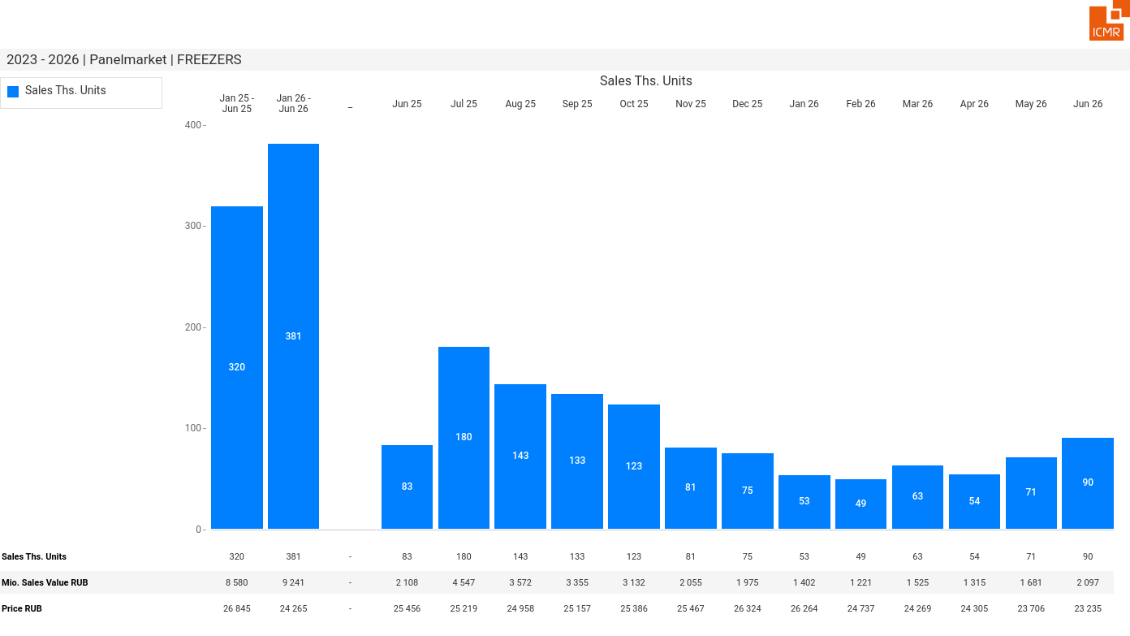
07/2026 PRJ 26fc7bc0 - TMPL 11b030d1 - FRM 78efef62 - ID 1

Slide 2
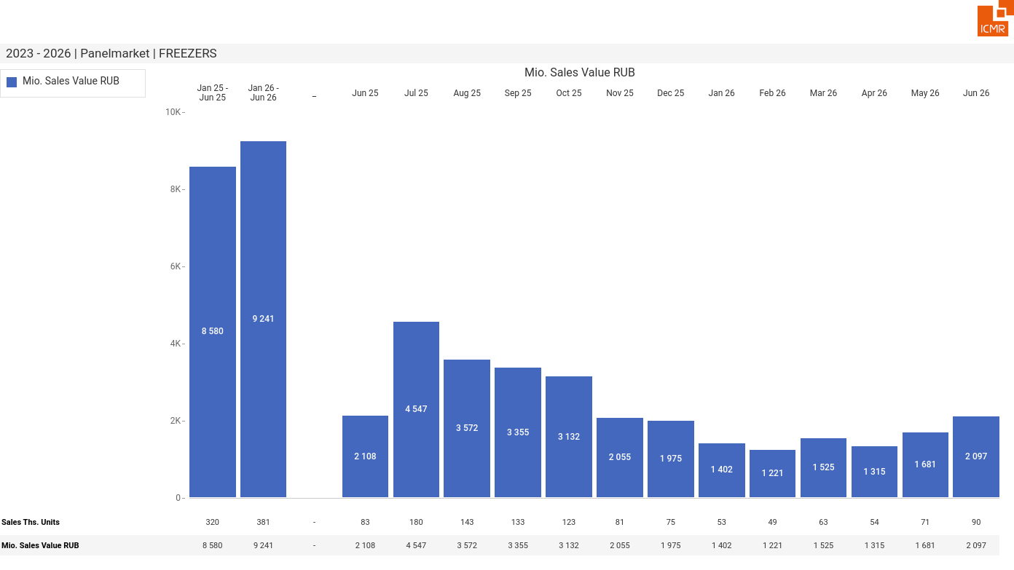
07/2026 PRJ 26fc7bc0 - TMPL 11b030d1 - FRM 08dcd8d3 - ID 2

Slide 3
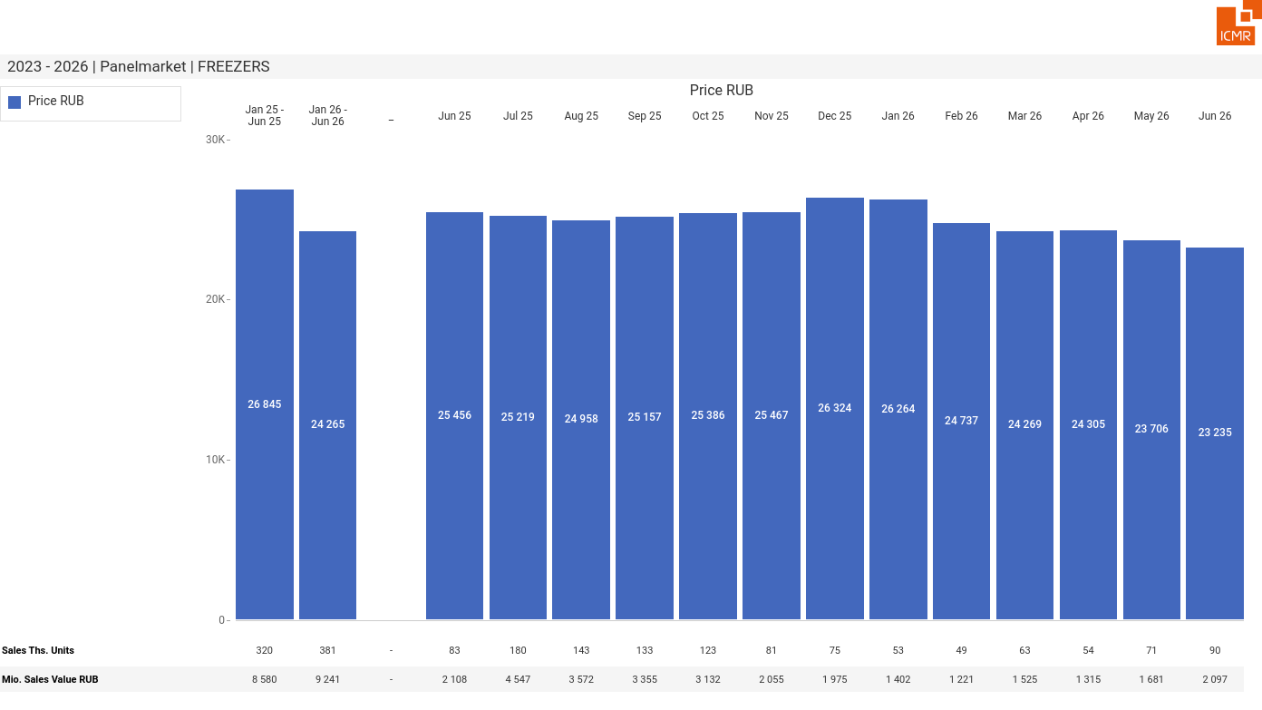
07/2026 PRJ 26fc7bc0 - TMPL 11b030d1 - FRM d9178bc9 - ID 3

Slide 4
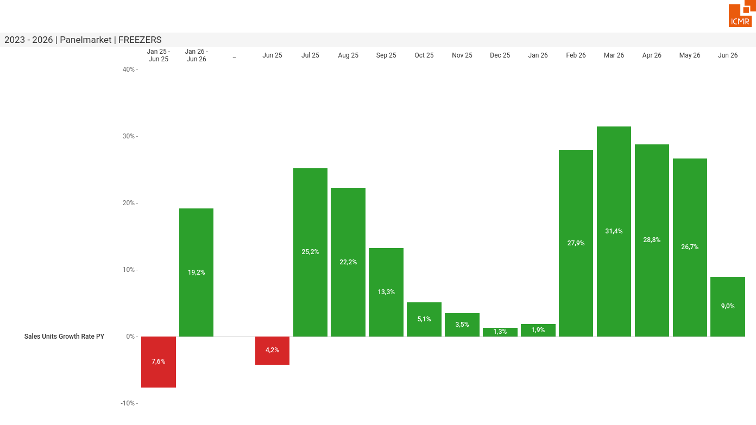
07/2026 PRJ 26fc7bc0 - TMPL 11b030d1 - FRM 79e8797f - ID 4

Slide 5
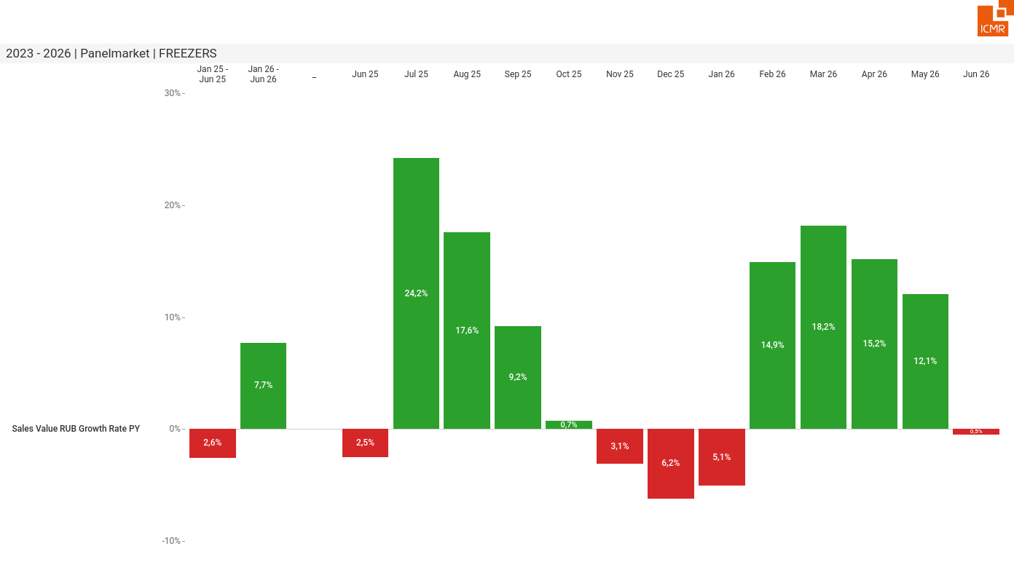
07/2026 PRJ 26fc7bc0 - TMPL 11b030d1 - FRM e219cefa - ID 5

Slide 6
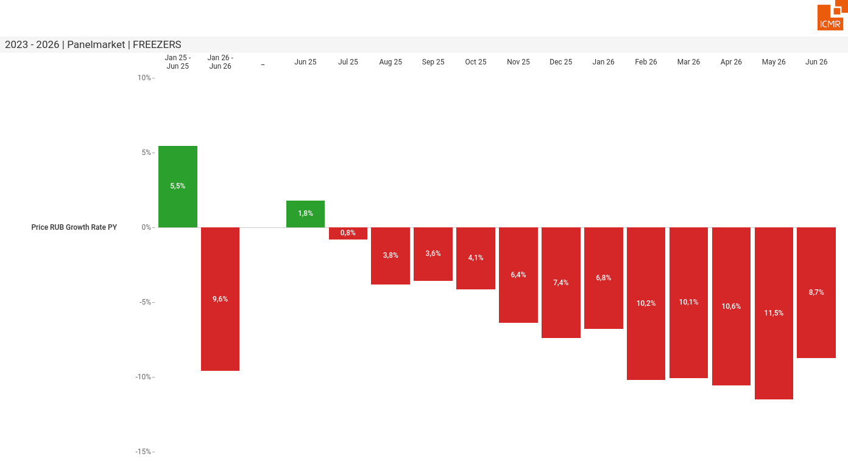
07/2026 PRJ 26fc7bc0 - TMPL 11b030d1 - FRM e8888c1b - ID 6

Slide 7
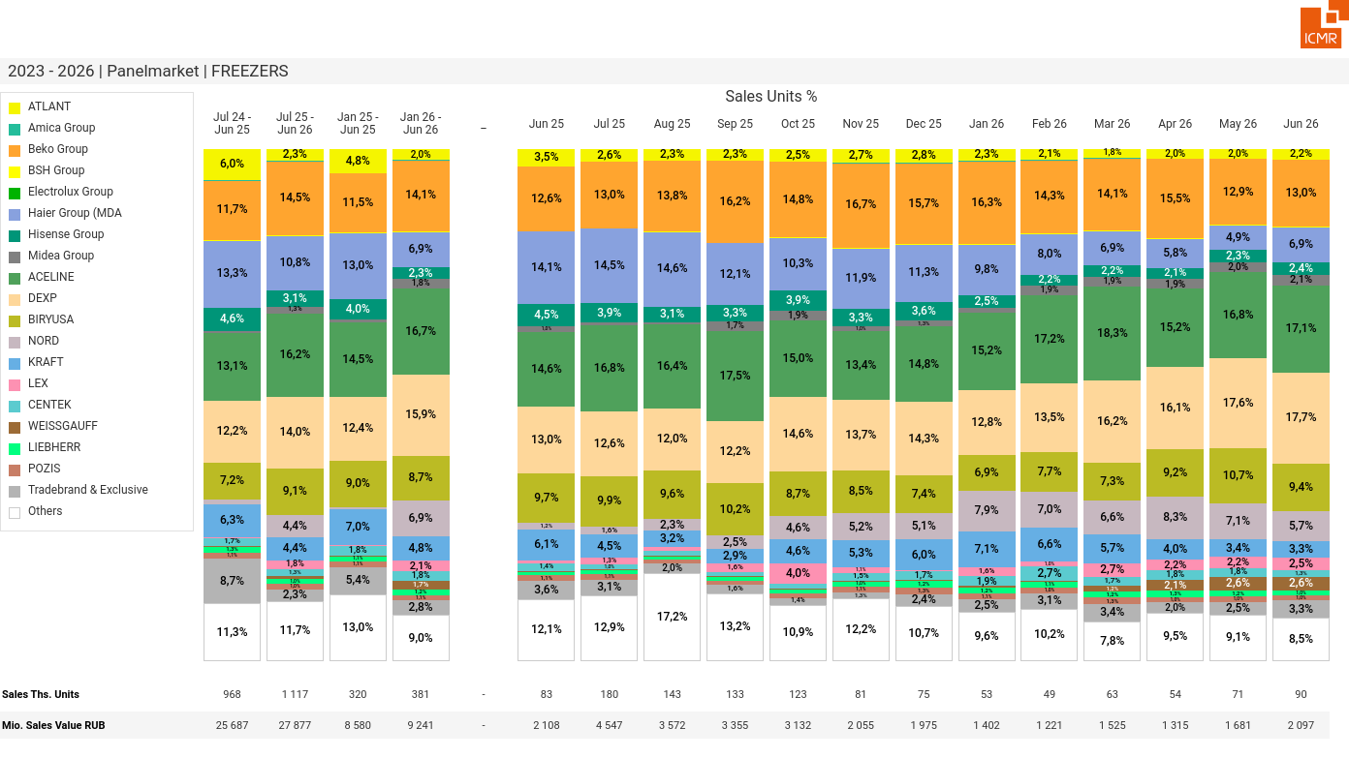
07/2026 PRJ 26fc7bc0 - TMPL 11b030d1 - FRM 89642b16 - ID 7

Slide 8
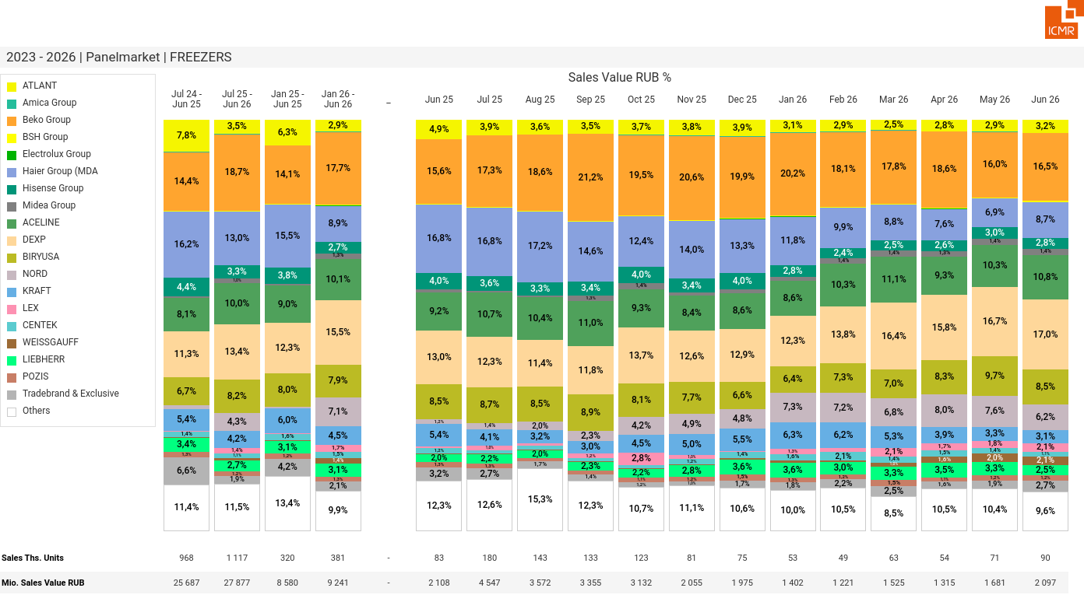
07/2026 PRJ 26fc7bc0 - TMPL 11b030d1 - FRM 0acdee83 - ID 8

Slide 9
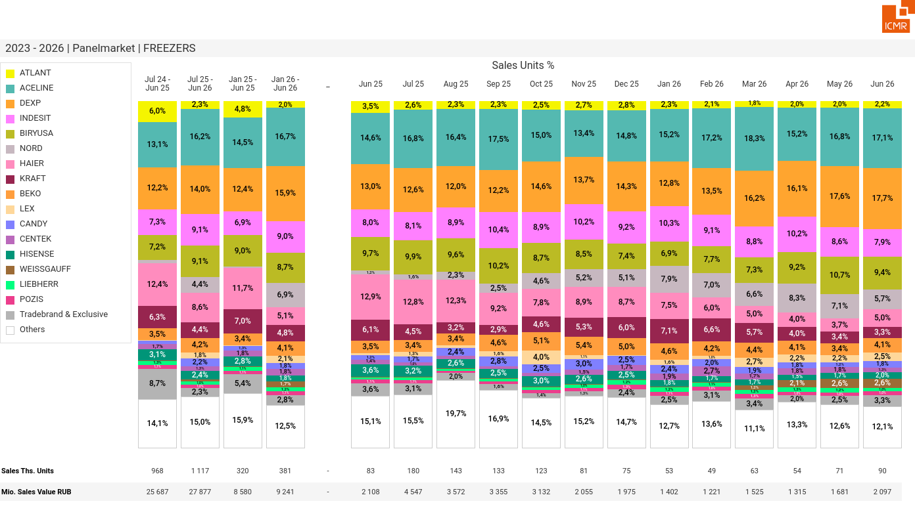
07/2026 PRJ 26fc7bc0 - TMPL 11b030d1 - FRM 41d0d989 - ID 9

Slide 10
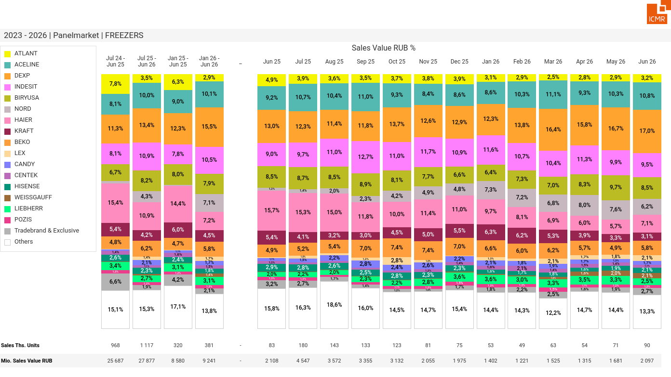
07/2026 PRJ 26fc7bc0 - TMPL 11b030d1 - FRM daa42b8c - ID 10

Slide 11
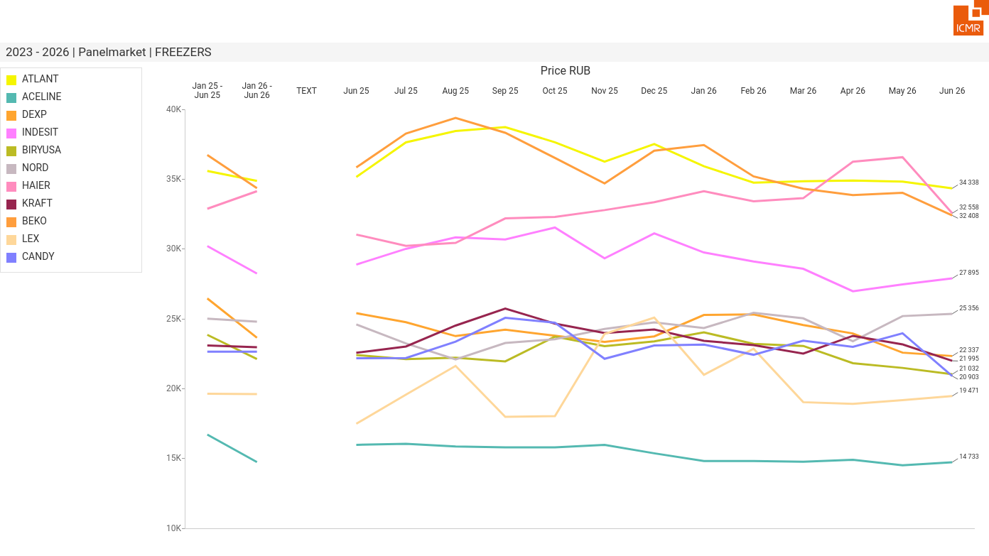
07/2026 PRJ 26fc7bc0 - TMPL 11b030d1 - FRM 2666c950 - ID 11

Slide 12
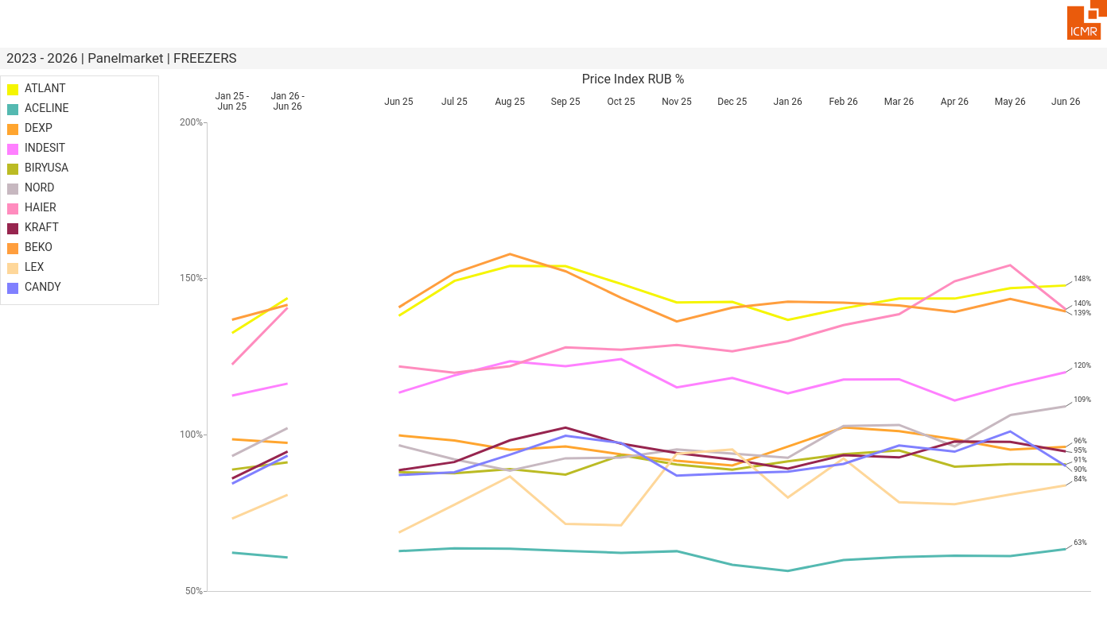
07/2026 PRJ 26fc7bc0 - TMPL 11b030d1 - FRM 8f5ca0e5 - ID 12

Slide 13
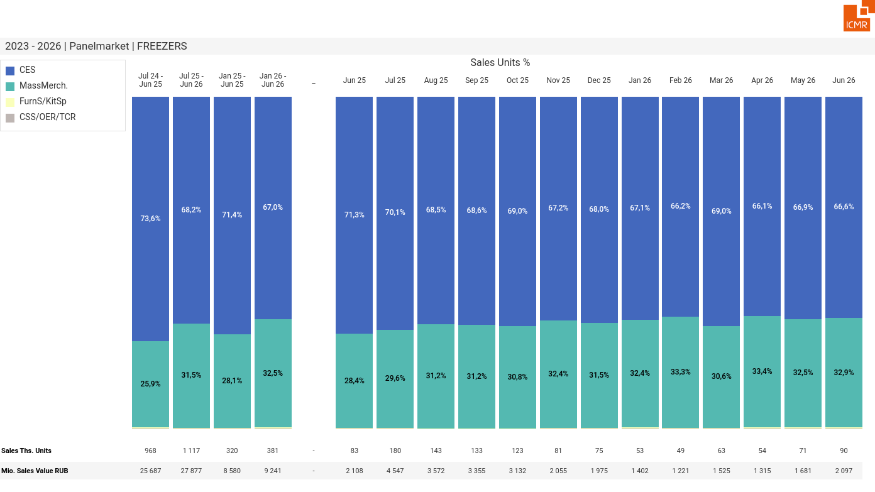
07/2026 PRJ 26fc7bc0 - TMPL 11b030d1 - FRM dfaf6960 - ID 13

Slide 14

07/2026 PRJ 26fc7bc0 - TMPL 11b030d1 - FRM 9b79d46f - ID 14

Slide 15
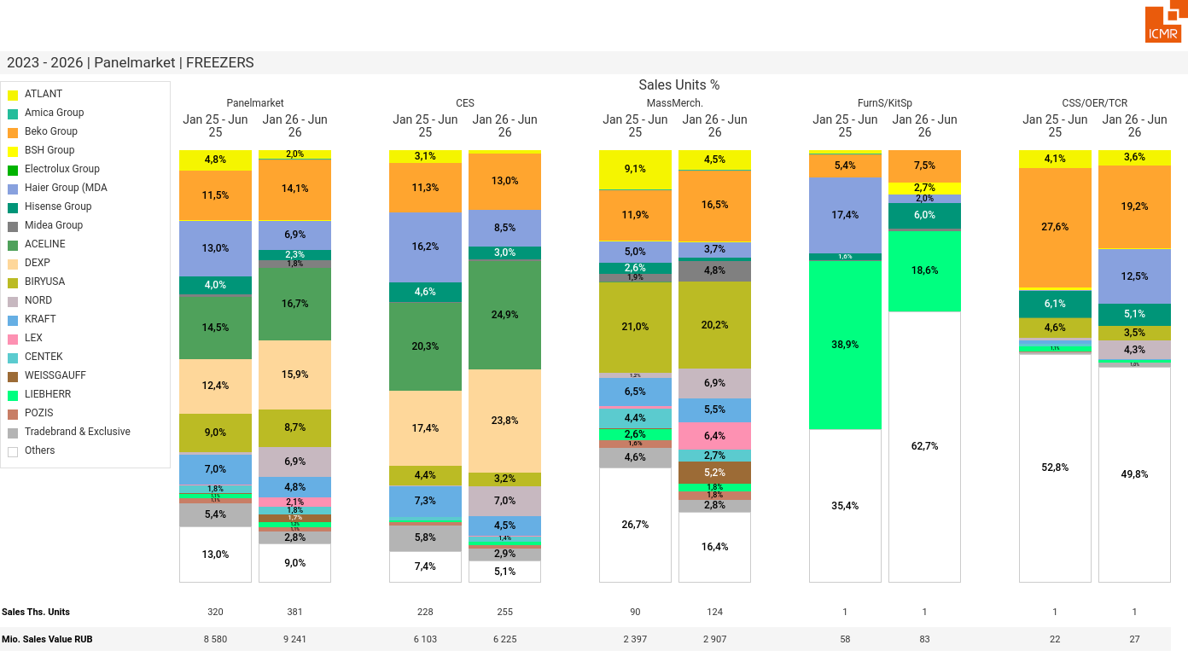
07/2026 PRJ 26fc7bc0 - TMPL 11b030d1 - FRM 2efc8f4c - ID 15

Slide 16
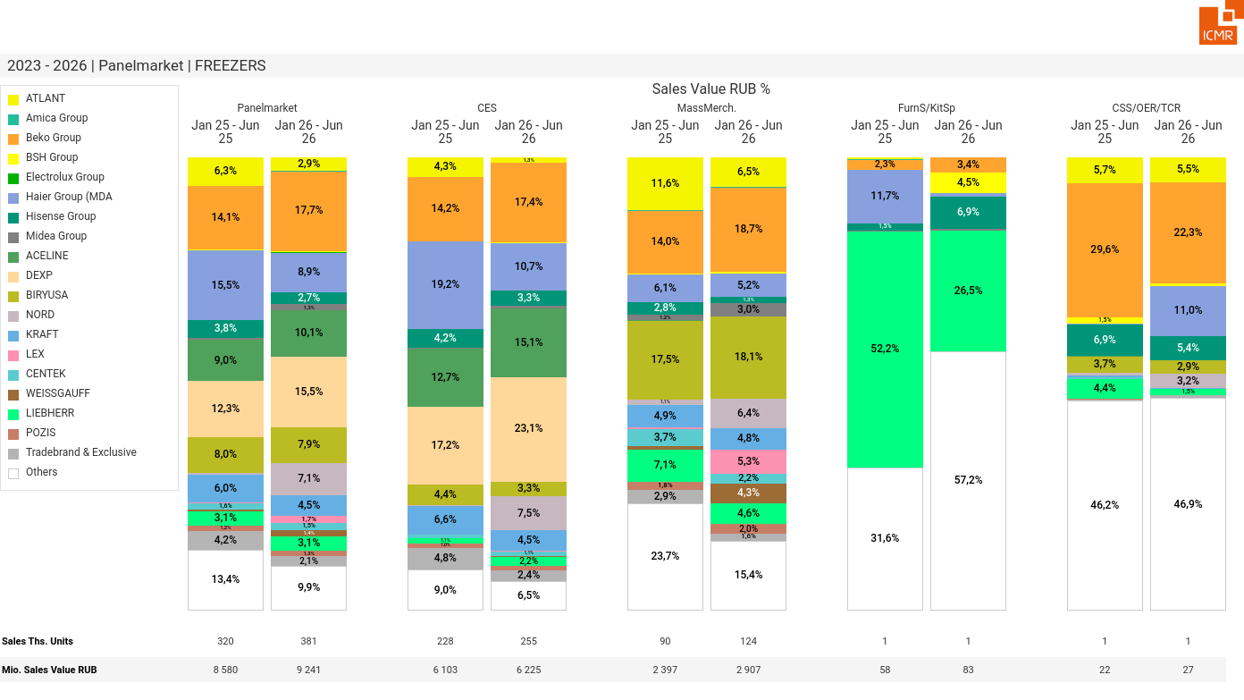
07/2026 PRJ 26fc7bc0 - TMPL 11b030d1 - FRM f97fb718 - ID 16

Slide 17
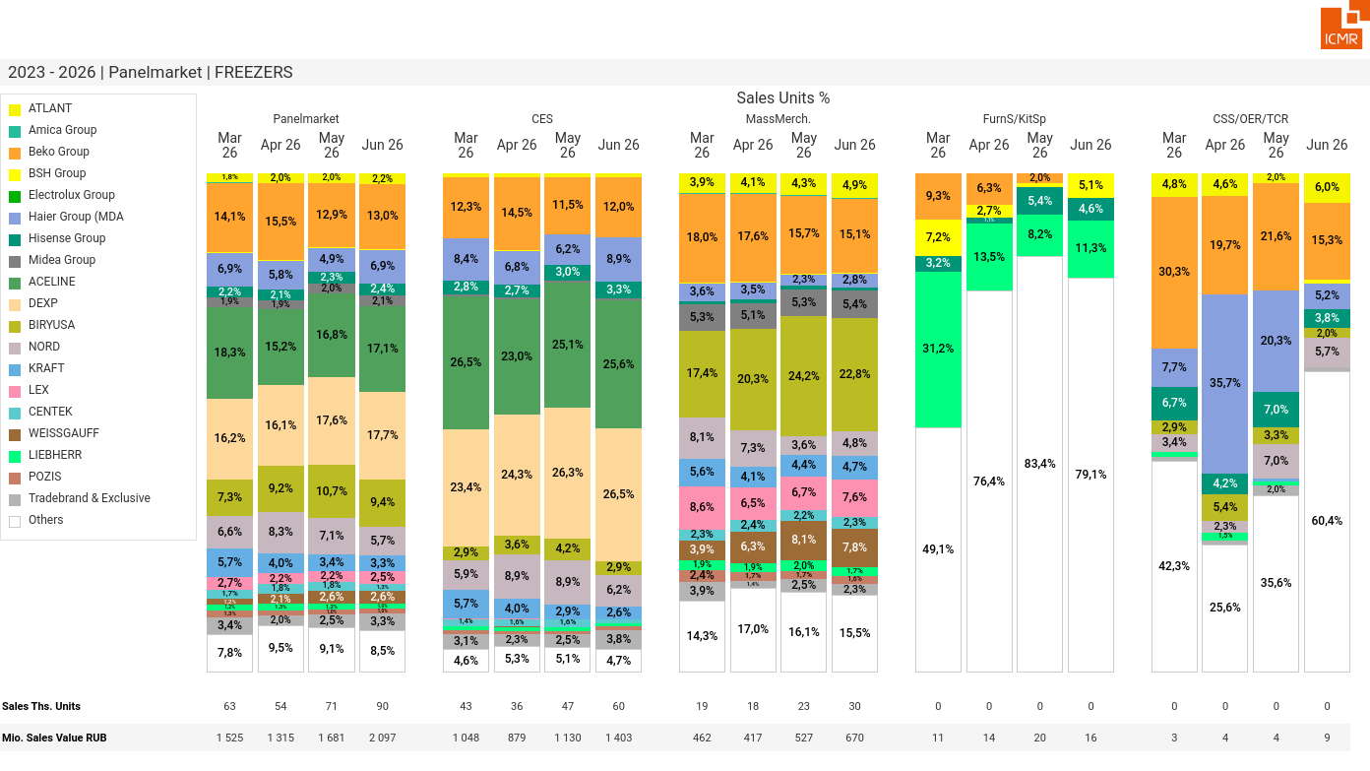
07/2026 PRJ 26fc7bc0 - TMPL 11b030d1 - FRM ddc25200 - ID 17

Slide 18
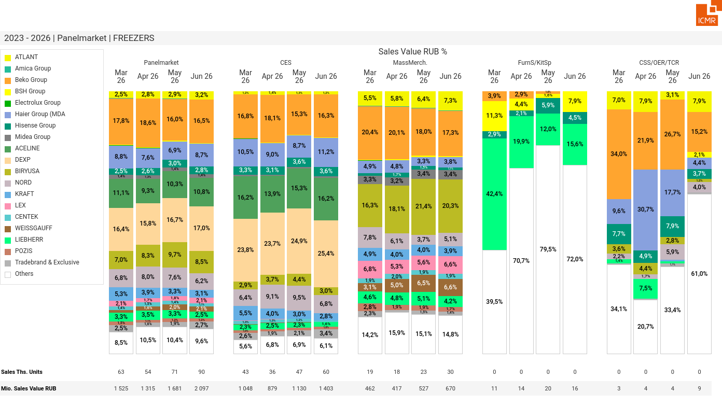
07/2026 PRJ 26fc7bc0 - TMPL 11b030d1 - FRM 31e6e5a7 - ID 18

Slide 19
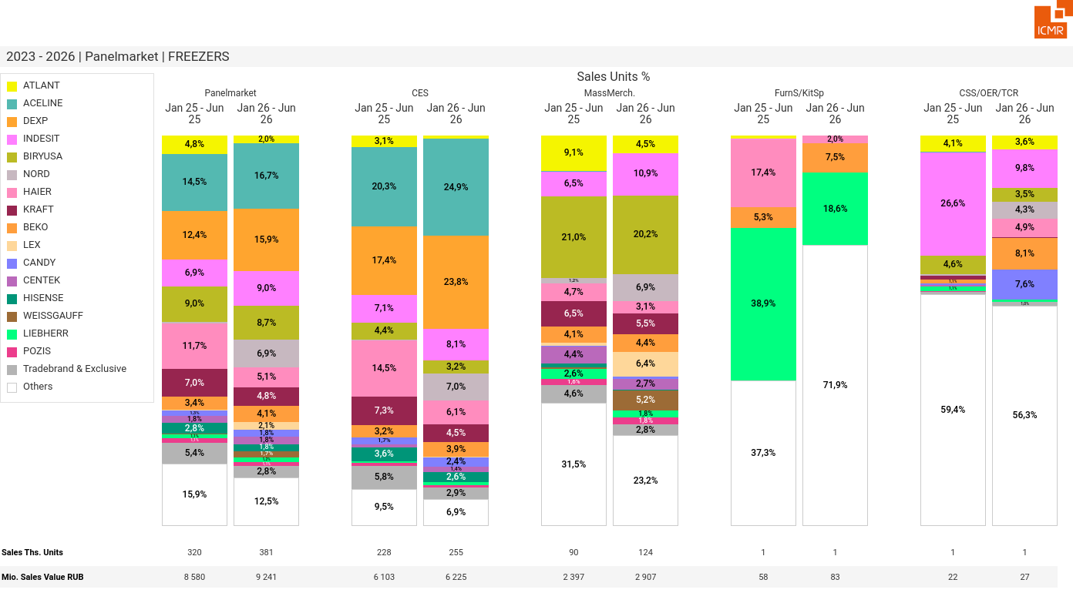
07/2026 PRJ 26fc7bc0 - TMPL 11b030d1 - FRM 16bf4f17 - ID 19

Slide 20
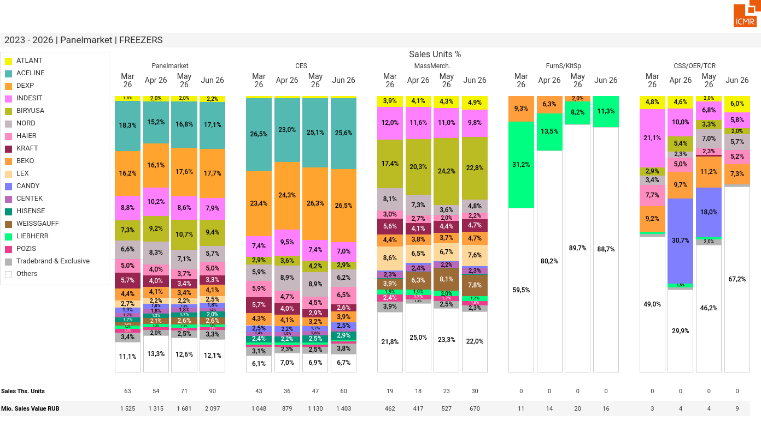
07/2026 PRJ 26fc7bc0 - TMPL 11b030d1 - FRM ad6be4b7 - ID 20

Slide 21
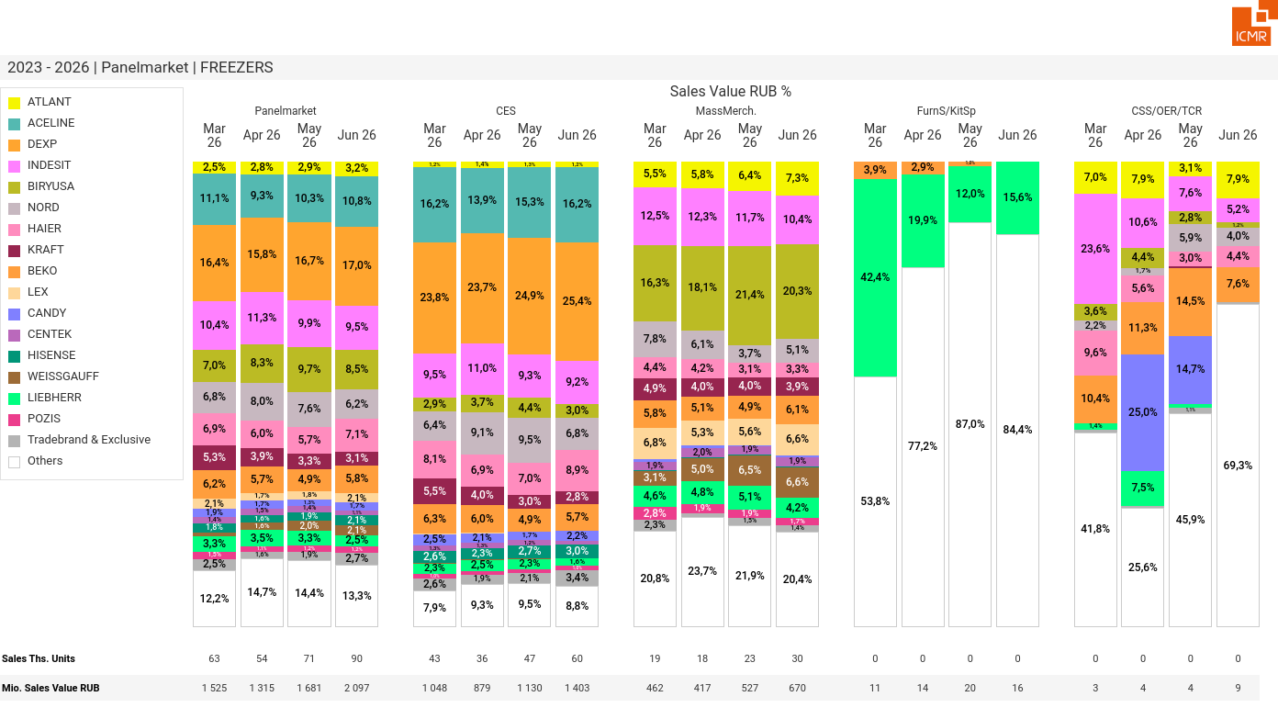
07/2026 PRJ 26fc7bc0 - TMPL 11b030d1 - FRM e6f7c7d8 - ID 21

Slide 22
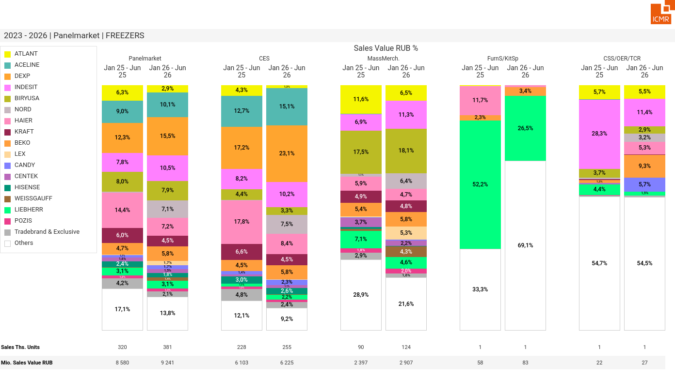
07/2026 PRJ 26fc7bc0 - TMPL 11b030d1 - FRM 73076191 - ID 22

Slide 23
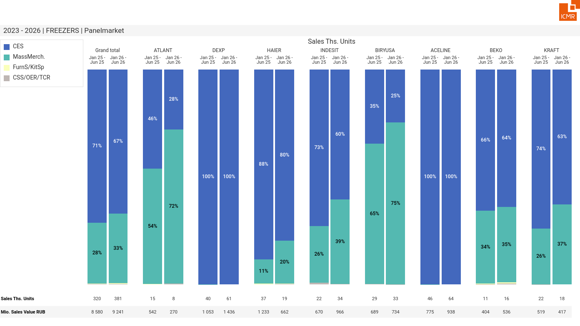
07/2026 PRJ 26fc7bc0 - TMPL 11b030d1 - FRM ca16d931 - ID 23

Slide 24
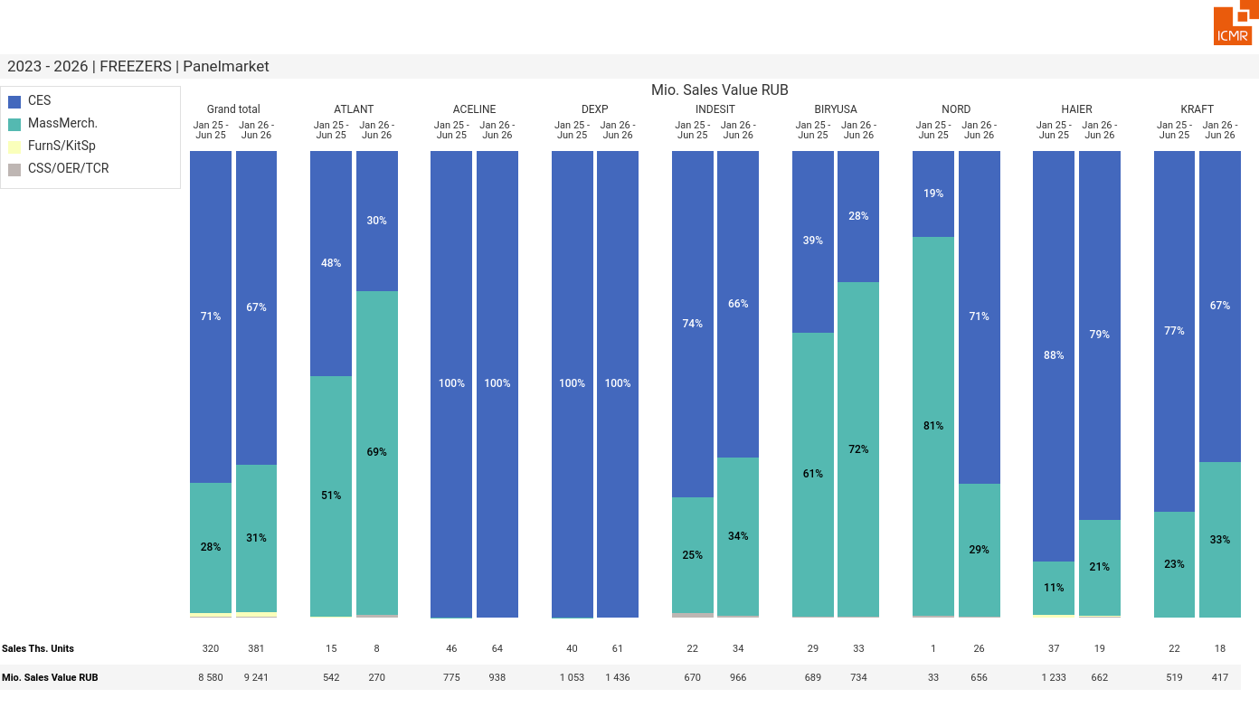
07/2026 PRJ 26fc7bc0 - TMPL 11b030d1 - FRM 781e44e6 - ID 24

Slide 25
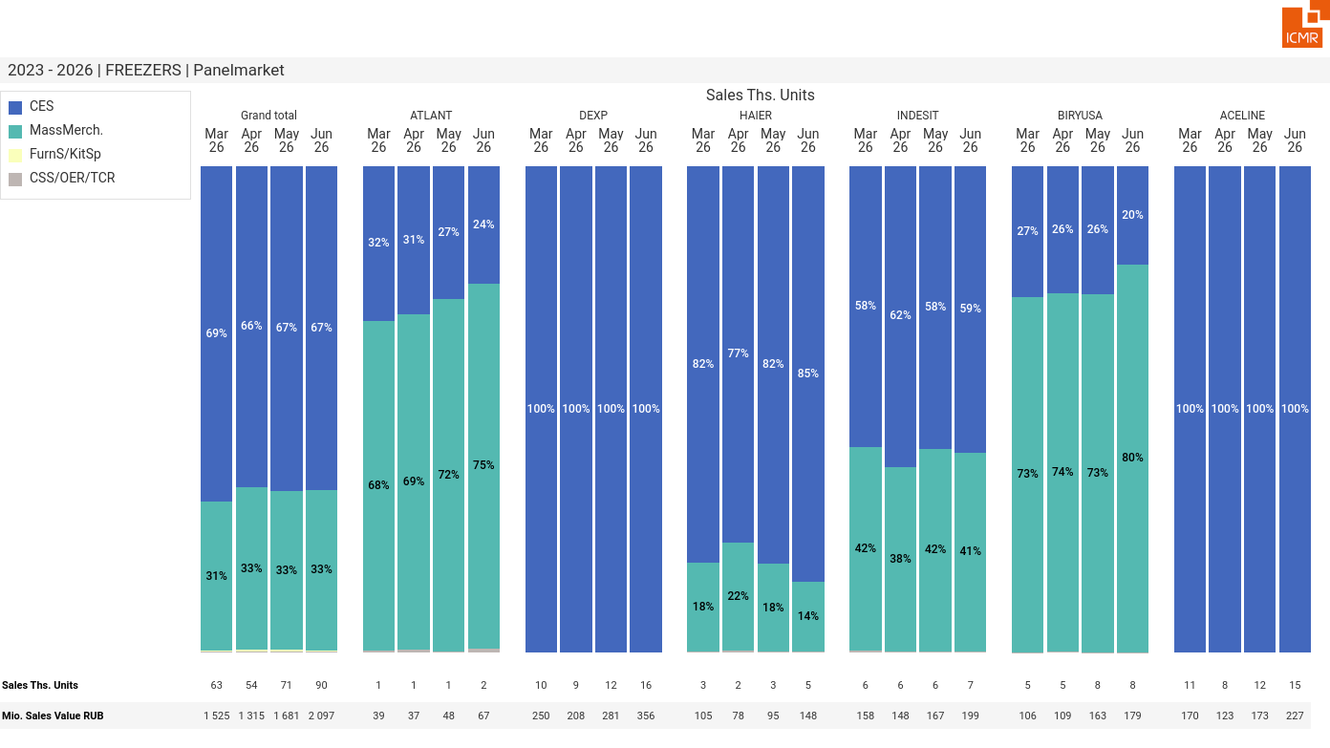
07/2026 PRJ 26fc7bc0 - TMPL 11b030d1 - FRM 47c491e0 - ID 25

Slide 26
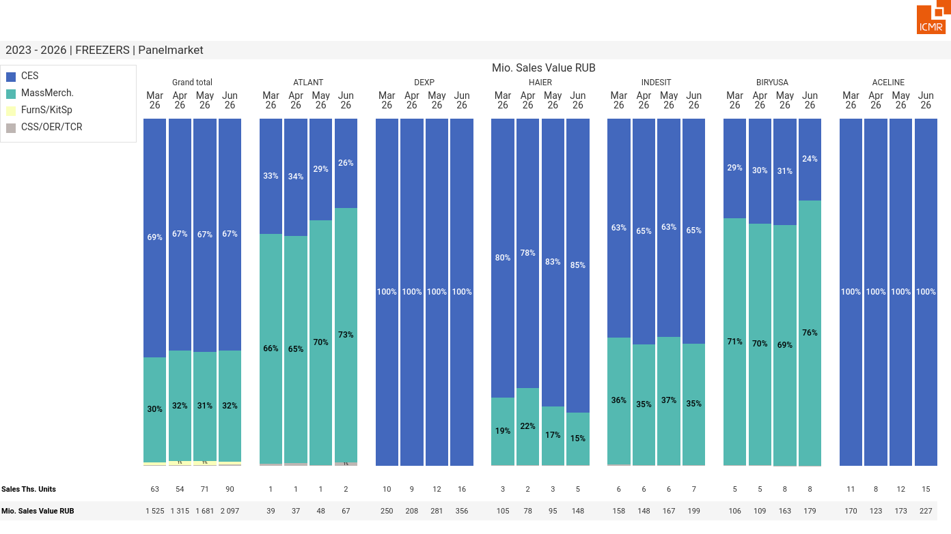
07/2026 PRJ 26fc7bc0 - TMPL 11b030d1 - FRM 0aac5996 - ID 26

Slide 27
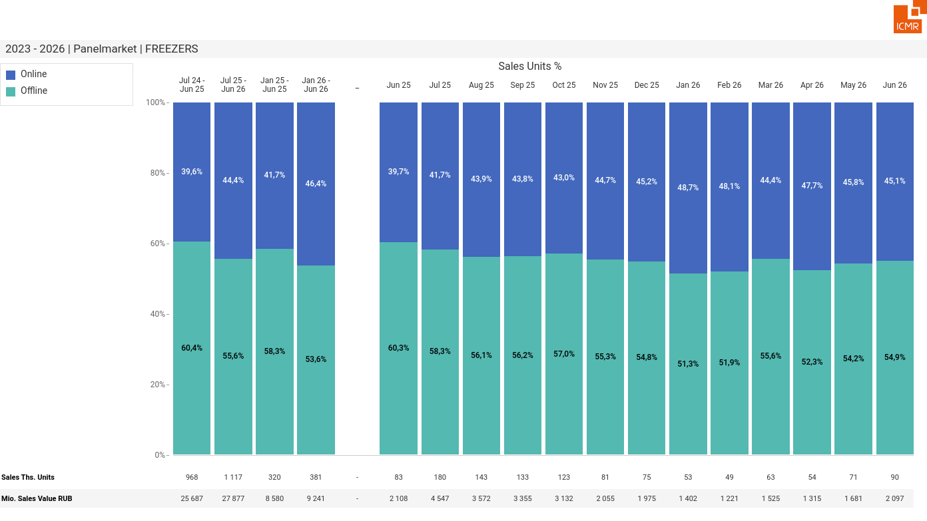
07/2026 PRJ 26fc7bc0 - TMPL 11b030d1 - FRM d7f8f9b9 - ID 27

Slide 28

07/2026 PRJ 26fc7bc0 - TMPL 11b030d1 - FRM 2b0c2cd2 - ID 28

Slide 29
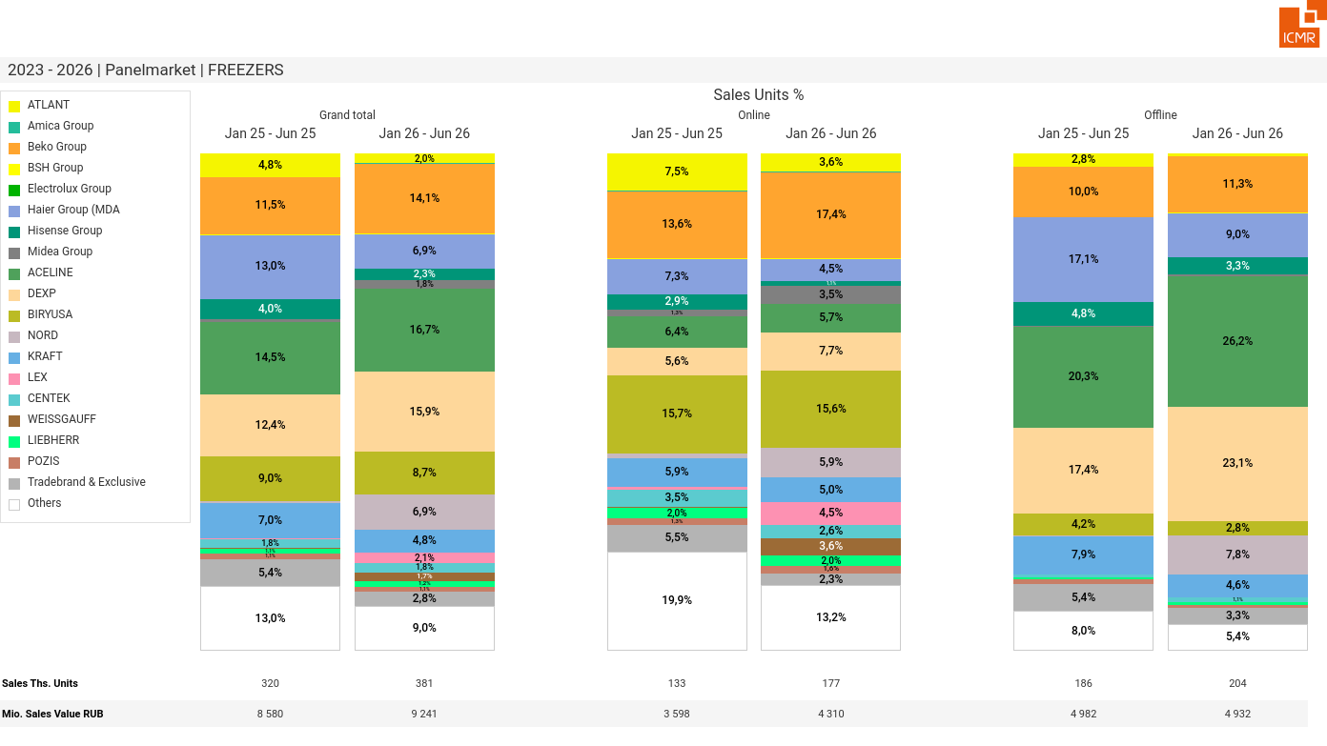
07/2026 PRJ 26fc7bc0 - TMPL 11b030d1 - FRM 93c70626 - ID 29

Slide 30
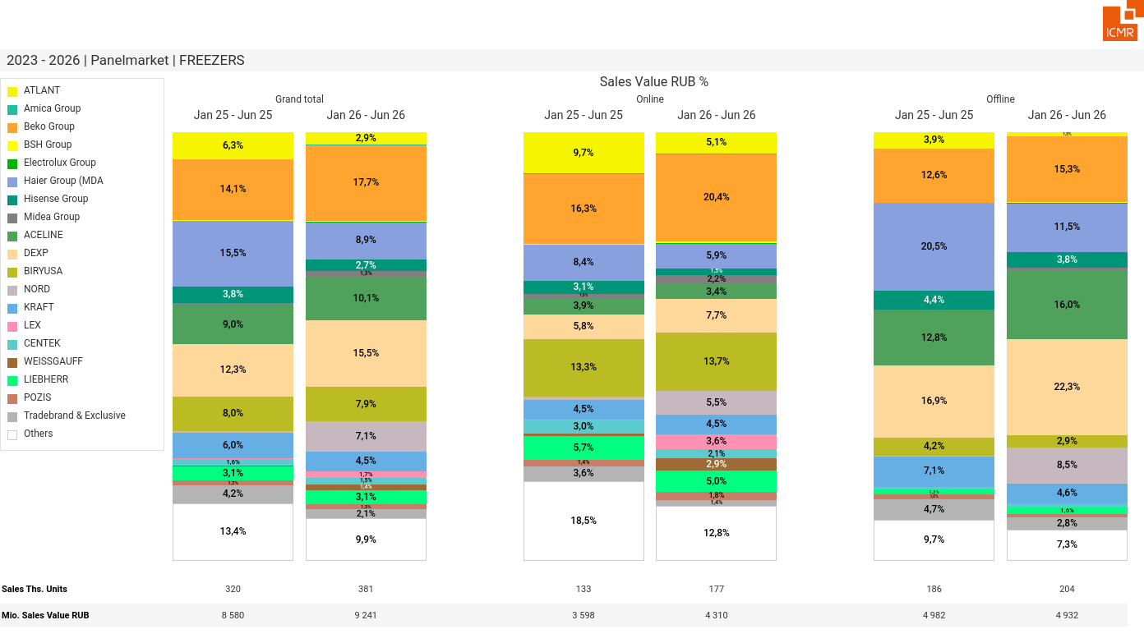
07/2026 PRJ 26fc7bc0 - TMPL 11b030d1 - FRM 8fc51eaa - ID 30

Slide 31
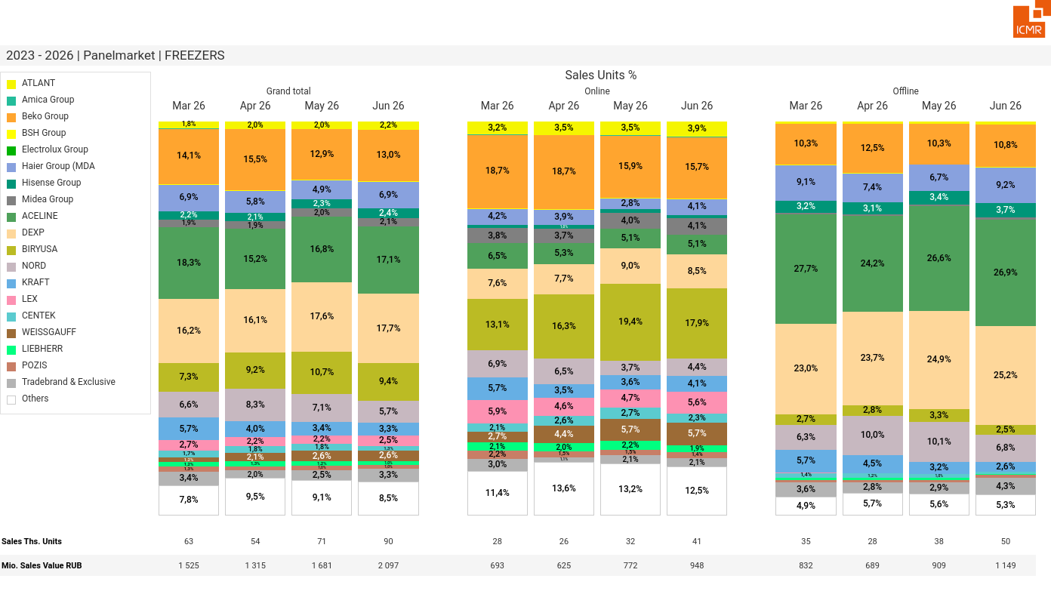
07/2026 PRJ 26fc7bc0 - TMPL 11b030d1 - FRM e69a1d92 - ID 31

Slide 32
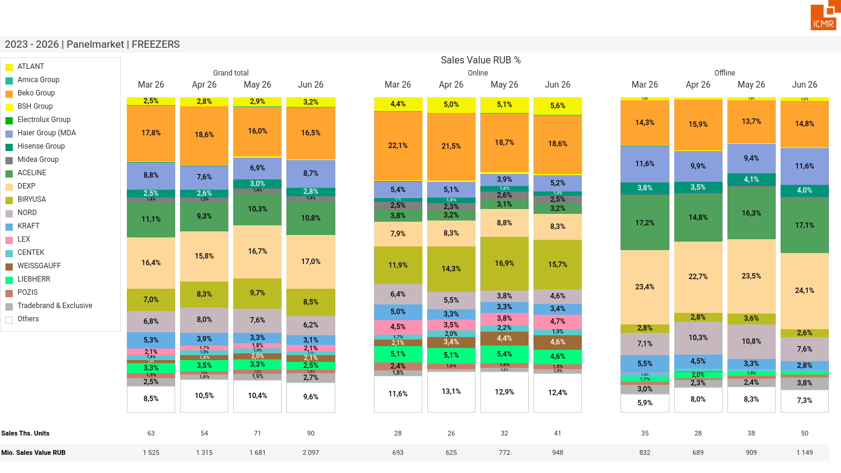
07/2026 PRJ 26fc7bc0 - TMPL 11b030d1 - FRM f4cb8af9 - ID 32

Slide 33
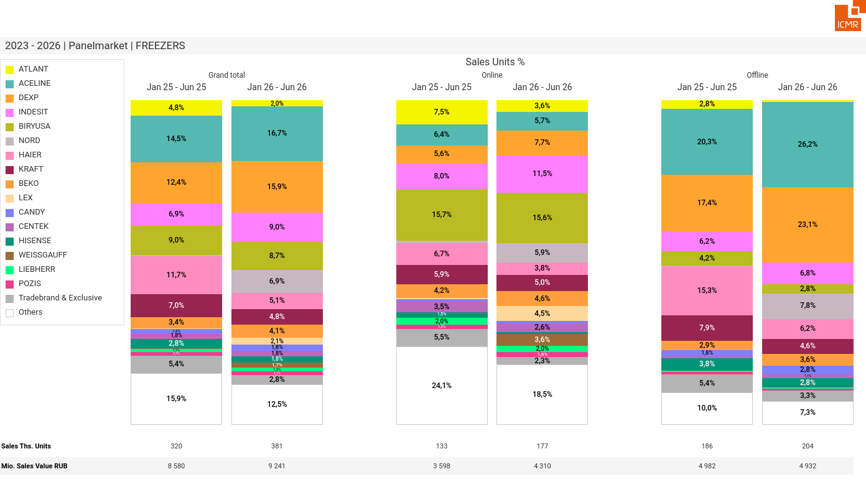
07/2026 PRJ 26fc7bc0 - TMPL 11b030d1 - FRM cc1e7c24 - ID 33

Slide 34
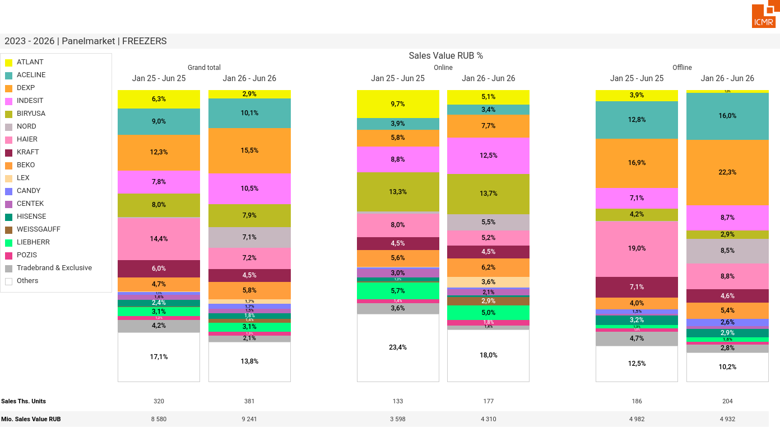
07/2026 PRJ 26fc7bc0 - TMPL 11b030d1 - FRM c1a6f54d - ID 34

Slide 35
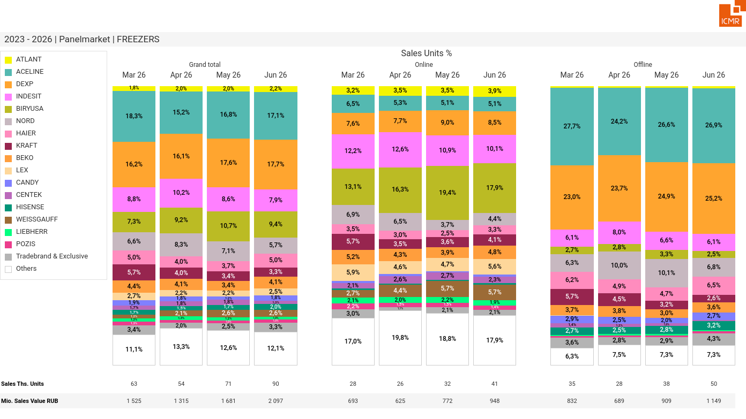
07/2026 PRJ 26fc7bc0 - TMPL 11b030d1 - FRM 0c257d78 - ID 35

Slide 36
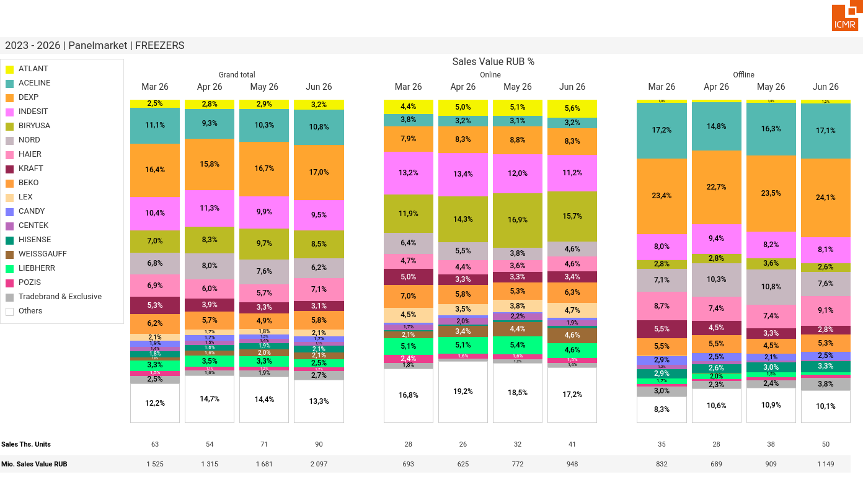
07/2026 PRJ 26fc7bc0 - TMPL 11b030d1 - FRM 96d2f641 - ID 36

Slide 37
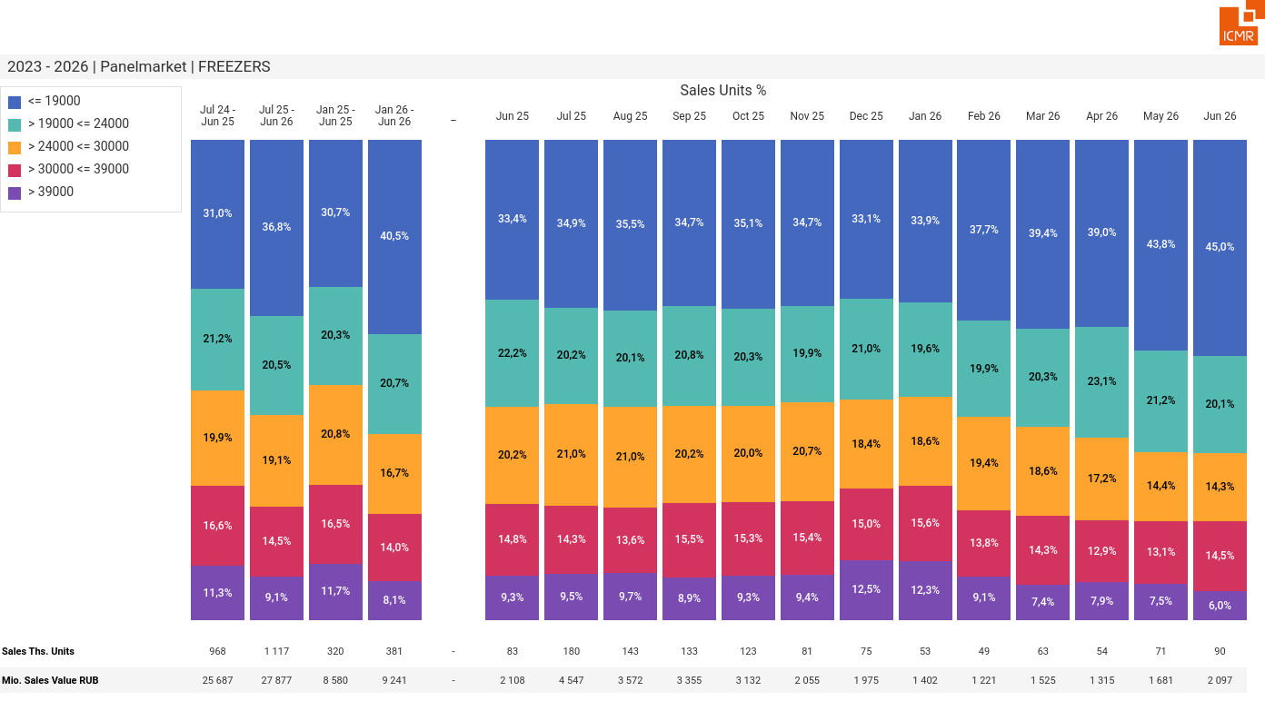
07/2026 PRJ 26fc7bc0 - TMPL 11b030d1 - FRM d190bf29 - ID 37

Slide 38
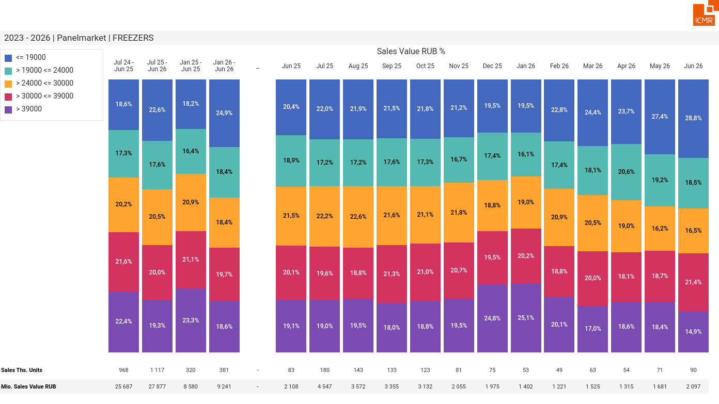
07/2026 PRJ 26fc7bc0 - TMPL 11b030d1 - FRM e60d76ad - ID 38

Slide 39
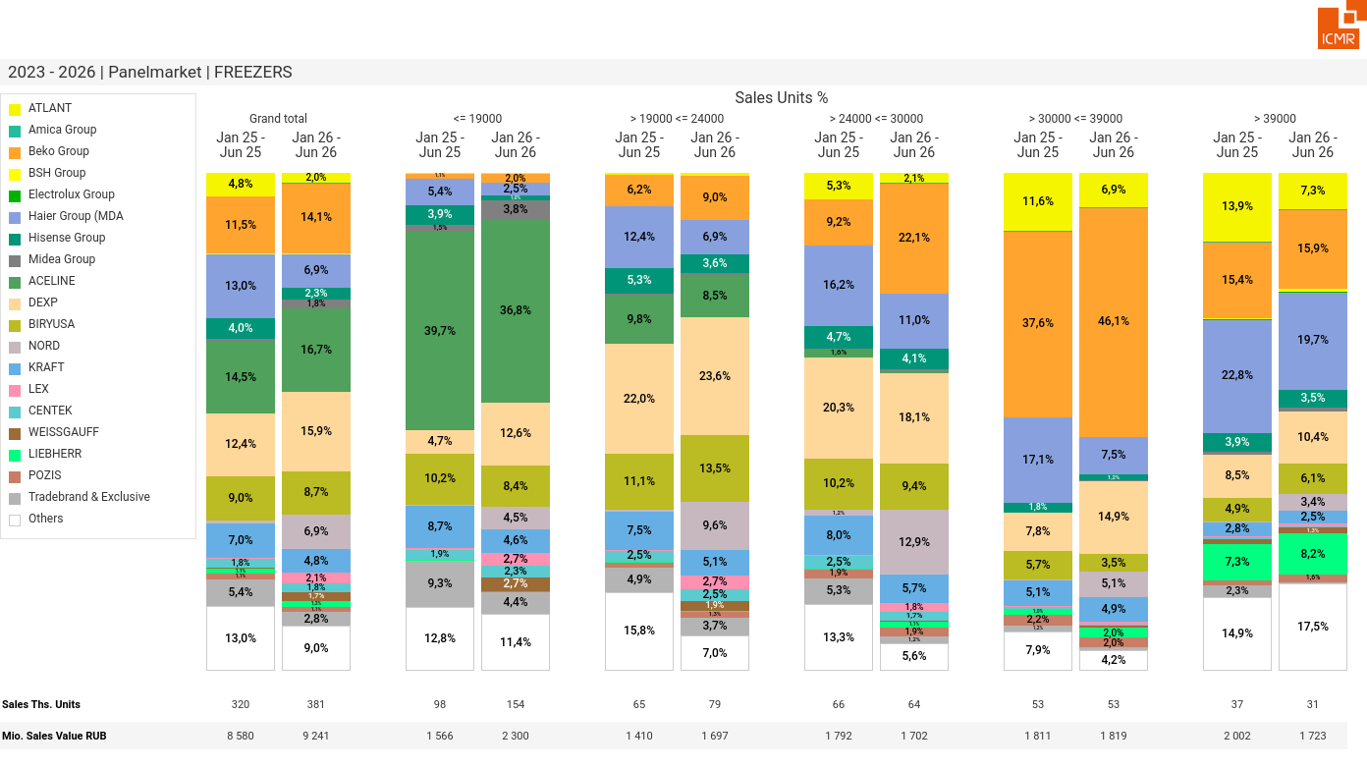
07/2026 PRJ 26fc7bc0 - TMPL 11b030d1 - FRM 7e1c90fa - ID 39

Slide 40
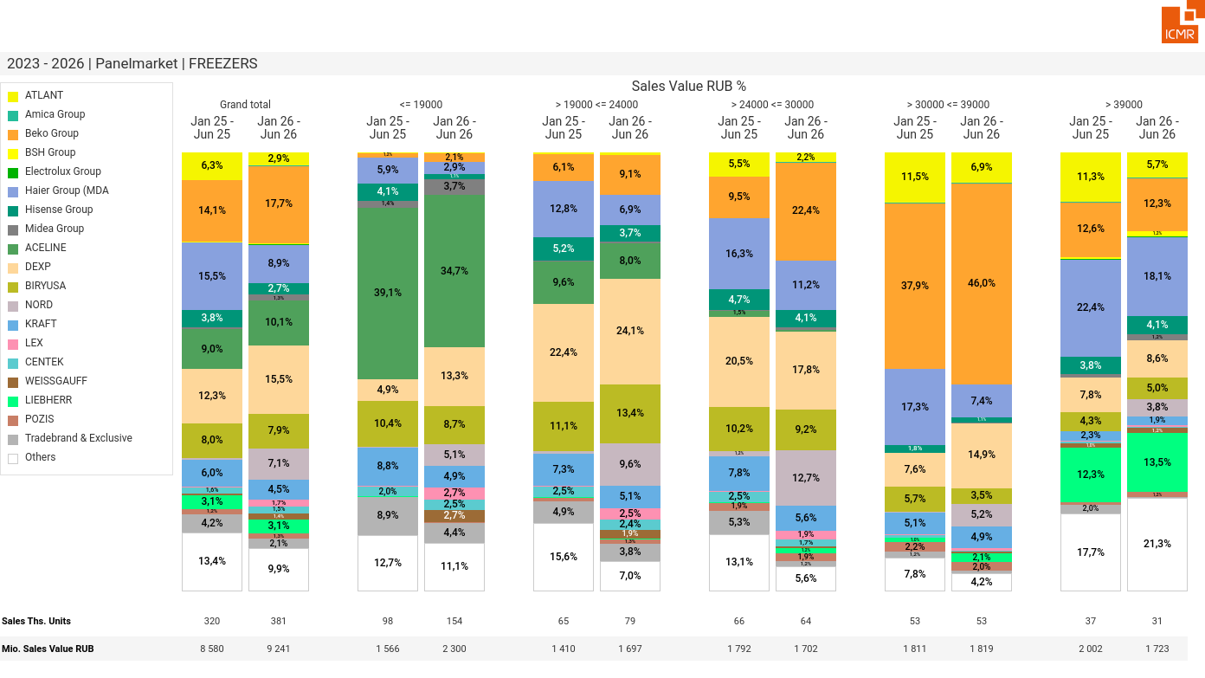
07/2026 PRJ 26fc7bc0 - TMPL 11b030d1 - FRM ef7bd4a9 - ID 40

Slide 41
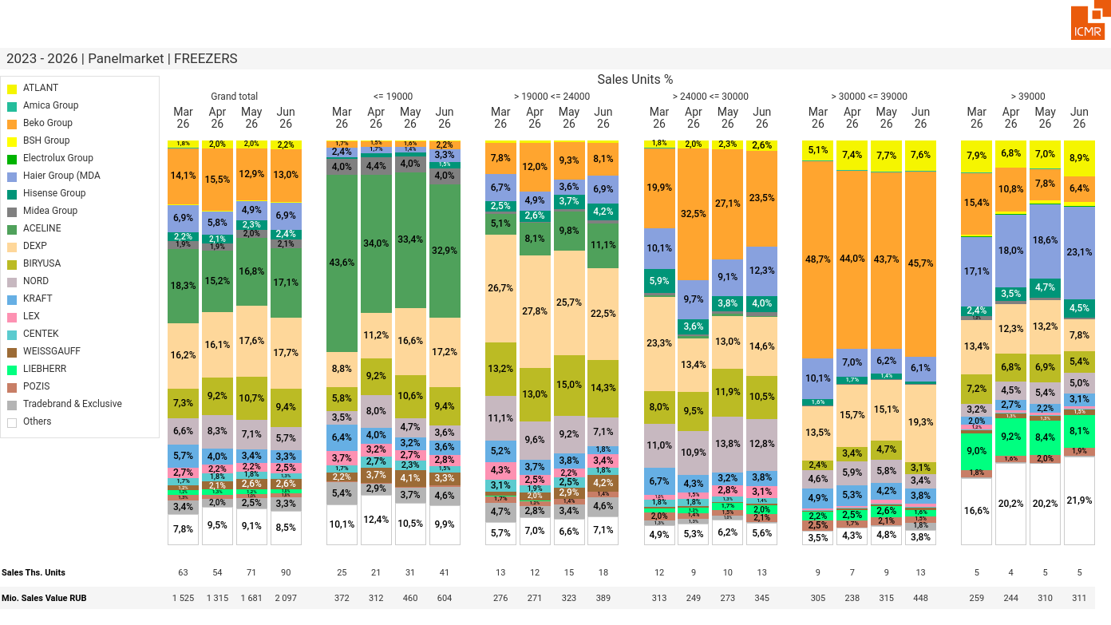
07/2026 PRJ 26fc7bc0 - TMPL 11b030d1 - FRM 44b751d7 - ID 41

Slide 42
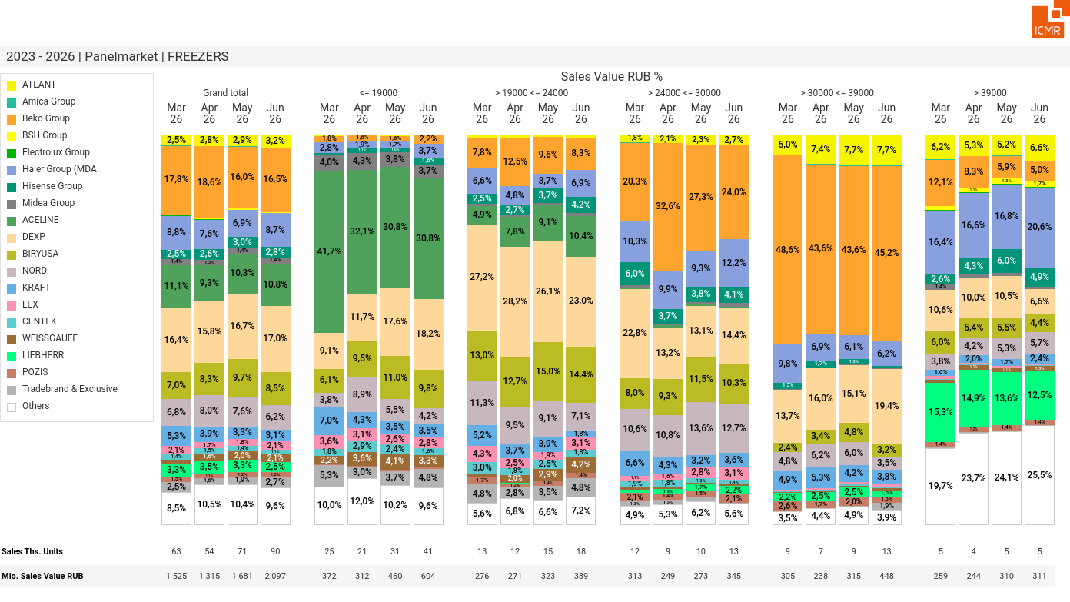
07/2026 PRJ 26fc7bc0 - TMPL 11b030d1 - FRM 32a17530 - ID 42

Slide 43
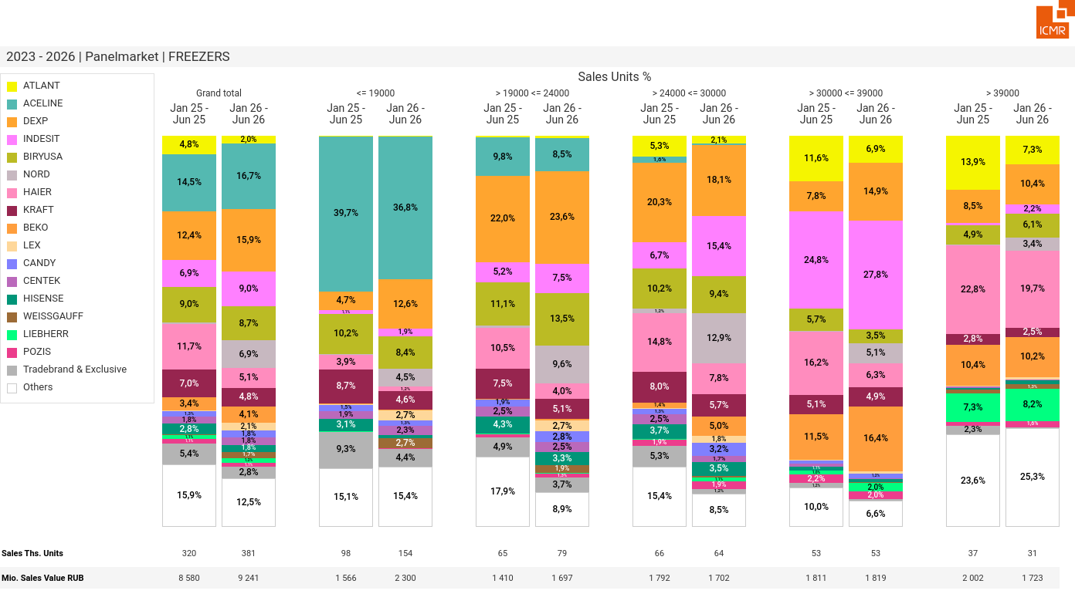
07/2026 PRJ 26fc7bc0 - TMPL 11b030d1 - FRM 63f28138 - ID 43

Slide 44
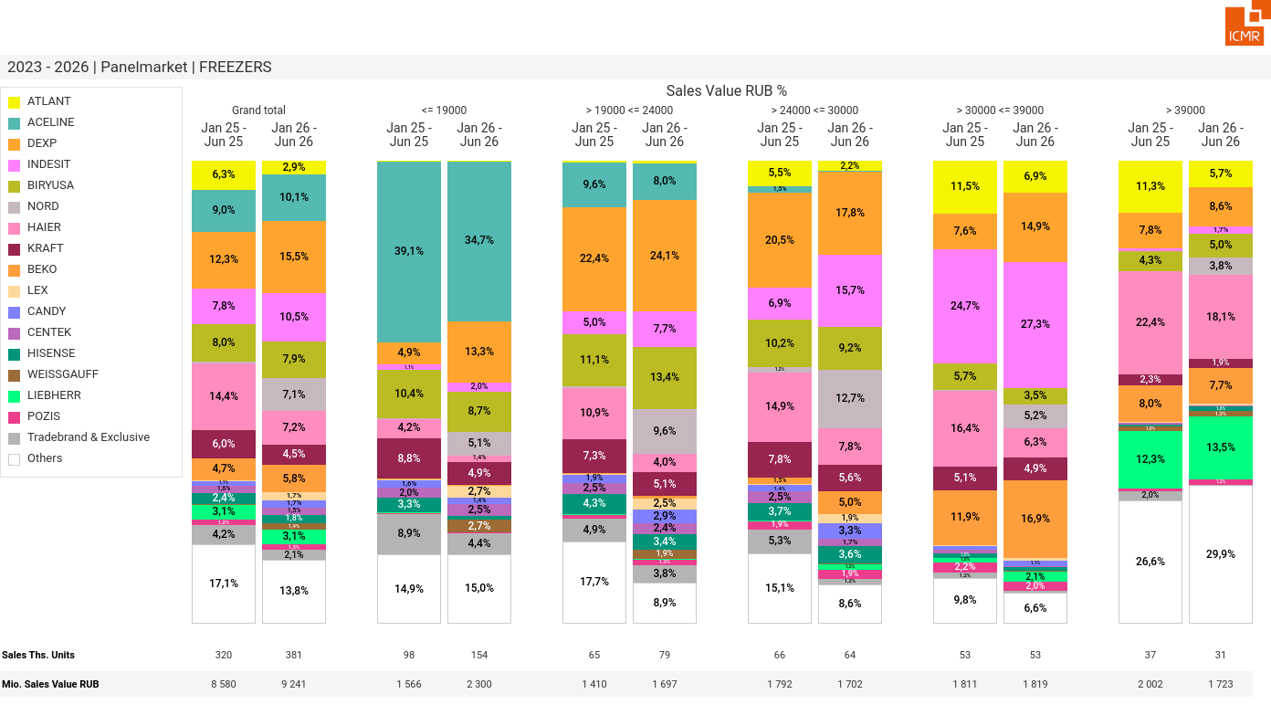
07/2026 PRJ 26fc7bc0 - TMPL 11b030d1 - FRM 62521842 - ID 44

Slide 45
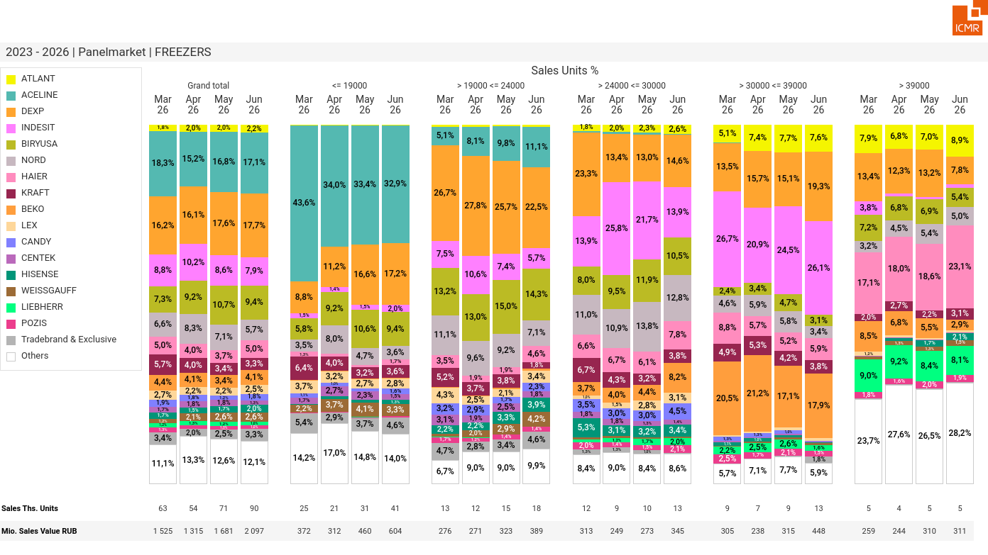
07/2026 PRJ 26fc7bc0 - TMPL 11b030d1 - FRM 1f3982fa - ID 45

Slide 46
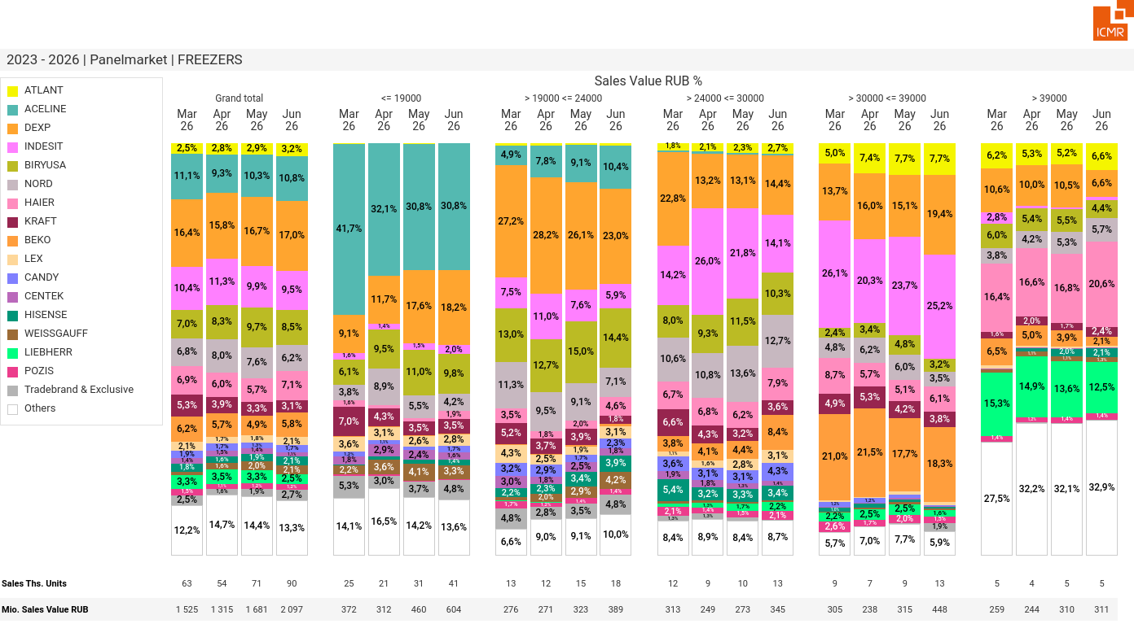
07/2026 PRJ 26fc7bc0 - TMPL 11b030d1 - FRM 3b73d099 - ID 46

Slide 47
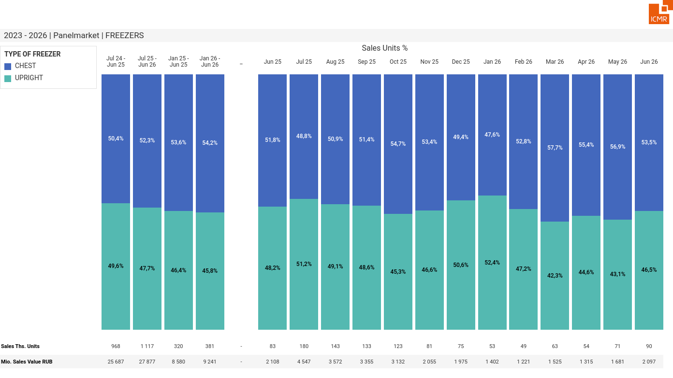
07/2026 PRJ 26fc7bc0 - TMPL 11b030d1 - FRM 3bb4c236 - ID 47

Slide 48
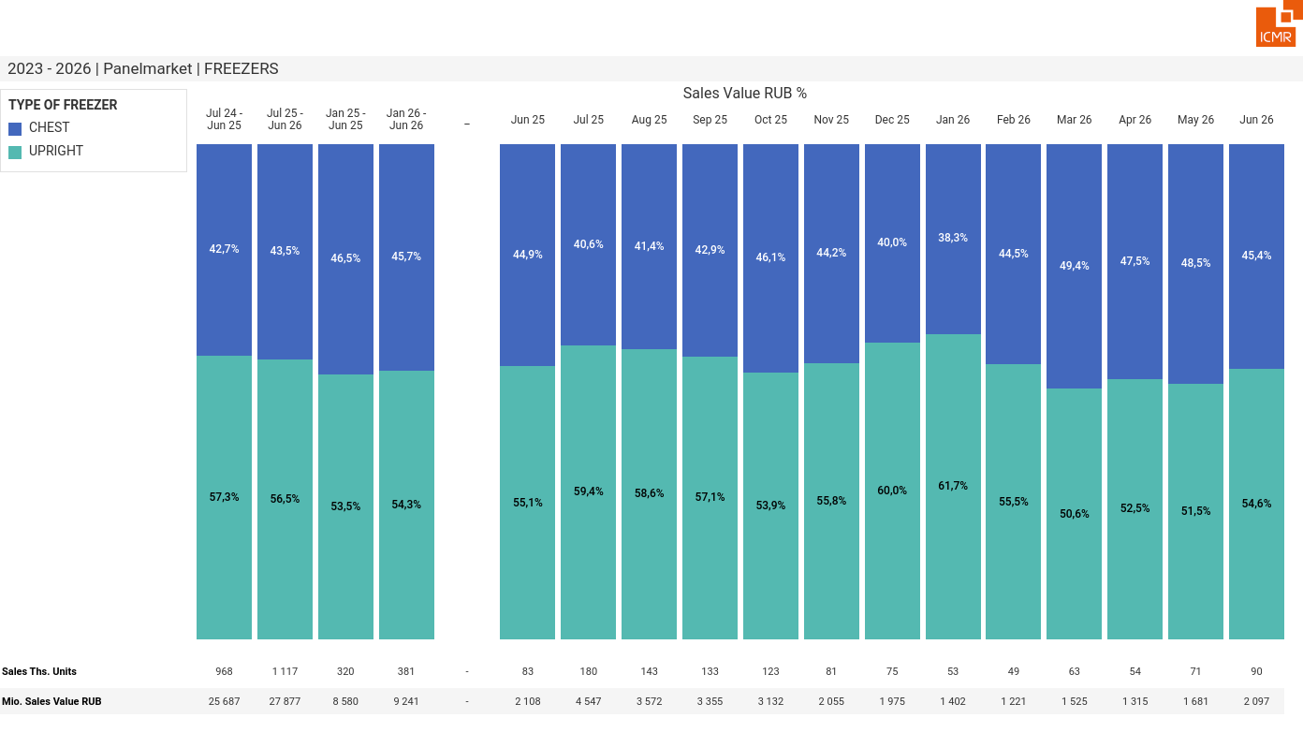
07/2026 PRJ 26fc7bc0 - TMPL 11b030d1 - FRM 719ffe8c - ID 48

Slide 49
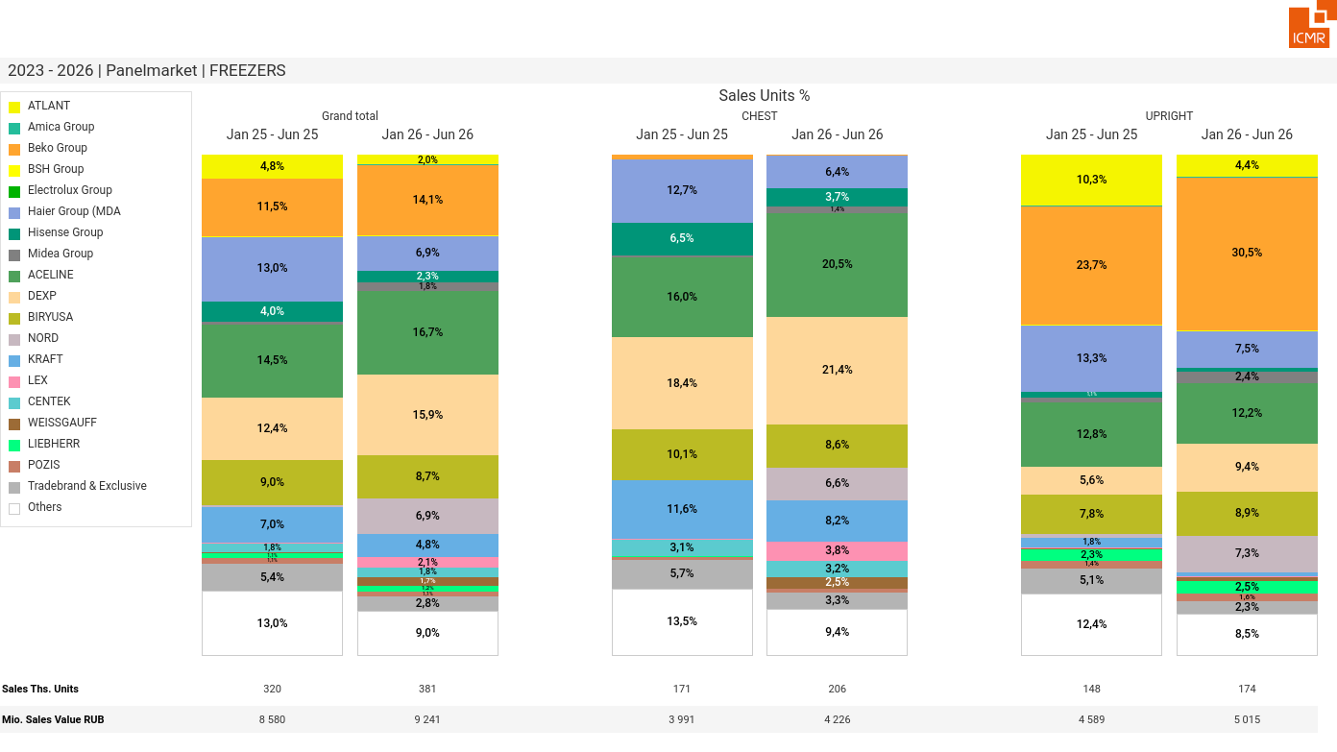
07/2026 PRJ 26fc7bc0 - TMPL 11b030d1 - FRM e7f3723b - ID 49

Slide 50
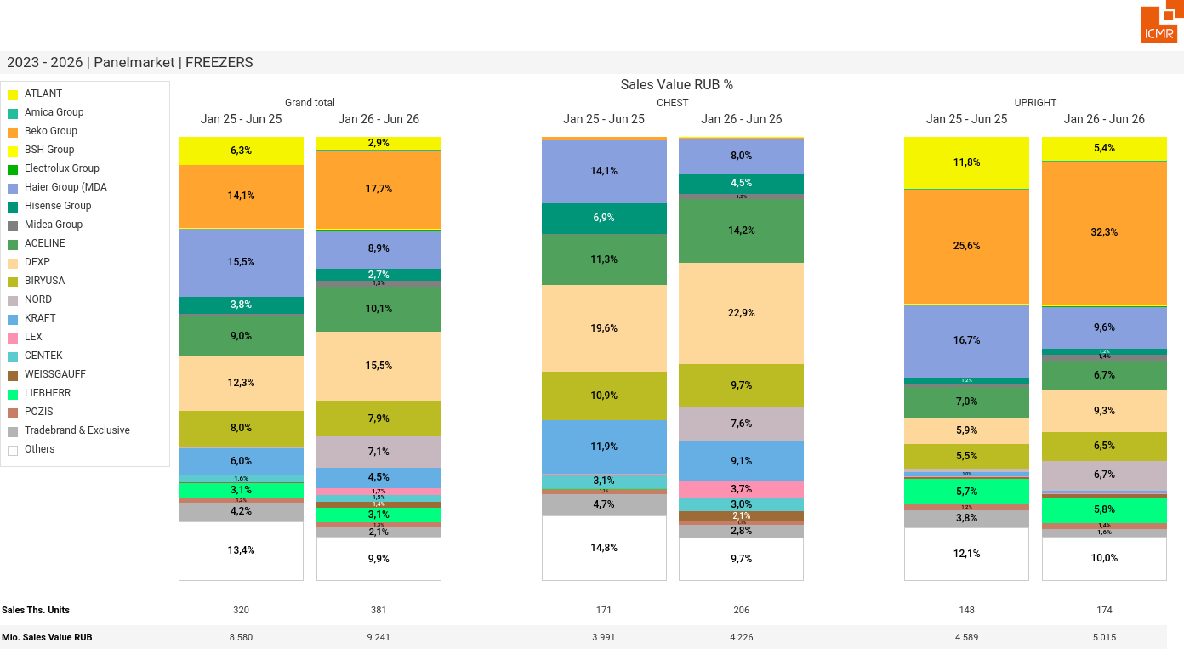
07/2026 PRJ 26fc7bc0 - TMPL 11b030d1 - FRM e356587c - ID 50

Slide 51
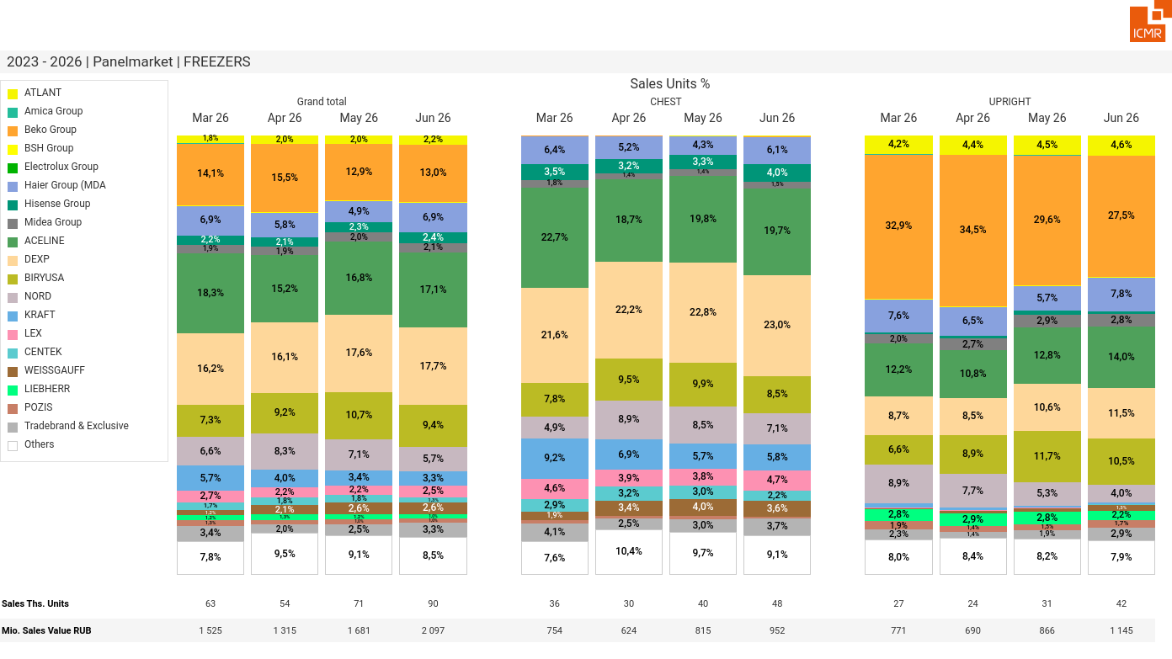
07/2026 PRJ 26fc7bc0 - TMPL 11b030d1 - FRM 1c7bb8b1 - ID 51

Slide 52
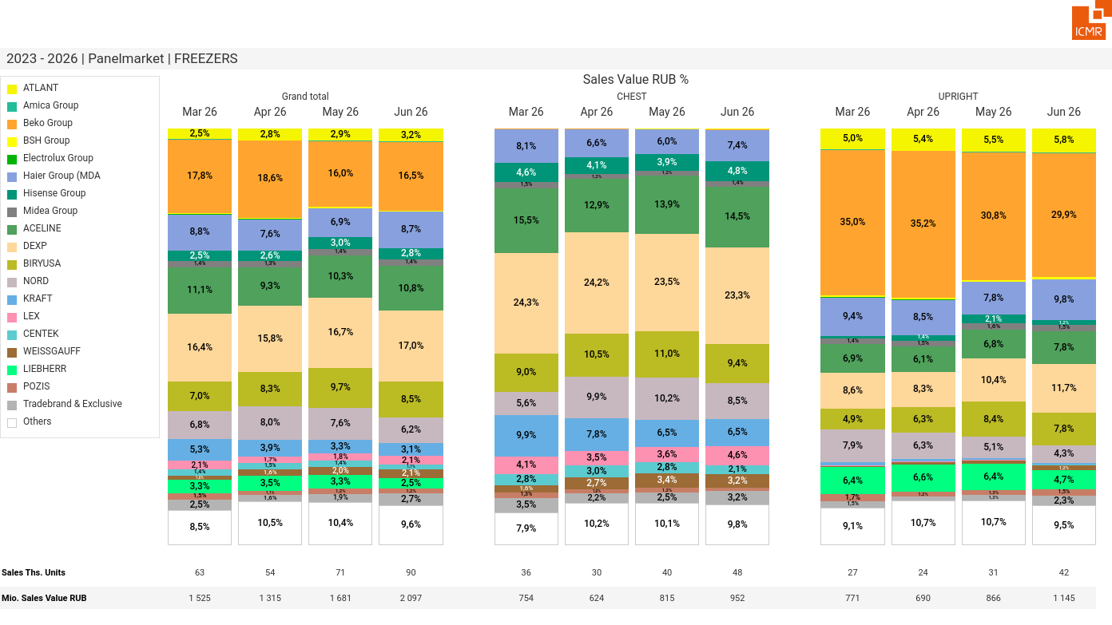
07/2026 PRJ 26fc7bc0 - TMPL 11b030d1 - FRM afeb7319 - ID 52

Slide 53

07/2026 PRJ 26fc7bc0 - TMPL 11b030d1 - FRM 5de912b3 - ID 53

Slide 54

07/2026 PRJ 26fc7bc0 - TMPL 11b030d1 - FRM 684d4845 - ID 54

Slide 55

07/2026 PRJ 26fc7bc0 - TMPL 11b030d1 - FRM eb0ba9e7 - ID 55

Slide 56

07/2026 PRJ 26fc7bc0 - TMPL 11b030d1 - FRM 8c4d1c93 - ID 56

Slide 57

07/2026 PRJ 26fc7bc0 - TMPL 11b030d1 - FRM c344f40f - ID 57

Slide 58

07/2026 PRJ 26fc7bc0 - TMPL 11b030d1 - FRM e580de20 - ID 58

Slide 59

07/2026 PRJ 26fc7bc0 - TMPL 11b030d1 - FRM c6686e97 - ID 59

Slide 60

07/2026 PRJ 26fc7bc0 - TMPL 11b030d1 - FRM a4fa1263 - ID 60

Slide 61

07/2026 PRJ 26fc7bc0 - TMPL 11b030d1 - FRM d331d022 - ID 61

Slide 62

07/2026 PRJ 26fc7bc0 - TMPL 11b030d1 - FRM db83c57f - ID 62

Slide 63

07/2026 PRJ 26fc7bc0 - TMPL 11b030d1 - FRM bd531cc7 - ID 63

Slide 64

07/2026 PRJ 26fc7bc0 - TMPL 11b030d1 - FRM 20f68699 - ID 64

Slide 65

07/2026 PRJ 26fc7bc0 - TMPL 11b030d1 - FRM d900f65f - ID 65

Slide 66

07/2026 PRJ 26fc7bc0 - TMPL 11b030d1 - FRM 2a91d50d - ID 66

Slide 67

07/2026 PRJ 26fc7bc0 - TMPL 11b030d1 - FRM a6c7f0d9 - ID 67

Slide 68

07/2026 PRJ 26fc7bc0 - TMPL 11b030d1 - FRM 6924a6c7 - ID 68

Slide 69

07/2026 PRJ 26fc7bc0 - TMPL 11b030d1 - FRM ca8e89a5 - ID 69

Slide 70

07/2026 PRJ 26fc7bc0 - TMPL 11b030d1 - FRM 79371c24 - ID 70

Slide 71

07/2026 PRJ 26fc7bc0 - TMPL 11b030d1 - FRM 46edca70 - ID 71

Slide 72

07/2026 PRJ 26fc7bc0 - TMPL 11b030d1 - FRM 7969ece0 - ID 72

Slide 73

07/2026 PRJ 26fc7bc0 - TMPL 11b030d1 - FRM b7af3747 - ID 73

Slide 74

07/2026 PRJ 26fc7bc0 - TMPL 11b030d1 - FRM 7ac4a58f - ID 74

Slide 75

07/2026 PRJ 26fc7bc0 - TMPL 11b030d1 - FRM 49046723 - ID 75

Slide 76

07/2026 PRJ 26fc7bc0 - TMPL 11b030d1 - FRM facc293c - ID 76

Slide 77

07/2026 PRJ 26fc7bc0 - TMPL 11b030d1 - FRM 24d4a8d5 - ID 77

Slide 78

07/2026 PRJ 26fc7bc0 - TMPL 11b030d1 - FRM 38a784d0 - ID 78

Slide 79

07/2026 PRJ 26fc7bc0 - TMPL 11b030d1 - FRM 59b22bbe - ID 79

Slide 80

07/2026 PRJ 26fc7bc0 - TMPL 11b030d1 - FRM 4017eb3e - ID 80

Slide 81

07/2026 PRJ 26fc7bc0 - TMPL 11b030d1 - FRM 767cfeae - ID 81

Slide 82

07/2026 PRJ 26fc7bc0 - TMPL 11b030d1 - FRM 0b9a9b39 - ID 82

Slide 83

07/2026 PRJ 26fc7bc0 - TMPL 11b030d1 - FRM a19c37b7 - ID 83

Slide 84

07/2026 PRJ 26fc7bc0 - TMPL 11b030d1 - FRM e34288dd - ID 84

Slide 85

07/2026 PRJ 26fc7bc0 - TMPL 11b030d1 - FRM b1c4d587 - ID 85

Slide 86

07/2026 PRJ 26fc7bc0 - TMPL 11b030d1 - FRM 3bb80f01 - ID 86

Slide 87

07/2026 PRJ 26fc7bc0 - TMPL 11b030d1 - FRM 49c84bef - ID 87

Slide 88

07/2026 PRJ 26fc7bc0 - TMPL 11b030d1 - FRM a9230c48 - ID 88

Slide 89

07/2026 PRJ 26fc7bc0 - TMPL 11b030d1 - FRM e4f52bc1 - ID 89

Slide 90

07/2026 PRJ 26fc7bc0 - TMPL 11b030d1 - FRM e6795eaa - ID 90

Slide 91

07/2026 PRJ 26fc7bc0 - TMPL 11b030d1 - FRM 9972f3a4 - ID 91

Slide 92

07/2026 PRJ 26fc7bc0 - TMPL 11b030d1 - FRM 06b53a85 - ID 92

Slide 93

07/2026 PRJ 26fc7bc0 - TMPL 11b030d1 - FRM 7117ae30 - ID 93

Slide 94

07/2026 PRJ 26fc7bc0 - TMPL 11b030d1 - FRM 8d5a459a - ID 94

Slide 95

07/2026 PRJ 26fc7bc0 - TMPL 11b030d1 - FRM 5d31d59a - ID 95

Slide 96

07/2026 PRJ 26fc7bc0 - TMPL 11b030d1 - FRM 2d1aa82e - ID 96

Slide 97

07/2026 PRJ 26fc7bc0 - TMPL 11b030d1 - FRM 6fb3566f - ID 97

Slide 98

07/2026 PRJ 26fc7bc0 - TMPL 11b030d1 - FRM ed80f3ba - ID 98

Slide 99

07/2026 PRJ 26fc7bc0 - TMPL 11b030d1 - FRM a307ad72 - ID 99

Slide 100

07/2026 PRJ 26fc7bc0 - TMPL 11b030d1 - FRM 28f7ae8a - ID 100

Slide 101

07/2026 PRJ 26fc7bc0 - TMPL 11b030d1 - FRM 43d06240 - ID 101

Slide 102

07/2026 PRJ 26fc7bc0 - TMPL 11b030d1 - FRM e5249e45 - ID 102

Slide 103

07/2026 PRJ 26fc7bc0 - TMPL 11b030d1 - FRM 9a1a720f - ID 103

Slide 104

07/2026 PRJ 26fc7bc0 - TMPL 11b030d1 - FRM 3c3cbe67 - ID 104

Slide 105

07/2026 PRJ 26fc7bc0 - TMPL 11b030d1 - FRM a273a71a - ID 105

Slide 106

07/2026 PRJ 26fc7bc0 - TMPL 11b030d1 - FRM 0b3827e1 - ID 106

Slide 107

07/2026 PRJ 26fc7bc0 - TMPL 11b030d1 - FRM d2786647 - ID 107

Slide 108

07/2026 PRJ 26fc7bc0 - TMPL 11b030d1 - FRM 5e156bfc - ID 108

Slide 109

07/2026 PRJ 26fc7bc0 - TMPL 11b030d1 - FRM 94c49efc - ID 109

Slide 110

07/2026 PRJ 26fc7bc0 - TMPL 11b030d1 - FRM 4d685dde - ID 110

Slide 111

07/2026 PRJ 26fc7bc0 - TMPL 11b030d1 - FRM 4a917e84 - ID 111

Slide 112

07/2026 PRJ 26fc7bc0 - TMPL 11b030d1 - FRM 8cac1306 - ID 112

Slide 113

07/2026 PRJ 26fc7bc0 - TMPL 11b030d1 - FRM dd7d5a0a - ID 113

Slide 114

07/2026 PRJ 26fc7bc0 - TMPL 11b030d1 - FRM 7df87af4 - ID 114

Slide 115

07/2026 PRJ 26fc7bc0 - TMPL 11b030d1 - FRM 3235a6f8 - ID 115

Slide 116

07/2026 PRJ 26fc7bc0 - TMPL 11b030d1 - FRM 9e191eb2 - ID 116

Slide 117

07/2026 PRJ 26fc7bc0 - TMPL 11b030d1 - FRM 5d4873cd - ID 117

Slide 118

07/2026 PRJ 26fc7bc0 - TMPL 11b030d1 - FRM 675680fa - ID 118

Slide 119

07/2026 PRJ 26fc7bc0 - TMPL 11b030d1 - FRM 2fc14a4d - ID 119

Slide 120

07/2026 PRJ 26fc7bc0 - TMPL 11b030d1 - FRM fb982150 - ID 120

Slide 121

07/2026 PRJ 26fc7bc0 - TMPL 11b030d1 - FRM 3eae0720 - ID 121

Slide 122

07/2026 PRJ 26fc7bc0 - TMPL 11b030d1 - FRM c94132a1 - ID 122

Slide 123

07/2026 PRJ 26fc7bc0 - TMPL 11b030d1 - FRM 5087f095 - ID 123

Slide 124

07/2026 PRJ 26fc7bc0 - TMPL 11b030d1 - FRM 61b5acc6 - ID 124

Slide 125

07/2026 PRJ 26fc7bc0 - TMPL 11b030d1 - FRM 657d0d52 - ID 125

Slide 126

07/2026 PRJ 26fc7bc0 - TMPL 11b030d1 - FRM 63b7a716 - ID 126

Slide 127

07/2026 PRJ 26fc7bc0 - TMPL 11b030d1 - FRM 3bf4b819 - ID 127

Slide 128

07/2026 PRJ 26fc7bc0 - TMPL 11b030d1 - FRM 301666cd - ID 128

Slide 129

07/2026 PRJ 26fc7bc0 - TMPL 11b030d1 - FRM 348125b1 - ID 129

Slide 130

07/2026 PRJ 26fc7bc0 - TMPL 11b030d1 - FRM dc08509f - ID 130

Slide 131

07/2026 PRJ 26fc7bc0 - TMPL 11b030d1 - FRM eb139410 - ID 131

Slide 132

07/2026 PRJ 26fc7bc0 - TMPL 11b030d1 - FRM 41c9fb07 - ID 132

Slide 133

07/2026 PRJ 26fc7bc0 - TMPL 11b030d1 - FRM 1fa432cd - ID 133

Slide 134

07/2026 PRJ 26fc7bc0 - TMPL 11b030d1 - FRM be2c5536 - ID 134

Slide 135

07/2026 PRJ 26fc7bc0 - TMPL 11b030d1 - FRM 41474301 - ID 135

Slide 136

07/2026 PRJ 26fc7bc0 - TMPL 11b030d1 - FRM eb4f94a0 - ID 136

Slide 137

07/2026 PRJ 26fc7bc0 - TMPL 11b030d1 - FRM 1fdbe154 - ID 137

Slide 138

07/2026 PRJ 26fc7bc0 - TMPL 11b030d1 - FRM 20f86666 - ID 138

Slide 139

07/2026 PRJ 26fc7bc0 - TMPL 11b030d1 - FRM 148219af - ID 139

Slide 140

07/2026 PRJ 26fc7bc0 - TMPL 11b030d1 - FRM 229e6d35 - ID 140

Slide 141

07/2026 PRJ 26fc7bc0 - TMPL 11b030d1 - FRM 2e0b6742 - ID 141

Slide 142

07/2026 PRJ 26fc7bc0 - TMPL 11b030d1 - FRM 608d4711 - ID 142

Slide 143

07/2026 PRJ 26fc7bc0 - TMPL 11b030d1 - FRM a54603bf - ID 143

Slide 144

07/2026 PRJ 26fc7bc0 - TMPL 11b030d1 - FRM fcea12b0 - ID 144

Slide 145

07/2026 PRJ 26fc7bc0 - TMPL 11b030d1 - FRM 251abdd6 - ID 145

Slide 146

07/2026 PRJ 26fc7bc0 - TMPL 11b030d1 - FRM 8e511cbf - ID 146

Slide 147

07/2026 PRJ 26fc7bc0 - TMPL 11b030d1 - FRM d86cf355 - ID 147

Slide 148

07/2026 PRJ 26fc7bc0 - TMPL 11b030d1 - FRM 96bc5d8f - ID 148

Slide 149

07/2026 PRJ 26fc7bc0 - TMPL 11b030d1 - FRM 67058a32 - ID 149

Slide 150

07/2026 PRJ 26fc7bc0 - TMPL 11b030d1 - FRM d655ba1e - ID 150

Slide 151

07/2026 PRJ 26fc7bc0 - TMPL 11b030d1 - FRM d272ddf8 - ID 151

Slide 152

07/2026 PRJ 26fc7bc0 - TMPL 11b030d1 - FRM 5c7c6761 - ID 152

Slide 153

07/2026 PRJ 26fc7bc0 - TMPL 11b030d1 - FRM 903ee2ad - ID 153

Slide 154

07/2026 PRJ 26fc7bc0 - TMPL 11b030d1 - FRM c2ebc552 - ID 154

Slide 155

07/2026 PRJ 26fc7bc0 - TMPL 11b030d1 - FRM 5e7452fc - ID 155

Slide 156

07/2026 PRJ 26fc7bc0 - TMPL 11b030d1 - FRM d1410d29 - ID 156

Slide 157

07/2026 PRJ 26fc7bc0 - TMPL 11b030d1 - FRM 366f03be - ID 157

Slide 158

07/2026 PRJ 26fc7bc0 - TMPL 11b030d1 - FRM 87c8a7e5 - ID 158

Slide 159

07/2026 PRJ 26fc7bc0 - TMPL 11b030d1 - FRM 2dc489ba - ID 159

Slide 160

07/2026 PRJ 26fc7bc0 - TMPL 11b030d1 - FRM 812aae1f - ID 160

Slide 161

07/2026 PRJ 26fc7bc0 - TMPL 11b030d1 - FRM 7d462f33 - ID 161

Slide 162

07/2026 PRJ 26fc7bc0 - TMPL 11b030d1 - FRM eff12ce3 - ID 162

Slide 163

07/2026 PRJ 26fc7bc0 - TMPL 11b030d1 - FRM b8187a9a - ID 163

Slide 164

07/2026 PRJ 26fc7bc0 - TMPL 11b030d1 - FRM 2796a3ae - ID 164

Slide 165

07/2026 PRJ 26fc7bc0 - TMPL 11b030d1 - FRM 5e485a2d - ID 165

Slide 166

07/2026 PRJ 26fc7bc0 - TMPL 11b030d1 - FRM c07efc78 - ID 166

Slide 167

07/2026 PRJ 26fc7bc0 - TMPL 11b030d1 - FRM 057fa7c0 - ID 167

Slide 168

07/2026 PRJ 26fc7bc0 - TMPL 11b030d1 - FRM 136497d6 - ID 168

Slide 169

07/2026 PRJ 26fc7bc0 - TMPL 11b030d1 - FRM 9d51d849 - ID 169

Slide 170

07/2026 PRJ 26fc7bc0 - TMPL 11b030d1 - FRM 0eb39558 - ID 170

Slide 171

07/2026 PRJ 26fc7bc0 - TMPL 11b030d1 - FRM 1696c9d9 - ID 171

Slide 172

07/2026 PRJ 26fc7bc0 - TMPL 11b030d1 - FRM f5641fc0 - ID 172

Slide 173

07/2026 PRJ 26fc7bc0 - TMPL 11b030d1 - FRM 63b8e795 - ID 173

Slide 174

07/2026 PRJ 26fc7bc0 - TMPL 11b030d1 - FRM e36fe762 - ID 174

Slide 175

07/2026 PRJ 26fc7bc0 - TMPL 11b030d1 - FRM 3e6832e8 - ID 175

Slide 176

07/2026 PRJ 26fc7bc0 - TMPL 11b030d1 - FRM f7f9711f - ID 176

Slide 177

07/2026 PRJ 26fc7bc0 - TMPL 11b030d1 - FRM 4731a106 - ID 177

Slide 178

07/2026 PRJ 26fc7bc0 - TMPL 11b030d1 - FRM a3713c0e - ID 178

Slide 179

07/2026 PRJ 26fc7bc0 - TMPL 11b030d1 - FRM f4a2f4cc - ID 179

Slide 180

07/2026 PRJ 26fc7bc0 - TMPL 11b030d1 - FRM c614e29a - ID 180

Slide 181

07/2026 PRJ 26fc7bc0 - TMPL 11b030d1 - FRM fa54687a - ID 181

Slide 182

07/2026 PRJ 26fc7bc0 - TMPL 11b030d1 - FRM bd4006d4 - ID 182

Slide 183

07/2026 PRJ 26fc7bc0 - TMPL 11b030d1 - FRM dc2b2f22 - ID 183

Slide 184

07/2026 PRJ 26fc7bc0 - TMPL 11b030d1 - FRM fbde2adb - ID 184

Slide 185

07/2026 PRJ 26fc7bc0 - TMPL 11b030d1 - FRM d1501563 - ID 185

Slide 186

07/2026 PRJ 26fc7bc0 - TMPL 11b030d1 - FRM 413e5a3a - ID 186

Slide 187

07/2026 PRJ 26fc7bc0 - TMPL 11b030d1 - FRM e3cf845c - ID 187

Slide 188

07/2026 PRJ 26fc7bc0 - TMPL 11b030d1 - FRM 76dd374a - ID 188

Slide 189

07/2026 PRJ 26fc7bc0 - TMPL 11b030d1 - FRM 69dc0568 - ID 189

Slide 190

07/2026 PRJ 26fc7bc0 - TMPL 11b030d1 - FRM 322dc769 - ID 190

Slide 191

07/2026 PRJ 26fc7bc0 - TMPL 11b030d1 - FRM 23c30a34 - ID 191

Slide 192

07/2026 PRJ 26fc7bc0 - TMPL 11b030d1 - FRM 438d04fb - ID 192

Slide 193

07/2026 PRJ 26fc7bc0 - TMPL 11b030d1 - FRM aeddb1af - ID 193

Slide 194

07/2026 PRJ 26fc7bc0 - TMPL 11b030d1 - FRM e7c54533 - ID 194

Slide 195

07/2026 PRJ 26fc7bc0 - TMPL 11b030d1 - FRM 8be7e996 - ID 195

Slide 196

07/2026 PRJ 26fc7bc0 - TMPL 11b030d1 - FRM accc7e83 - ID 196

Slide 197

07/2026 PRJ 26fc7bc0 - TMPL 11b030d1 - FRM 9b4017f5 - ID 197

Slide 198

07/2026 PRJ 26fc7bc0 - TMPL 11b030d1 - FRM 296b6237 - ID 198

Slide 199

07/2026 PRJ 26fc7bc0 - TMPL 11b030d1 - FRM 80273bef - ID 199

Slide 200

07/2026 PRJ 26fc7bc0 - TMPL 11b030d1 - FRM 20c8453c - ID 200

Slide 201

07/2026 PRJ 26fc7bc0 - TMPL 11b030d1 - FRM e20fff09 - ID 201

Slide 202

07/2026 PRJ 26fc7bc0 - TMPL 11b030d1 - FRM ad17801c - ID 202

Slide 203

07/2026 PRJ 26fc7bc0 - TMPL 11b030d1 - FRM d155da02 - ID 203

Slide 204

07/2026 PRJ 26fc7bc0 - TMPL 11b030d1 - FRM 90d9b422 - ID 204

Slide 205

07/2026 PRJ 26fc7bc0 - TMPL 11b030d1 - FRM a63529e0 - ID 205

Slide 206
07/2026 PRJ 26fc7bc0 - TMPL 11b030d1 - FRM 8a27bd67 - ID 206

Slide 207
07/2026 PRJ 26fc7bc0 - TMPL 11b030d1 - FRM 8df94f23 - ID 207

Slide 208
07/2026 PRJ 26fc7bc0 - TMPL 11b030d1 - FRM 1bd92974 - ID 208

Slide 209
07/2026 PRJ 26fc7bc0 - TMPL 11b030d1 - FRM f34932b7 - ID 209

Slide 210
07/2026 PRJ 26fc7bc0 - TMPL 11b030d1 - FRM 01099436 - ID 210

Slide 211
07/2026 PRJ 26fc7bc0 - TMPL 11b030d1 - FRM fd72074f - ID 211

Slide 212
07/2026 PRJ 26fc7bc0 - TMPL 11b030d1 - FRM 7a99d08f - ID 212

Slide 213
07/2026 PRJ 26fc7bc0 - TMPL 11b030d1 - FRM 67a93120 - ID 213

Slide 214
07/2026 PRJ 26fc7bc0 - TMPL 11b030d1 - FRM 9fde7de8 - ID 214

Slide 215
07/2026 PRJ 26fc7bc0 - TMPL 11b030d1 - FRM b8363719 - ID 215

Slide 216
07/2026 PRJ 26fc7bc0 - TMPL 11b030d1 - FRM 334dab56 - ID 216

Slide 217
07/2026 PRJ 26fc7bc0 - TMPL 11b030d1 - FRM 717d17a7 - ID 217

Slide 218
07/2026 PRJ 26fc7bc0 - TMPL 11b030d1 - FRM 3084b4ff - ID 218

Slide 219
07/2026 PRJ 26fc7bc0 - TMPL 11b030d1 - FRM e3a0b0eb - ID 219

Slide 220
07/2026 PRJ 26fc7bc0 - TMPL 11b030d1 - FRM 5300ea71 - ID 220

Slide 221
07/2026 PRJ 26fc7bc0 - TMPL 11b030d1 - FRM 7b145280 - ID 221

Slide 222
07/2026 PRJ 26fc7bc0 - TMPL 11b030d1 - FRM 554311e3 - ID 222

Slide 223
07/2026 PRJ 26fc7bc0 - TMPL 11b030d1 - FRM 337f5e56 - ID 223

Slide 224
07/2026 PRJ 26fc7bc0 - TMPL 11b030d1 - FRM ce21b5ab - ID 224

Slide 225
07/2026 PRJ 26fc7bc0 - TMPL 11b030d1 - FRM 471d92f4 - ID 225

Slide 226
07/2026 PRJ 26fc7bc0 - TMPL 11b030d1 - FRM 8269cd2b - ID 226

Slide 227
07/2026 PRJ 26fc7bc0 - TMPL 11b030d1 - FRM c5da2f6a - ID 227

Slide 228
07/2026 PRJ 26fc7bc0 - TMPL 11b030d1 - FRM 5f138f95 - ID 228

Slide 229
07/2026 PRJ 26fc7bc0 - TMPL 11b030d1 - FRM e3a83739 - ID 229

Slide 230
07/2026 PRJ 26fc7bc0 - TMPL 11b030d1 - FRM 8c57ea2d - ID 230

Slide 231
07/2026 PRJ 26fc7bc0 - TMPL 11b030d1 - FRM f2635fc4 - ID 231

Slide 232
07/2026 PRJ 26fc7bc0 - TMPL 11b030d1 - FRM ba54d9f6 - ID 232

Slide 233
07/2026 PRJ 26fc7bc0 - TMPL 11b030d1 - FRM 5b9c1493 - ID 233

Slide 234
07/2026 PRJ 26fc7bc0 - TMPL 11b030d1 - FRM 5a3c592a - ID 234

Slide 235
07/2026 PRJ 26fc7bc0 - TMPL 11b030d1 - FRM b636e047 - ID 235

Slide 236
07/2026 PRJ 26fc7bc0 - TMPL 11b030d1 - FRM d7d3bc42 - ID 236

Slide 237
07/2026 PRJ 26fc7bc0 - TMPL 11b030d1 - FRM a0265dd0 - ID 237

Slide 238
07/2026 PRJ 26fc7bc0 - TMPL 11b030d1 - FRM b598c02a - ID 238

Slide 239
07/2026 PRJ 26fc7bc0 - TMPL 11b030d1 - FRM cdbf32dd - ID 239

Slide 240
07/2026 PRJ 26fc7bc0 - TMPL 11b030d1 - FRM 81efd2ed - ID 240

Slide 241
07/2026 PRJ 26fc7bc0 - TMPL 11b030d1 - FRM 52905565 - ID 241

Slide 242
07/2026 PRJ 26fc7bc0 - TMPL 11b030d1 - FRM 05472106 - ID 242

Slide 243
07/2026 PRJ 26fc7bc0 - TMPL 11b030d1 - FRM 1ca30d7d - ID 243

Slide 244
07/2026 PRJ 26fc7bc0 - TMPL 11b030d1 - FRM 3a8143f2 - ID 244

Slide 245
07/2026 PRJ 26fc7bc0 - TMPL 11b030d1 - FRM b2a450a1 - ID 245

Slide 246
07/2026 PRJ 26fc7bc0 - TMPL 11b030d1 - FRM ad00b2c6 - ID 246

Slide 247
07/2026 PRJ 26fc7bc0 - TMPL 11b030d1 - FRM 44498592 - ID 247

Slide 248
07/2026 PRJ 26fc7bc0 - TMPL 11b030d1 - FRM e6d22a4b - ID 248

Slide 249
07/2026 PRJ 26fc7bc0 - TMPL 11b030d1 - FRM 63096f0c - ID 249

Slide 250
07/2026 PRJ 26fc7bc0 - TMPL 11b030d1 - FRM d074328f - ID 250

Slide 251
07/2026 PRJ 26fc7bc0 - TMPL 11b030d1 - FRM f25b7b86 - ID 251

Slide 252
07/2026 PRJ 26fc7bc0 - TMPL 11b030d1 - FRM 41aecb08 - ID 252

Slide 253
07/2026 PRJ 26fc7bc0 - TMPL 11b030d1 - FRM 5f6a5db8 - ID 253

Slide 254
07/2026 PRJ 26fc7bc0 - TMPL 11b030d1 - FRM 80ef1a15 - ID 254

Slide 255
07/2026 PRJ 26fc7bc0 - TMPL 11b030d1 - FRM 72d872d2 - ID 255

Slide 256
07/2026 PRJ 26fc7bc0 - TMPL 11b030d1 - FRM a79b6686 - ID 256

Slide 257
07/2026 PRJ 26fc7bc0 - TMPL 11b030d1 - FRM 1b5b5ba3 - ID 257

Slide 258
07/2026 PRJ 26fc7bc0 - TMPL 11b030d1 - FRM abbb0de7 - ID 258

Slide 259
07/2026 PRJ 26fc7bc0 - TMPL 11b030d1 - FRM 6ab97749 - ID 259

Slide 260
07/2026 PRJ 26fc7bc0 - TMPL 11b030d1 - FRM f479a99b - ID 260

Slide 261
07/2026 PRJ 26fc7bc0 - TMPL 11b030d1 - FRM 24943440 - ID 261

Slide 262
07/2026 PRJ 26fc7bc0 - TMPL 11b030d1 - FRM 2f966b78 - ID 262

Slide 263
07/2026 PRJ 26fc7bc0 - TMPL 11b030d1 - FRM c2984531 - ID 263

Slide 264
07/2026 PRJ 26fc7bc0 - TMPL 11b030d1 - FRM c9bee425 - ID 264

Slide 265
07/2026 PRJ 26fc7bc0 - TMPL 11b030d1 - FRM 1410ee7b - ID 265

Slide 266
07/2026 PRJ 26fc7bc0 - TMPL 11b030d1 - FRM 478012d9 - ID 266

Slide 267
07/2026 PRJ 26fc7bc0 - TMPL 11b030d1 - FRM 61967e1d - ID 267

Slide 268
07/2026 PRJ 26fc7bc0 - TMPL 11b030d1 - FRM 01a619ad - ID 268

Slide 269
07/2026 PRJ 26fc7bc0 - TMPL 11b030d1 - FRM 483b21ea - ID 269

Slide 270
07/2026 PRJ 26fc7bc0 - TMPL 11b030d1 - FRM 62a7435e - ID 270

Slide 271
07/2026 PRJ 26fc7bc0 - TMPL 11b030d1 - FRM 9fbb8b5e - ID 271

Slide 272
07/2026 PRJ 26fc7bc0 - TMPL 11b030d1 - FRM ed466e6b - ID 272

Slide 273
07/2026 PRJ 26fc7bc0 - TMPL 11b030d1 - FRM c74ea1a7 - ID 273

Slide 274
07/2026 PRJ 26fc7bc0 - TMPL 11b030d1 - FRM 0a2a2bb8 - ID 274

Slide 275
07/2026 PRJ 26fc7bc0 - TMPL 11b030d1 - FRM a42cec9d - ID 275

Slide 276
07/2026 PRJ 26fc7bc0 - TMPL 11b030d1 - FRM 44af3796 - ID 276

Slide 277
07/2026 PRJ 26fc7bc0 - TMPL 11b030d1 - FRM f9adcfda - ID 277

Slide 278
07/2026 PRJ 26fc7bc0 - TMPL 11b030d1 - FRM e5834c30 - ID 278

Slide 279
07/2026 PRJ 26fc7bc0 - TMPL 11b030d1 - FRM beb4a008 - ID 279

Slide 280
07/2026 PRJ 26fc7bc0 - TMPL 11b030d1 - FRM 8631fd10 - ID 280

Slide 281
07/2026 PRJ 26fc7bc0 - TMPL 11b030d1 - FRM 82ce01d9 - ID 281

Slide 282
07/2026 PRJ 26fc7bc0 - TMPL 11b030d1 - FRM d3d2dc18 - ID 282

Slide 283
07/2026 PRJ 26fc7bc0 - TMPL 11b030d1 - FRM 489a8394 - ID 283

Slide 284
07/2026 PRJ 26fc7bc0 - TMPL 11b030d1 - FRM e24ce6a7 - ID 284

Slide 285
07/2026 PRJ 26fc7bc0 - TMPL 11b030d1 - FRM 04cf64ec - ID 285

Slide 286
07/2026 PRJ 26fc7bc0 - TMPL 11b030d1 - FRM 589368d7 - ID 286

Slide 287
07/2026 PRJ 26fc7bc0 - TMPL 11b030d1 - FRM 29821073 - ID 287

Slide 288
07/2026 PRJ 26fc7bc0 - TMPL 11b030d1 - FRM acbc95cc - ID 288

Slide 289
07/2026 PRJ 26fc7bc0 - TMPL 11b030d1 - FRM abfa07a6 - ID 289

Slide 290
07/2026 PRJ 26fc7bc0 - TMPL 11b030d1 - FRM 8dee9d0d - ID 290

Slide 291
07/2026 PRJ 26fc7bc0 - TMPL 11b030d1 - FRM 35751e9f - ID 291

Slide 292
07/2026 PRJ 26fc7bc0 - TMPL 11b030d1 - FRM b55cd947 - ID 292

Slide 293
07/2026 PRJ 26fc7bc0 - TMPL 11b030d1 - FRM 41c8c31d - ID 293

Slide 294
07/2026 PRJ 26fc7bc0 - TMPL 11b030d1 - FRM 52ae2c38 - ID 294

Slide 295
07/2026 PRJ 26fc7bc0 - TMPL 11b030d1 - FRM 57979e24 - ID 295

Slide 296
07/2026 PRJ 26fc7bc0 - TMPL 11b030d1 - FRM ef8ed32c - ID 296

Slide 297
07/2026 PRJ 26fc7bc0 - TMPL 11b030d1 - FRM 96d3610e - ID 297

Slide 298
07/2026 PRJ 26fc7bc0 - TMPL 11b030d1 - FRM dda83105 - ID 298

Slide 299
07/2026 PRJ 26fc7bc0 - TMPL 11b030d1 - FRM eeec5798 - ID 299

Slide 300
07/2026 PRJ 26fc7bc0 - TMPL 11b030d1 - FRM 87a82c2f - ID 300

Slide 301
07/2026 PRJ 26fc7bc0 - TMPL 11b030d1 - FRM 8b110a1b - ID 301

Slide 302
07/2026 PRJ 26fc7bc0 - TMPL 11b030d1 - FRM 78a50a7c - ID 302

Slide 303
07/2026 PRJ 26fc7bc0 - TMPL 11b030d1 - FRM 4eee1d84 - ID 303

Slide 304
07/2026 PRJ 26fc7bc0 - TMPL 11b030d1 - FRM 65c02f4c - ID 304

Slide 305
07/2026 PRJ 26fc7bc0 - TMPL 11b030d1 - FRM 7d4b0c0f - ID 305

Slide 306
07/2026 PRJ 26fc7bc0 - TMPL 11b030d1 - FRM b6866337 - ID 306

Slide 307
07/2026 PRJ 26fc7bc0 - TMPL 11b030d1 - FRM f1d82d3e - ID 307

Slide 308
07/2026 PRJ 26fc7bc0 - TMPL 11b030d1 - FRM 64ed5626 - ID 308

Slide 309
07/2026 PRJ 26fc7bc0 - TMPL 11b030d1 - FRM ccb75721 - ID 309

Slide 310
07/2026 PRJ 26fc7bc0 - TMPL 11b030d1 - FRM 11e4eff9 - ID 310

Slide 311
07/2026 PRJ 26fc7bc0 - TMPL 11b030d1 - FRM fe113540 - ID 311

Slide 312
07/2026 PRJ 26fc7bc0 - TMPL 11b030d1 - FRM dbd6de0c - ID 312

Slide 313
07/2026 PRJ 26fc7bc0 - TMPL 11b030d1 - FRM 8105355c - ID 313

Slide 314
07/2026 PRJ 26fc7bc0 - TMPL 11b030d1 - FRM 7ee5ad8e - ID 314

Slide 315
07/2026 PRJ 26fc7bc0 - TMPL 11b030d1 - FRM 4e94dcf7 - ID 315

Slide 316
07/2026 PRJ 26fc7bc0 - TMPL 11b030d1 - FRM 3a5d4510 - ID 316

Slide 317
07/2026 PRJ 26fc7bc0 - TMPL 11b030d1 - FRM 4e536b75 - ID 317

Slide 318
07/2026 PRJ 26fc7bc0 - TMPL 11b030d1 - FRM 82c3e370 - ID 318

Slide 319
07/2026 PRJ 26fc7bc0 - TMPL 11b030d1 - FRM 0ce44aa5 - ID 319

Slide 320
07/2026 PRJ 26fc7bc0 - TMPL 11b030d1 - FRM e818f83d - ID 320

